Slide 1
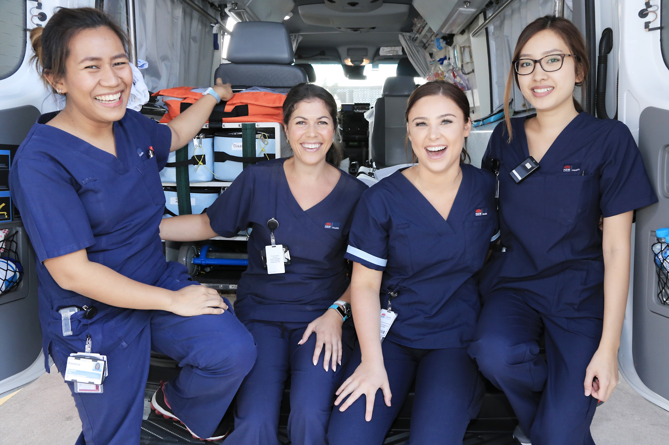
SAFETY CULTURE SURVEY
SAFETY CULTURE SURVEY
Rd
What is culture anyway?
Culture is the way we think — our values, our attitudes, our perceptions and our beliefs. It’s also how we act — our habits and our typical behaviours – it’s ‘how we do things around here’.
Why do we have to do a culture survey?
We want to know what you think about how we manage safety in our ward. Better culture means better outcomes for our patients and fewer adverse events. Ultimately, a healthier culture benefits both patients and staff.
What will be done with
the results?
Once the survey has been closed, we will review the results and feedback to the team through a facilitated group discussion, highlighting some areas to look at in more detail.
Commencing xxxx
Prizes for participation
Our goal is 70% survey completion
De-identified results
Facilitated survey debrief sessions
LHD logo
Survey Lead contact details

Slide 2
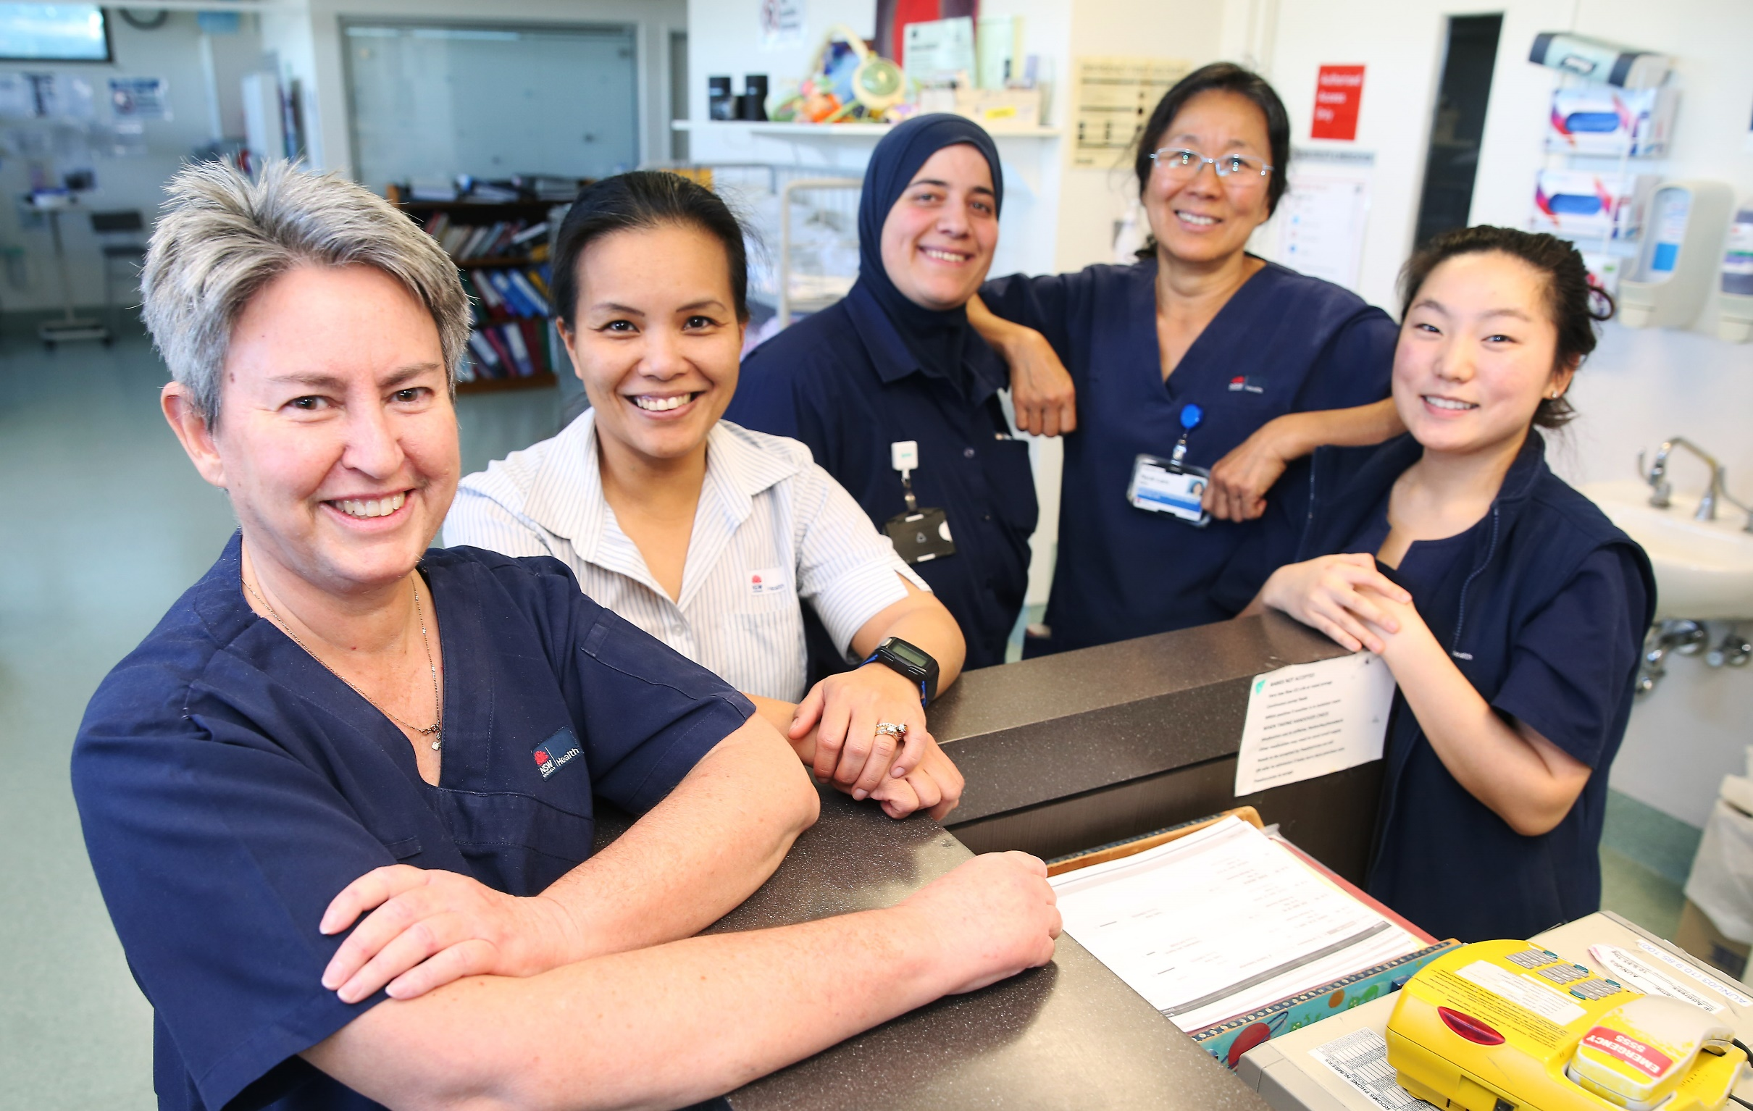
Rd
SAFETY CULTURE SURVEY
SAFETY CULTURE SURVEY
Rd
Why do we have to do a culture survey?
We want to know what you think about how we manage safety in our ward. Better culture means better outcomes for our patients and fewer adverse events. Ultimately, a healthier culture benefits both patients and staff.
Your voice matters
Commencing xxxxx
Prizes for participation
Our goal is 70% survey completion
De-identified results
Facilitated survey debrief sessions
LHD logo
Survey Lead contact details

Slide 3
SAFETY CULTURE SURVEY
Rd
We want to hear from you to better understand how we work and function as a team and how we think about safety.
Your voice matters.
What is culture anyway?
Culture is the way we think — our values, our attitudes, our perceptions and our beliefs. It’s also how we act — our habits and our typical behaviours – it’s ‘how we do things around here’.
What will be done with the results?
Once the survey has been closed, the next step is to review the results and feedback to the team.
We will then highlight some areas to look at in more detail through a facilitated group discussion.
Commencing xxxx
Prizes for participation
Our goal is 70% survey completion
De-identified results
Facilitated survey debrief session
LHD logo
Survey Lead contact details

