Slide 1
The 5x5 Antimicrobial Audit
Challenging Cases:
A tutorial for 5x5 Auditors
START

Slide 2
Introduction
To complete the Challenging Cases Tutorial you should have access to the following documents from the 5x5 Antimicrobial Audit package:
Audit User Guide, including the appendices
Frequently Asked Questions
Community Acquired Pneumonia Cheat Sheet
It is STONGLY RECOMMENDED that you become familiar with these documents prior to completing the tutorial.
You will also require:
A pen
Copies of the Data Collection Form, available in Appendix A of the Audit User Guide
Access to Therapeutic Guidelines: Antibiotic (NOTE: If need to access the eTGs, press ALT + TAB to toggle between windows without losing your slide position)
The Challenging Cases Tutorial has been included in the 5x5 Antimicrobial Audit Package as a supplement resource for auditor education and engagement.
It is important to understand that this training module does not represent a complete induction to the 5x5 Antimicrobial Audit, but simply allows auditors to navigate the processes and challenges of data collection using mocked-up clinical scenarios that are representative of real patients.
While progressing through this interactive PowerPoint presentation, auditors will be required to undertake data collection on 6 sample patients.
In each case, the auditor will be able to review limited but relevant information in the chart, notes and electronic medical record. They will also be able to make a decision to contact the doctor or declare the patient ineligible for the audit.
I have everything I need
I have read through the above documents

Slide 3
Some things to remember…
Therapeutic Guidelines: Antibiotic vs. Locally endorsed guidelines
For the purpose of this training module, please only refer to the latest version of the Therapeutic Guidelines: Antibiotic. (In a real audit situation, you should refer to locally endorsed guidelines from your facility, or if they are not available, use Therapeutic Guidelines: Antibiotic.)
You are auditing the choice of antimicrobial agent only
This audit does not require you to look at the dose, route, frequency etc. You are only considering which antimicrobial agent(s) has been prescribed.

Slide 4
Some things to remember…
Guideline Concordance vs. Appropriateness
Occasionally you may find a patient receiving therapy that is not concordant with guidelines, but you believe the therapy is still appropriate. In these scenarios, you need to list the therapy as non-concordant (audit question 3), and check whether the reason for this non-concordance has been documented (audit question 4).
Please do not be tempted to record what you perceive as ‘appropriate’ therapy as concordant when it doesn’t match the guidelines.
Keep in mind that concordance with guidelines AND non-concordance with a documented reason are BOTH considered positive outcomes for this audit.

Slide 5
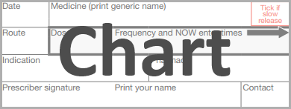
Case Study 1
You have randomly selected a patient on your general medical ward. Your bed list tells you it is an 82yo male admitted this morning.
Please click the icons below to review relevant information in the chart, notes and electronic medical record.
Based on the information available, is this patient eligible for inclusion in the audit?
Are you sure?
This patient appears to fulfil the audit’s eligibility criteria, based on the information available. You should continue with the audit on the next slide.
Correct! This patient appears to be eligible for the audit.
OK
YES
NO
OK
Please Note: The User Guide contains an Eligibility Flowchart (Appendix C) that you may find helpful.

Slide 6
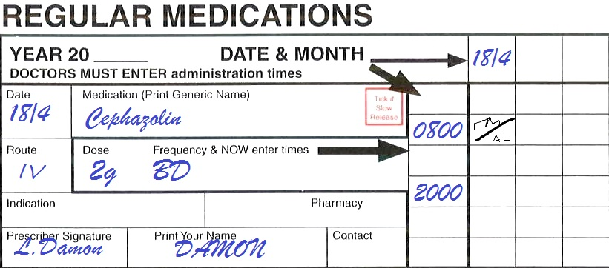
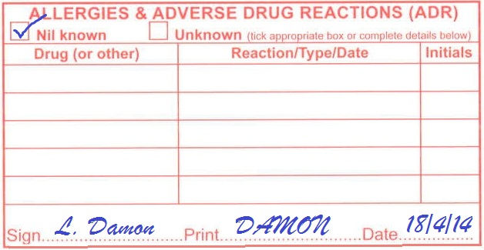
DONE

Slide 7
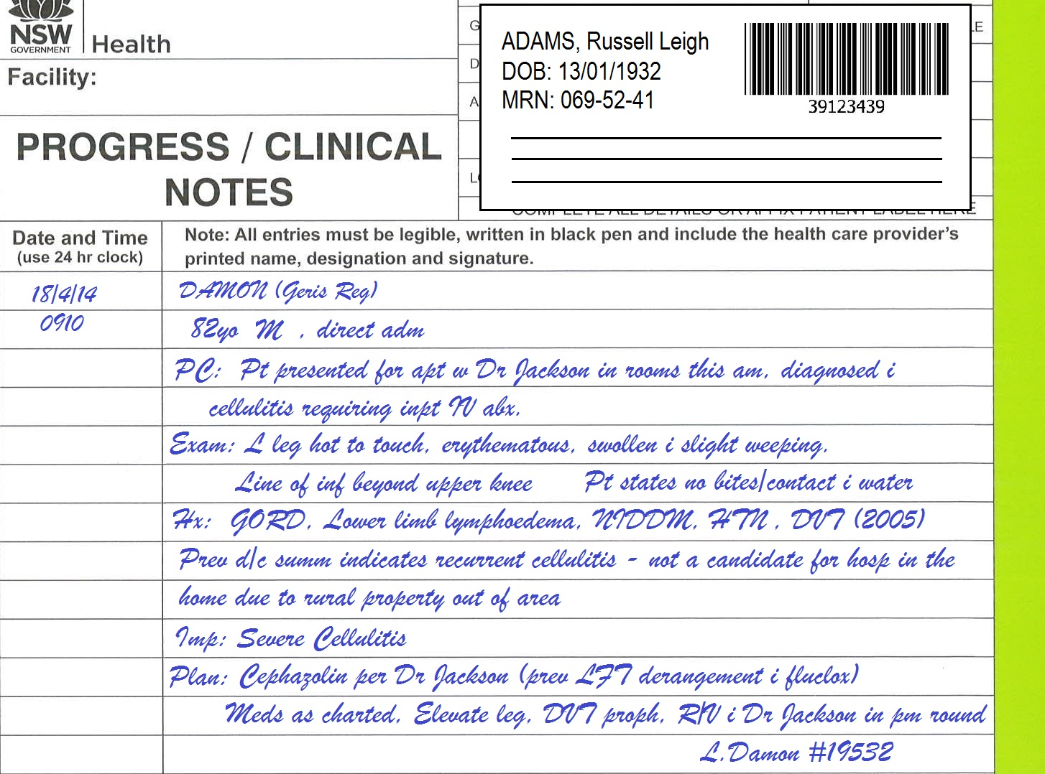
DONE

Slide 8
DONE

Slide 9
Case Study 1
Use the Data Collection Form to record your answers to the 5 audit questions.
The icons are still available for you to review information from the chart, notes and electronic medical record.
If you need to contact the doctor for either question 2 or question 5, please click the ‘Contact Doctor’ icon.
If at any time you believe the patient is not eligible for the audit, click the ‘Patient Not Eligible’ icon.
Click NEXT when you are ready to go through the answers.
Contact doctor to clarify indication
Are you sure?
This patient appears to fulfil the audit’s eligibility criteria, based on the information available.
Is has been made quite clear in the notes that this patient has ‘severe cellulitis’.
You should not need to contact the doctor in this case.
You should not need to contact the doctor to recommend guideline concordant therapy in this case.
Perhaps you should review your answers to questions 3 & 4?
OR
Contact doctor to recommend guideline concordant therapy
OK
OK
DONE

Slide 10
DONE

Slide 11
DONE

Slide 12
DONE

Slide 13
Case Study 1 - Answers
Q1. Yes
Q2. N/A
Q3. No
Q4. Yes
Q5. N/A
The entry in the progress notes states that the patient has previously had LFT derangement with flucloxacillin.
Remember, this question asks whether or not a reason has been provided. It is unrelated to whether or not you believe the reason is ‘good enough’ to divert from guidelines, (however feel free to record this sort of information in the comments section).
For severe cellulitis in a patient without a penicillin allergy, the Therapeutic Guidelines: Antibiotic recommend flucloxacillin. This patient is receiving cephazolin, therefore the therapy is considered non-concordant.
Note that the patient’s previous LFT derangement with flucloxacillin is an adverse drug reaction, but does not constitute an allergy or hypersensitivity as defined by the guidelines.
The indication severe cellulitis has been clearly documented in the progress notes.
OK
OK
OK

Slide 14
Case Study 2
You have randomly selected a bed in your general medical ward. The bed list tells you the patient is a 68yo F, and displays their reason for admission as “chest inf”.
Please click the icons below to review relevant information in the chart, notes and electronic medical record.
Based on the information available, is this patient eligible for inclusion in the audit?
Are you sure?
This patient appears to fulfil the audit’s eligibility criteria, based on the information available. You should continue with the audit on the next slide.
Correct! This patient appears to be eligible for the audit.
OK
YES
NO
OK
Please Note: The User Guide contains an Eligibility Flowchart (Appendix C) that you may find helpful.

Slide 15
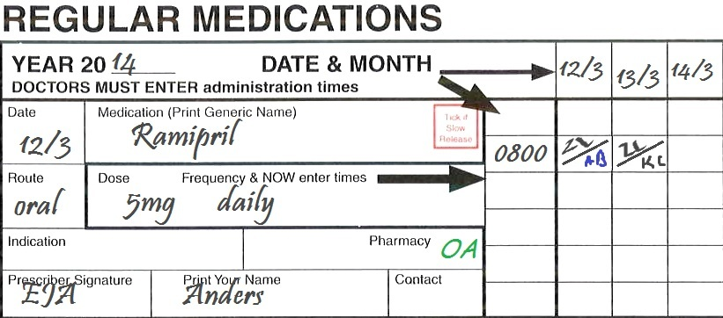
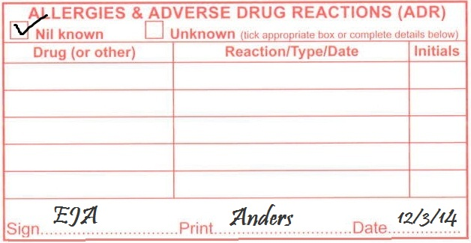
DONE

Slide 16
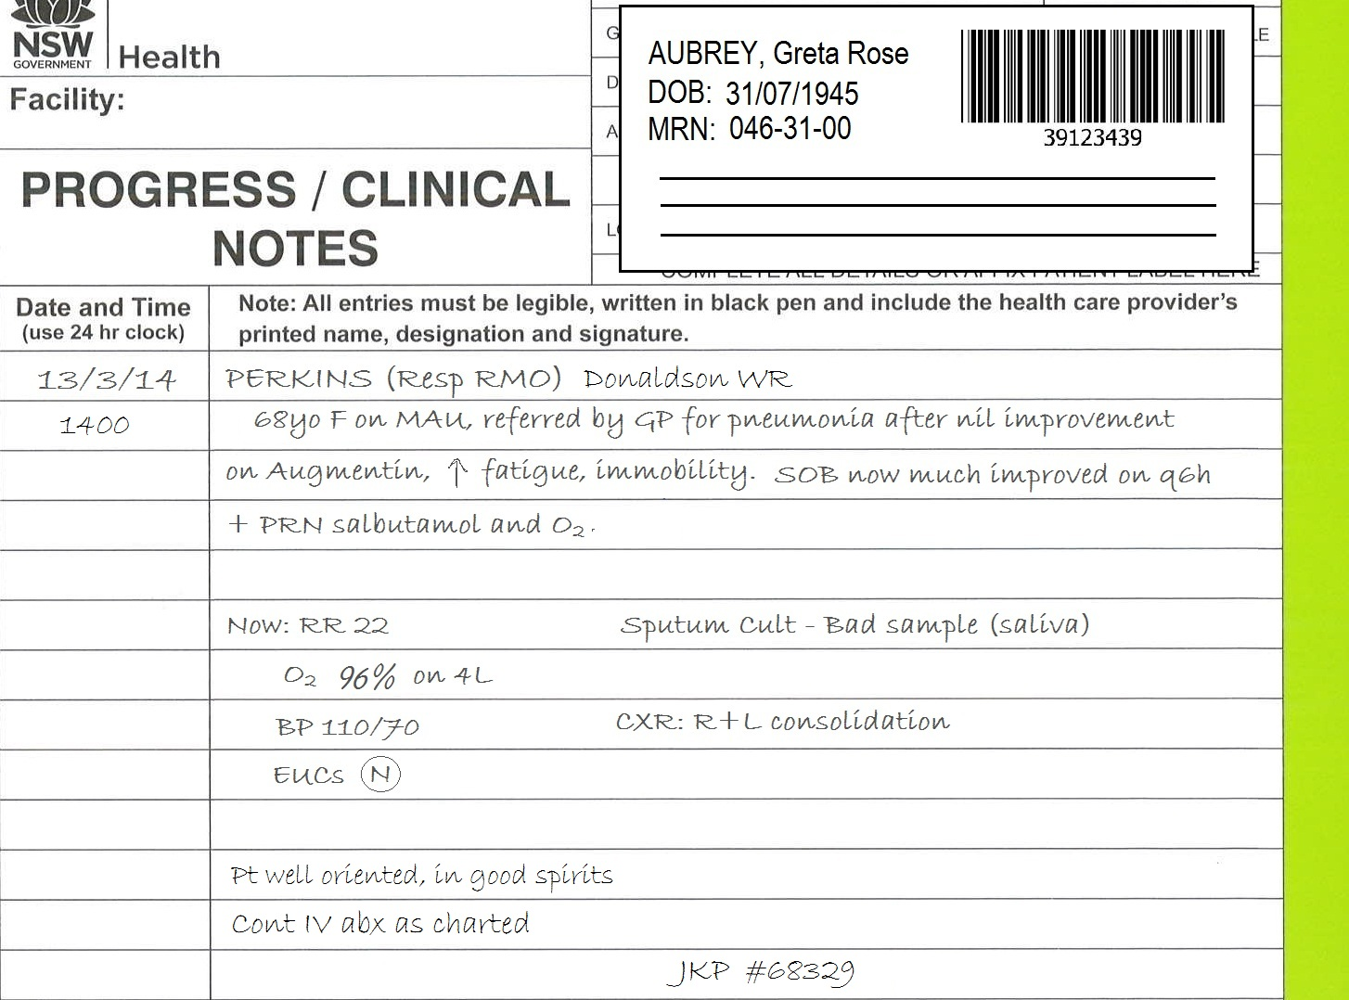
DONE

Slide 17
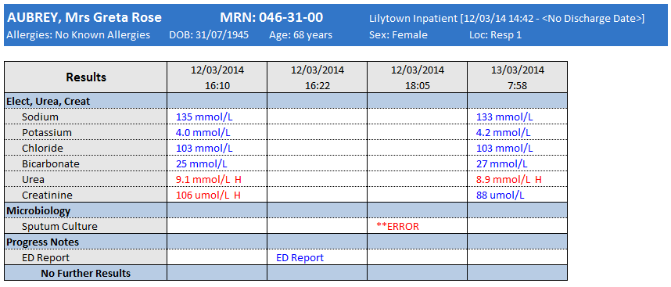
ED Review
Verified E. Anders 12/03/14 16:22
Modified E. Anders 12/03/14 16:44
PC: Referral by GP - worsening SOB, fatigue, mild fevers, has had 4/7 po abx.
RR 29 and O₂ saturation 88% on RA, BP 95/70
Patient oriented T,P,P. States just “very tired” and SOB
Hx: HTN, anaemia, R TKR (2009)
Plan: Supplemental O_{2­} to keep >90%, Meds as charted, CXR, Resp consult, likely admit MAU
___________________
E. Anders
Addit: Resp will attend, sputum culture and IV Abx as per team
Sputum Culture **ERROR
Post 13/03/14 07:35
Sputum culture could not be performed. (Microscopy showed sample provided is saliva.)
Click on relevant results to reveal more information.
DONE

Slide 18
Case Study 2
Well Done!
It would be a good idea to contact the prescriber with intent to recommend a change to therapy for moderate CAP. You could do this by making a recommendation in the notes or speaking to the medical team in person.
You can find information to support your recommendation in the latest version of Therapeutic Guidelines: Antibiotic. If you are not confident in making a recommendation, you should write down why in the comments section and speak to your Audit Coordinator about your concerns.
Use the Data Collection Form to record your answers to the 5 audit questions. The icons are still available for you to review information from the chart, notes and electronic medical record.
If you need to contact the doctor for either question 2 or question 5, please click the ‘Contact Doctor’ icon.
If at any time you believe the patient is not eligible for the audit, click the ‘Patient Not Eligible’ icon.
Click NEXT when you are ready to go through the answers.
It is written on the chart that this patient is receiving antibiotics for
Community Acquired Pneumonia (CAP).
Although the severity of this diagnosis has not been explicitly stated, you are provided with enough cues to determine severity and thus should not need to contact the doctor in this case.
(You may wish to use the CAP Cheat Sheet to assist you with these cases.)
Contact doctor to clarify indication
Are you sure?
This patient appears to fulfil the audit’s eligibility criteria, based on the information available. You should continue with the audit on the next slide.
OR
Contact doctor to recommend guideline concordant therapy
OK
OK
OK
DONE

Slide 19
DONE

Slide 20
DONE

Slide 21
ED Review
Verified E. Anders 12/03/14 16:22
Modified E. Anders 12/03/14 16:44
PC: Referral by GP - worsening SOB, fatigue, mild fevers, has had 2/7 po abx.
RR 29 and O₂ saturation 88% on RA, BP 95/70
Patient oriented T,P,P. States just “very tired” and SOB
Hx: HTN, anaemia, R TKR (2009)
Plan: Supplemental O_{2­} to keep >90%, Meds as charted, CXR, Resp consult, likely admit MAU
___________________
E. Anders
Addit: Resp will attend, sputum culture and IV Abx as per team
Sputum Culture **ERROR
Post 13/03/14 07:35
Sputum culture could not be performed. (Microscopy showed sample provided is saliva.)
Click on relevant results to reveal more information.
DONE

Slide 22
Case Study 2 - Answers
Q1. Yes
Q2. N/A
Q3. No
Q4. No
Q5. Yes*
There is a clear documentation of community-acquired pneumonia (CAP) on the chart. If only the notes were available, “pneumonia” would not be considered a clear enough indication as we need to know which type of pneumonia (Community-Acquired, Hospital-Acquired, Aspiration etc.) in order to match the patient’s therapy to a treatment guideline.
You may have noticed that the severity was not explicitly documented. In these cases the auditor must use the available cues to determine the severity of the condition at the time of prescribing. (You may wish to use the CAP Cheat Sheet to help.)
Using the CORB score, this patient appears to have
moderate CAP.
It would be a good idea to contact the prescriber with intent to recommend a change to therapy for moderate CAP. You could do this by making a recommendation in the notes or speaking to the medical team in person.
You can find information to support your recommendation in the latest version of Therapeutic Guidelines: Antibiotic. If you are not confident in making a recommendation, you should write down why in the comments section and speak to your Audit Coordinator about your concerns.
This patient is receiving ceftriaxone + azithromycin. When reviewing this regimen against the Therapeutic Guidelines: Antibiotic for moderate CAP, this treatment does not appear to be guideline-concordant.
There is no reason documented to justify guideline non-concordance in this case.
OK
OK
OK
OK

Slide 23
Case Study 3
Your randomly selected patient has come to your geriatrics ward overnight. She is a 78yo F who was sent into hospital from a nursing home.
Please click the icons below to review relevant information in the chart, notes and electronic medical record.
Are you sure?
Although partial culture results have now been posted, these were not available at the time of prescribing and current therapy is still considered empirically prescribed.
It is still within the audit rules to continue, but keep in mind whether or not the current culture results should prompt a change in therapy for this patient.
Based on the information available, is this patient eligible for inclusion in the audit?
Correct! This patient appears to be eligible for the audit.
OK
YES
NO
OK
Please Note: The User Guide contains an Eligibility Flowchart (Appendix C) that you may find helpful.

Slide 24
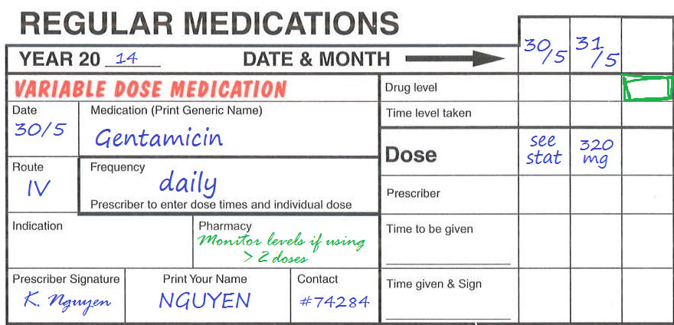
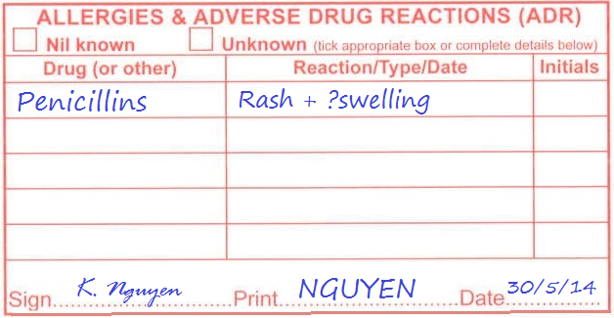
DONE

Slide 25
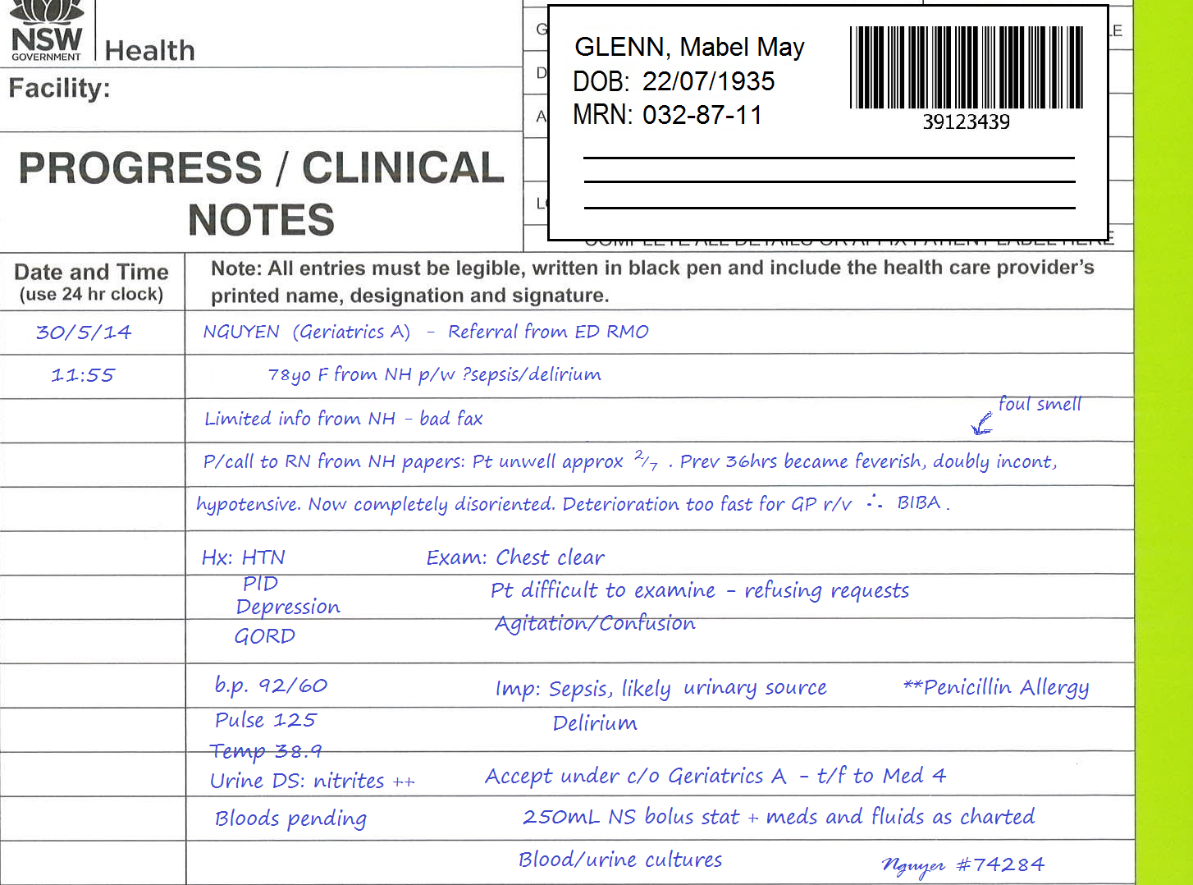
DONE

Slide 26
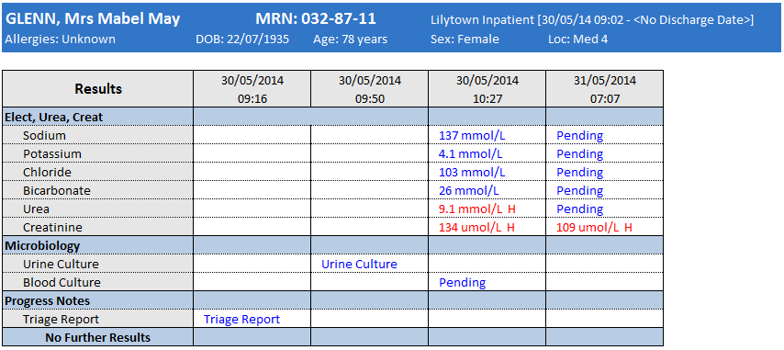
Triage Review
Verified J. Wilkinson 30/05/14 09:16
78 year old female BIBA from NH
BP 95/70, tachycardic 130bpm, O2 sats 99%
Bolus fluids given on route
Temp 39.0 C, last paracetamol 8am
Pt drowsy but rousable, not oriented to TPP
Noted penicillin allergy
?Sepsis pathway
TRIAGE CAT 3
J Wilkinson
Urine Culture
Logged 30/05/14 09:50
Posted 31/05/14 10:03
Heavy growth of likely coliform bacteria.
Identification and susceptibilities report to follow.
Blood Culture
Logged 30/05/14 10:27
Pending.
Click on relevant results to reveal more information.
DONE

Slide 27
Case Study 3
Are you sure?
Although partial culture results have now been posted, these were not available at the time of prescribing and current therapy is still considered empirically prescribed.
In cases like this, you should continue with the audit but keep in mind whether or not the current culture results should prompt a change in therapy for this patient.
Are you sure you need to proceed with this step?
This patient appears to be receiving guideline concordant therapy for severe sepsis with a urinary source. (Therapeutic Guidelines: Antibiotic suggests treatment as for severe pyelonephritis).
Perhaps you should review which guidelines you were using and the patient’s allergy status?
The progress notes for this patient provide an indication of
sepsis with a urinary source.
You have been provided with enough information to match the indication for antimicrobial therapy to a specific guideline, thus you should not need to contact the doctor in this case.
Use the Data Collection Form to record your answers to the 5 audit questions. The icons are still available for you to review information from the chart, notes and electronic medical record.
If you need to contact the doctor for either question 2 or question 5, please click the ‘Contact Doctor’ icon.
If at any time you believe the patient is not eligible for the audit, click the ‘Patient Not Eligible’ icon.
Click NEXT when you are ready to go through the answers.
Contact doctor to clarify indication
OR
Contact doctor to recommend guideline concordant therapy
OK
OK
OK
DONE

Slide 28
DONE

Slide 29
DONE

Slide 30
Triage Review
Verified J. Wilkinson 30/05/14 09:16
78 year old female BIBA from NH
BP 95/70, tachycardic 130bpm, O2 sats 99%
Bolus fluids given on route
Temp 39.0 C, last paracetamol 8am
Pt drowsy but rousable, not oriented to TPP
Noted penicillin allergy
?Sepsis pathway
TRIAGE CAT 3
J Wilkinson
Urine Culture
Logged 30/05/14 09:50
Posted 31/05/14 10:03
Heavy growth of likely coliform bacteria.
Identification and susceptibilities report to follow.
Blood Culture
Logged 30/05/14 10:27
Pending.
Click on relevant results to reveal more information.
DONE

Slide 31
Case Study 3 - Answers
Q1. Yes
Q2. N/A
Q3. Yes
Q4. N/A
Q5. N/A
Therapeutic Guidelines: Antibiotic states that severe sepsis of a likely urinary source should be treated as per the guidelines for severe pyelonephritis. This patient has a penicillin allergy, in which case the guidelines provide recommendations for gentamicin alone. This therapy therefore appears to be guideline concordant.
If the guidelines had not acknowledged or recommended alternate therapy for this patient’s allergy, the prescribed therapy would be considered non-concordant. In such circumstances, the allergy may be recorded as a documented reason for non-concordance (question 4).
Had the medical team had any concerns that gentamicin alone was not sufficient, they would be expected to consult an infectious diseases or microbiology expert, or the AMS team.
The progress notes state that the patient has sepsis, probably from a UTI.
Based on the available cues (hypotension, fever, tachycardia, delirium), you would expect this condition to be treated as severe sepsis from a urinary source, as opposed to being treated as per the direct guidelines for UTI (acute cystitis).
OK
OK

Slide 32
Case Study 4
You have randomly selected a patient on your general medical ward. This 54yo F is documented as having ‘abdo pain’.
Please click the icons below to review relevant information in the chart, notes and electronic medical record.
Based on the information available, is this patient eligible for inclusion in the audit?
Are you sure?
This patient appears to fulfil the audit’s eligibility criteria, based on the information available at this time. You should continue with the audit on the next slide.
Correct! This patient appears to be eligible for the audit.
OK
YES
NO
OK
Please Note: The User Guide contains an Eligibility Flowchart (Appendix C) that you may find helpful.

Slide 33
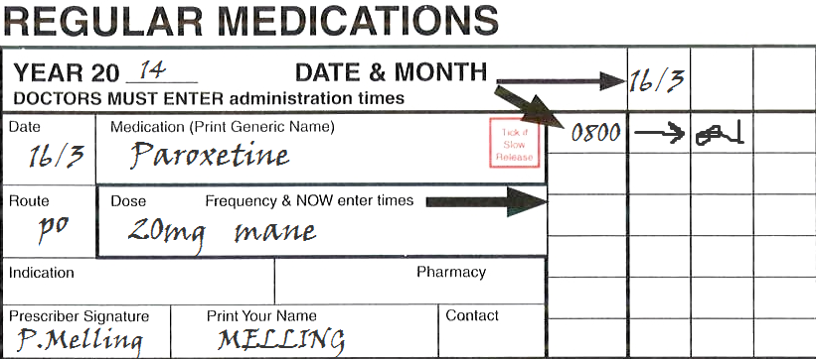
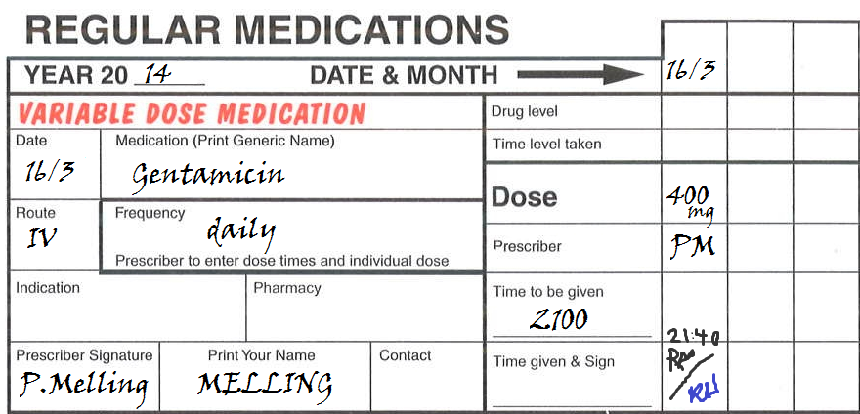
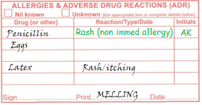
DONE

Slide 34
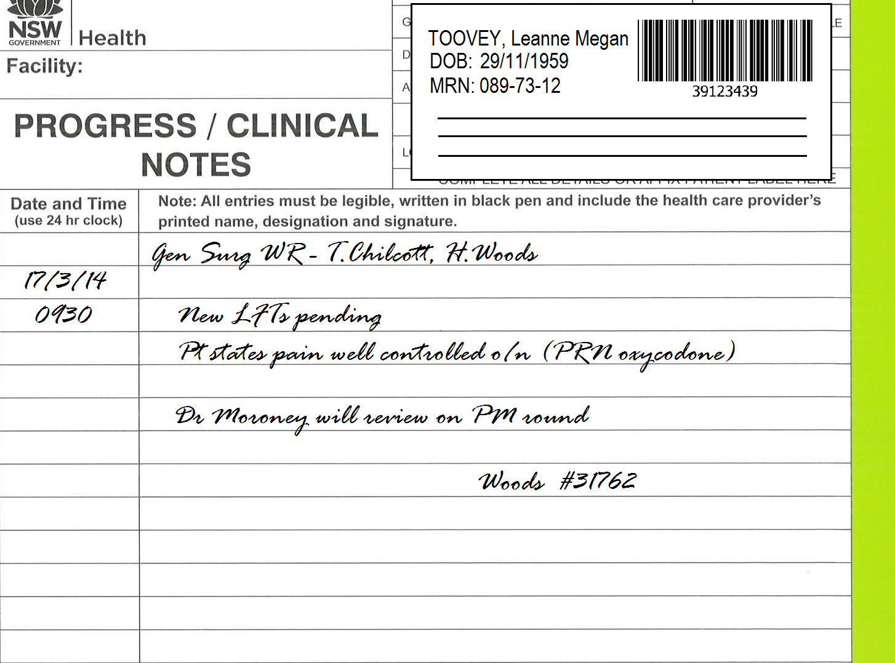
DONE

Slide 35
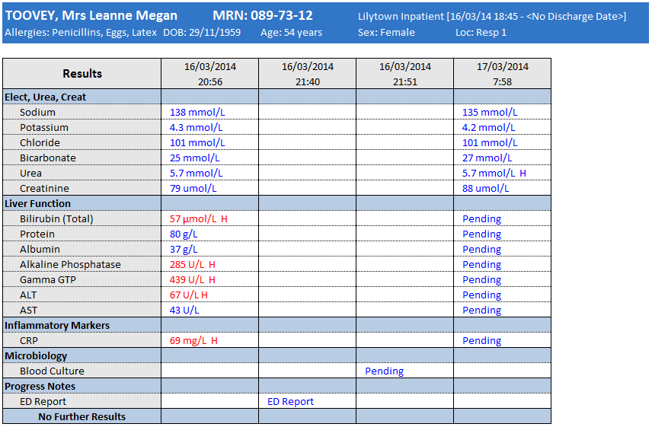
ED Review
Verified P. Melling 16/03/14 21:40
Modified P. Melling 16/03/14 21:54
54yo female presented with fever and RUQ pain developing over prev 6hrs.
Exam: Strong guarding response (upper abdo) with obvious tenderness in RUQ. Positive Murphy’s sign. ??mass
Pt states pain was 8/10, constant. Now 5/10 30min post endone
Hx: Breast Ca (remission since 2005), Generalised anxiety disorder, Gallstones
P/call to AH Gen Surg reg (Moroney Team)
Pt needs RUQ US
Triple abx Amp/Gent/Flagyl
r/v US results with senior - If not immed surgical, admit pt to Gen Med 2. Team will r/v mane.
___________________
Addit: Pt has strong penicillin allergy – change abx to Gent + Clinda
Blood Culture
Pending. Report due 1400 17/3/14.
DONE
Click on relevant results to reveal more information.

Slide 36
Case Study 4
Use the Data Collection Form to record your answers to the 5 audit questions. The icons are still available for you to review information from the chart, notes and electronic medical record.
If you need to contact the doctor for either question 2 or question 5, please click the ‘Contact Doctor’ icon.
If at any time you believe the patient is not eligible for the audit, click the ‘Patient Not Eligible’ icon.
Click NEXT when you are ready to go through the answers.
Well Done!
You may wish to contact the prescriber with a view to recommending a change to guideline-concordant therapy. Recommendations can be made in the notes or by speaking to the doctor/medical team in person.
*If you choose not to contact the doctor when prompted by the audit tool, you should record your reasoning in the comments section.
Contact doctor to clarify indication
Are you sure?
This patient appears to fulfil the audit’s eligibility criteria, based on the information available at this time. You should continue with the audit on the next slide.
OR
“Oh… the patient was diagnosed in ED before she came under our team. She has acute cholecystitis.”
Contact doctor to recommend guideline concordant therapy
OK
OK
OK
DONE

Slide 37
DONE

Slide 38
DONE

Slide 39
ED Review
Verified P. Melling 16/03/14 21:40
Modified P. Melling 16/03/14 21:54
54yo female presented with fever and RUQ pain developing over prev 6hrs.
Exam: Strong guarding response (upper abdo) with obvious tenderness in RUQ. Positive Murphy’s sign. ??mass
Pt states pain was 8/10, constant. Now 5/10 30min post endone
Hx: Breast Ca (remission since 2005), Generalised anxiety disorder, Gallstones
P/call to AH Gen Surg reg (Moroney Team)
Pt needs RUQ US
Triple abx Amp/Gent/Flagyl
r/v US results with senior - If not immed surgical, admit pt to Gen Med 2. Team will r/v mane.
___________________
Addit: Pt has penicillin allergy – change abx to Gent + Clinda
Blood Culture
Pending. Report due 1400 17/3/14.
DONE
Click on relevant results to reveal more information.

Slide 40
Case Study 4 - Answers
Q1. No
Q2. Yes
Q3. No
Q4. No
Q5. Yes*
You may wish to contact the prescriber with a view to recommending a change to guideline-concordant therapy. Recommendations can be made in the notes or by speaking to the doctor/medical team in person.
*If you choose not to contact the doctor when prompted by the audit tool, you should record your reasoning in the comments section.
There is no indication for antimicrobial therapy documented in the notes, chart or electronic medical record.
To proceed with the rest of the audit you needed to have contacted the doctor to find out that the indication for therapy is acute cholecystitis.
This patient has acute cholecystitis and a non-immediate penicillin allergy, in which case the guidelines recommend treatment with ceftriaxone or cefotaxime. The prescribed therapy (gentamicin + clindamicin) is therefore guideline non-concordant.
There is no reason documented to justify guideline non-concordance in this case.
OK
OK
OK
OK

Slide 41
Case Study 5
The next patient has been on your endocrine ward for 5 days. He is a 36yo male who was originally admitted for DKA and has been recovering well.
Please click the icons below to review relevant information in the chart, notes and electronic medical record.
Are you sure?
This patient appears to fulfil the audit’s eligibility criteria, based on the information available. You should continue with the audit on the next slide.
Based on the information available, is this patient eligible for inclusion in the audit?
Correct! This patient appears to be eligible for the audit.
OK
YES
NO
OK
Please Note: The User Guide contains an Eligibility Flowchart (Appendix C) that you may find helpful.

Slide 42
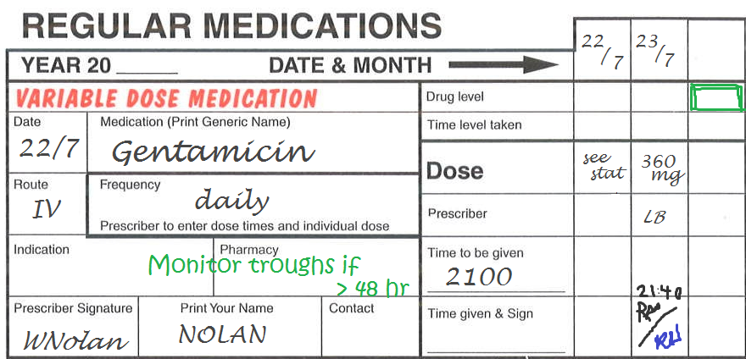
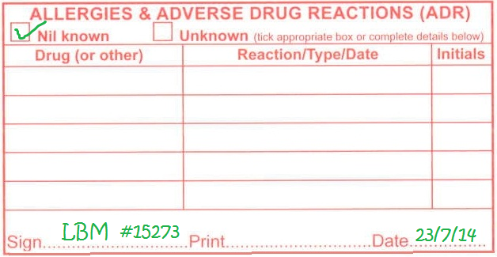
DONE

Slide 43
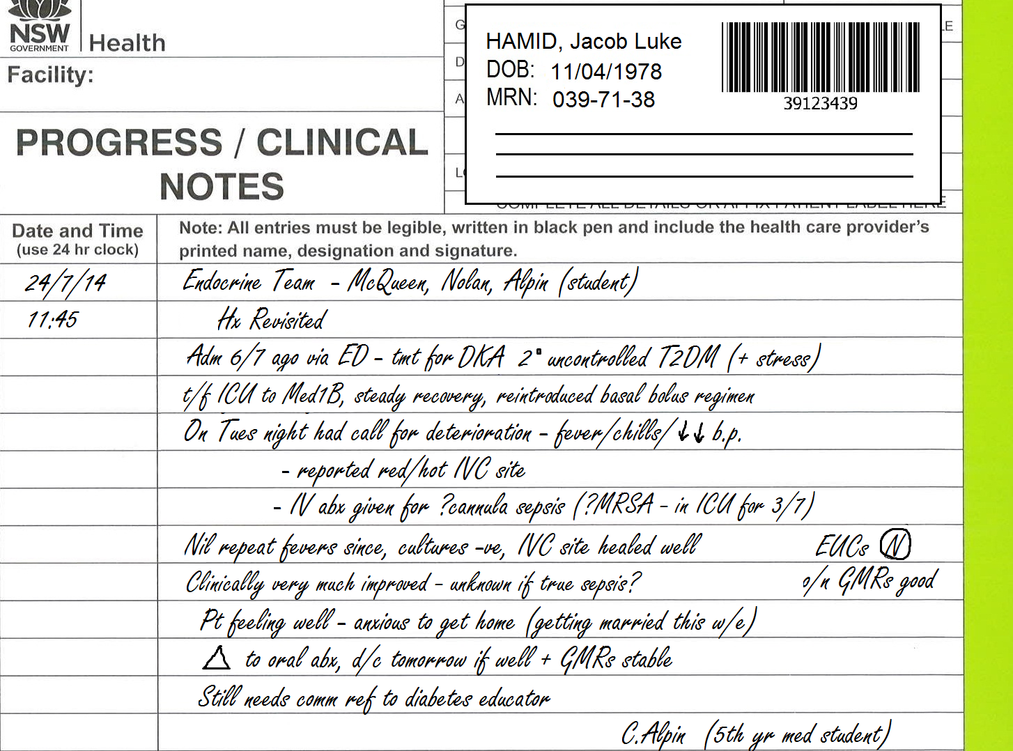
DONE

Slide 44
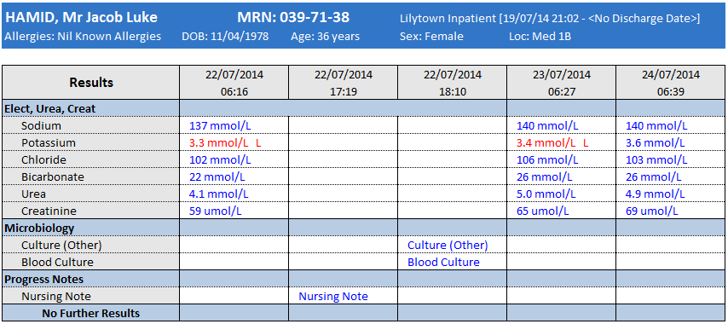
Nursing Note
Verified H. O’Day 22/07/14 17:19
Pt activated call button – stated ‘feeling dizzy and slight headache’.
Noted pale, clammy. Still sitting up in bed.
Manual BP 90/60
Temp 39.5
HR 105 – prev obs usually around 60
BSL attended = 8.9
Pt requiring clinical review
Nil response from team – contacted AH RMO
Bolus fluids given by ph order
Pt r/v by RMO within 20 minutes
H O.Day RN (with R. Swallei, EN)
Culture (Other)
Logged 22/07/14 18:10
Posted 24/07/14 08:05
Culture (Other): IVC line tip
Nil growth at 36hrs.
Report to follow if growth occurs.
Blood Culture
Logged 22/07/14 18:10
Pending.
Click on relevant results to reveal more information.
DONE

Slide 45
Case Study 5
Are you sure you need to proceed with this step?
You may have found the current antimicrobial therapy to be non-concordant with the guidelines, however the documentation of the patient’s clinical improvement and imminent discharge effectively provides a reason for the early de-escalation of therapy to oral antibiotics.
The audit will only prompt you to recommend guideline concordant therapy where a reason for non-concordance has not been documented. Keep in mind that you can always contact the doctor for other concerns outside the scope of data collection, especially if you believe the patient is at risk.
This patient appears to have been prescribed antimicrobial therapy for sepsis (?cannula site infection). The notes indicate there may also have been some concern about the risk of MRSA.
Please note that although the antimicrobial therapy has recently changed, it is clear from the notes that this is still prescribed for the indication that was originally identified and is not for a different diagnosis or condition.
You have been provided with enough information to match the indication for antimicrobial therapy to a specific guideline, thus you should not need to contact the doctor in this case.
Use the Data Collection Form to record your answers to the 5 audit questions. The icons are still available for you to review information from the chart, notes and electronic medical record.
If you need to contact the doctor for either question 2 or question 5, please click the ‘Contact Doctor’ icon.
If at any time you believe the patient is not eligible for the audit, click the ‘Patient Not Eligible’ icon.
Click NEXT when you are ready to go through the answers.
Contact doctor to clarify indication
Are you sure?
While this patient may be difficult to assess, they still fulfil the audit’s eligibility criteria and should be included in the audit.
OR
Contact doctor to recommend guideline concordant therapy
OK
OK
DONE
OK

Slide 46
DONE

Slide 47
DONE

Slide 48
Nursing Note
Verified H. O’Day 30/05/14 17:19
Pt activated call button – ‘bit dizzy and slight headache’.
Noted pt clammy but still sitting up in bed.
Manual BP 90/60
Temp 38.5
HR 105 – prev obs usually around 60
BSL attended = 8.9
Pt requiring clinical review
Nil response from team – contacted AH RMO
Panadol, bolus fluids given by ph order
Pt r/v by RMO within 20 minutes
H O.Day RN (with R. Swallei, EN)
Culture (Other)
Logged 22/07/14 18:10
Posted 24/07/14 08:05
Culture (Other): IVC line tip
Nil growth at 36hrs.
Report to follow if growth occurs.
Blood Culture
Logged 22/07/14 18:10
Pending.
Click on relevant results to reveal more information.
DONE

Slide 49
Case Study 5 - Answers
This patient has been prescribed antimicrobial therapy for suspected sepsis, secondary to a cannula site infection. At the time of diagnosis, the altered clinical parameters classify this patient’s condition as ‘severe’.
Remember that the audit does not ask you to determine the extent to which a documented diagnosis is correct or incorrect, or whether current therapy is appropriate or even warranted. As an auditor you are asked to focus on what the medical team believes they are treating and whether they have prescribed via the corresponding guidelines.
If, for example, you believed the patient in front of you only had mild thrombophlebitis that has largely resolved, you are encouraged to discuss these concerns with the doctor. Your personal assessment should not however, alter your response to the audit questions.
Q1. Yes
Q2. N/A
Q3. No
Q4. Yes
Q5. N/A
Therapeutic Guidelines: Antibiotic recommend gentamicin + vancomycin for severe sepsis from a likely IVD source.
Although we can see that this patient did receive concordant therapy initially, you are required to review only what is current. As clindamycin is not listed in the guidelines, technically it should be recorded as non-concordant. There is however, a documented reason (clinical improvement leading to de-escalation of therapy).
Although as an auditor you may sometimes feel that step-down therapy is (or isn’t) ‘appropriate’, you must must still follow the rules of the audit. Remember that guideline concordance OR documentation of a reason for non-concordance are both considered positive outcomes and will count towards the same indicator result.
Documentation in the notes suggests that the patient had shown significant clinical improvement, and also that the medical team were now unsure if this was a case of ‘true’ sepsis. This can be interpreted as a reason for the patient’s current therapy (oral clindamycin) not matching the guidelines for sepsis secondary to an intravascular device infection, as the therapy has been de-escalated upon reviewing the patient’s current condition.
Had the medical notes simply stated ‘change to oral therapy’ without making it clear that the patient had significantly improved, this may be interpreted as not providing a clear reason as there is no clinical rationale provided with reference to the change in therapy.
OK
OK
OK

Slide 50
Case Study 6
You have randomly selected a bed in your general medical ward. The bed list tells you the patient is an 82yo M with multiple comorbidities.
Please click the icons below to review relevant information in the chart, notes and electronic medical record.
Based on the information available, is this patient eligible for inclusion in the audit?
Well Done!
You have successfully identified that this patient is not eligible for the audit as it has been greater than 5 days since the in hospital identification of an indication for antimicrobial therapy.
You should discard any information collected for this audit record and move on to your next randomly selected patient.
The notes are missing!
You can’t find this patient’s notes anywhere! See if you can gather enough information from the other sources…
Are you sure? You should check the eligibility rules again!
OK
YES
NO
OK
Please Note: The User Guide contains an Eligibility Flowchart (Appendix C) that you may find helpful.
OK

Slide 51
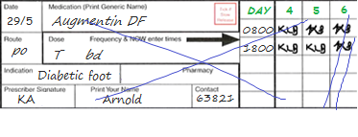
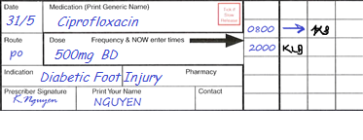
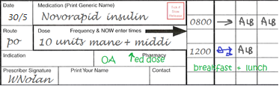
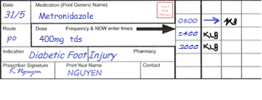
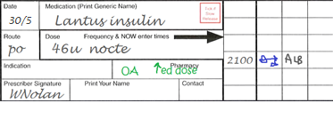
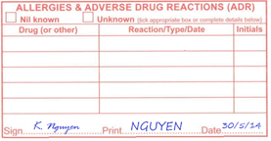
DONE

Slide 52
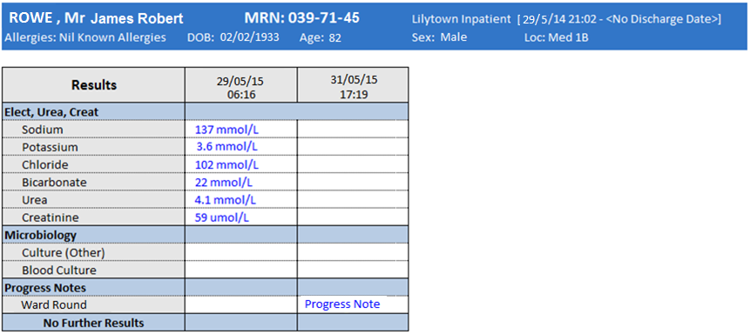
Ward Round
Verified K. Arnold 31/05/14 10:40
82yo man admitted to Royal City Hospital 24/5/14 via GP referral for diabetic foot injury + poor diabetic control + generally unwell/not managing at home. T/f to Lilytown Hospital on 29/5/15.
GMRs continue to be well controlled on current meds/diet. Discharged from diabetes educator at RCH.
R foot wound with continued poor healing, ?ulceration. Had 6/7 Aug DF (prescribed on adm to Baytown). Noted pt had fall with further wound trauma 2/7 ago. Abx changed to Ciprofloxacin + Flagyl yesterday pm.
Will r/v with Dr Stapleton this pm.
Wound care CNC r/v please
K.Arnold (Gen Med RMO)
Click on relevant results to reveal more information.
DONE

Slide 53
Case Study 4
Well Done!
You have correctly identified that this patient is not eligible for inclusion in the audit.
When reviewing this treatment against the Therapeutic Guidelines: Antibiotic for acute cholangitis, this patient’s immediate hypersensitivity to penicillin leads to a recommendation to ‘seek expert advice’. As explained on page 4 of the Frequently Asked Questions document, this means the patient is no longer eligible for the audit and all data should be discarded.
Use the Data Collection Form to record your answers to the 5 audit questions. The icons are still available for you to review information from the chart, notes and electronic medical record.
If you need to contact the doctor for either question 2 or question 5, please click the ‘Contact Doctor’ icon.
If at any time you believe the patient is not eligible for the audit, click the ‘Patient Not Eligible’ icon.
Click NEXT when you are ready to go through the answers.
Contact doctor to clarify indication
Are you sure you need to proceed with this step?
Given the patient’s diagnosis and allergy status, the guidelines say ‘seek expert advice’. The Frequently Asked Questions document provides some advice on how to handle this scenario.
OR
“Oh… the patient was diagnosed in ED before she came under our team. She has acute cholecystitis.”
Contact doctor to recommend guideline concordant therapy
OK
OK
DONE
Discard data and proceed to next patient

Slide 54
You’ve Finished!
Congratulations on completing the Challenging Cases Tutorial.
As an auditor, you should now have a better idea of how to proceed with some of the more complex patients you encounter.
If you have any questions or concerns about the answers provided in this tutorial, or general queries regarding the 5x5 Antimicrobial Audit, please feel free to get in touch with the Quality Use of Antimicrobials in Healthcare (QUAH) team at the Clinical Excellence Commission.
CEC-AMS@health.nsw.gov.au

