Slide 1
Venous Thromboembolism (VTE)
Reducing the Risk in Maternity Patients
[insert presenters name]
[insert presenters facility]

Slide 2
Objectives
Provide an introduction to venous thromboembolism (VTE)
Discuss how VTE affects pregnant and postpartum women
Identify which pregnant and postpartum women require assessment
Provide an overview of VTE Risk Assessment with regards to:
Using the Maternity VTE Risk Assessment Tool
Factors to consider when performing VTE risk assessments
Practise performing VTE Risk Assessments
Notes:
The purpose of this presentation is to provide an introduction to venous thromboembolism and how to assess and manage VTE risk using the ED adult VTE risk assessment tool. We will practise performing VTE risk assessments using two cases at the end of the presentation.

Slide 3
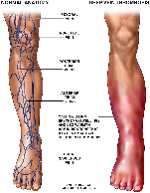
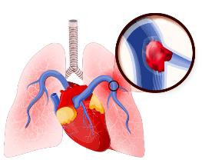
Venous Thromboembolism (VTE)
VTE
Deep Vein Thrombosis (DVT) | Pulmonary Embolism (PE)
Occurs in deep veins (most commonly in legs and groin) | Occurs after DVT dislodges and travels to the lungs
Can cause long-term issues – ‘post-thrombotic syndrome’ (PTS). PTS affects 23-60% of DVT patients within 2 years | Serious complication which can lead to death
Lower-extremity DVT has 3% PE-related mortality rate | Patients with PE have 30-60% chance of dying from it
Notes:
VTE is the term used to define cases of Deep Vein Thrombosis (DVT) and Pulmonary Embolism (PE).
DVTs as you know develop in the deep veins (most commonly in the lower leg). They can lead to ‘post-thrombotic syndrome’ (PTS), which can cause chronic symptoms including leg pain, swelling, redness, and ulceration. PTS affects 23-60% of DVT patients within 2 years.
The most serious complication of a DVT is that the clot could dislodge and travel to the lungs, becoming a Pulmonary Embolism (PE). In fact, lower-extremity DVT has a 3% PE-related mortality rate.
PE is a serious complication which can lead to death. Patients with PE have a 30-60% chance of dying from it.
We must remember that DVT and PE are not just single events, often patients suffer long-term complications.
DVT image from: https://www.healthdirect.gov.au/deep-vein-thrombosis
PE imagine from: https://www.ihtc.org/pulmonary-embolism/

Slide 4
What causes VTE?
Virchow’s Triad = categories of factors contributing to blood clot formation
Stasis
Alteration in normal blood flow
VIRCHOW’S TRIAD
Endothelial Injury
Injury or trauma to the inside of the blood vessel
Hypercoagulability
Alteration in the constitution of blood causing blood to clot more easily
Notes:
Virchow was the first to explain the categories of factors that contribute to the formation of thrombosis
Stasis e.g. due to varicose veins, prolonged travel, immobility
Hypercoagulability or the activation of coagulation e.g. due to inherited bleeding disorders, cancer, or during pregnancy
Endothelial Injury i.e. injury or trauma to the inside of the blood vessel

Slide 5
What's the Harm?
VTE
Mortality
- Readmission
- Increased Length Of Stay
- Post-thrombotic syndrome
Morbidity
Fatal PE
Notes:
VTE causes a significant mortality and morbidity burden.
Of course deaths from PEs concern us, but the impact of DVT also warrants action. We can see more readmissions, increased LOS and the possibility that many patients with DVT may then develop post thrombotic syndrome (PTS).
PTS affects 23-60% of DVT patients within 2 years.
Chronic symptoms including leg pain, swelling, redness, and ulceration.

Slide 6
The Impact of VTE
More than 14,000 Australians develop a VTE per year
More than 5,000 of them will die as a direct result
VTE causes 7% of all hospital deaths
Incidence 100 times greater in hospitalised patients than community residents
Largely preventable
Notes:
Note that these are general population figures – not specific to maternity only
The impact of VTE is significant. An article by Access Economics estimated that in 2008 there were approximately 14 000 cases of VTE in Australia. Using epidemiological evidence, it was estimated that VTE was responsible for more than 5000 deaths.
It is estimated that VTE causes 7% of all hospital deaths and the incidence is 100 times greater in hospitalised patients than in community residents.
Often these are just numbers to us, we might not experience what VTE actually does to patients, or we don’t see the impact often enough to warrant concern.
What does the harm VTE imposes actually mean for our patients on a case by case level?
What is the real harm?
Reference: Access Economics. The burden of venous thromboembolism in Australia. Report by Access Economics Pty Limited for the Australian and New Zealand Working Party on the management and prevention of venous thromboembolism, 2008.

Slide 7
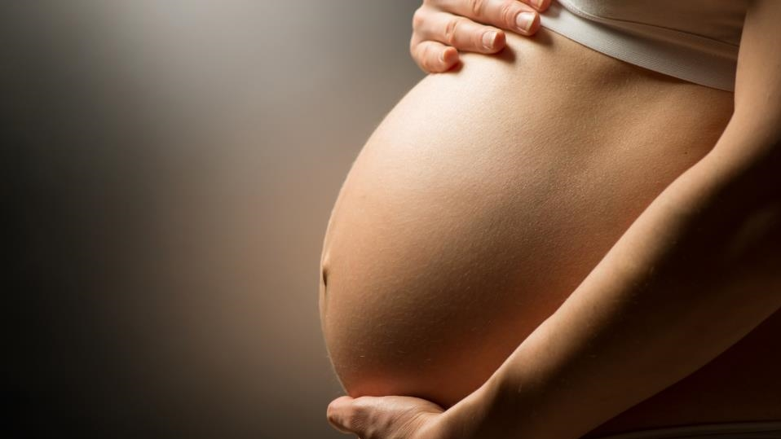
So how does VTE affect women who are pregnant or just given birth?

Slide 8
Of the 49 direct causes of maternal death identified in Australia between 2008-2012,
which leading two accounted for almost 43% of direct deaths?
Obstetric haemorrhage
Thromboembolism
Notes:
Ask staff what they think the causes are…..

Slide 9
VTE and Pregnancy
Identified as a direct cause of maternal death accounting for 3.2% of deaths worldwide
L Say et al. Global causes of maternal death: a WHO systematic analysis. Lancet Glob Health 2014; 2: e323–33
Also found to be one of the leading causes of direct maternal death in Australia (2008-2012) accounting for 9.5% of deaths
Humphrey MD, Bonello MR, Chughtai A, Macaldowie A, Harris K & Chambers GM 2015. Maternal deaths in Australia 2008–2012. Maternal deaths series no. 5. Cat. no. PER 70. Canberra: AIHW.

Slide 10
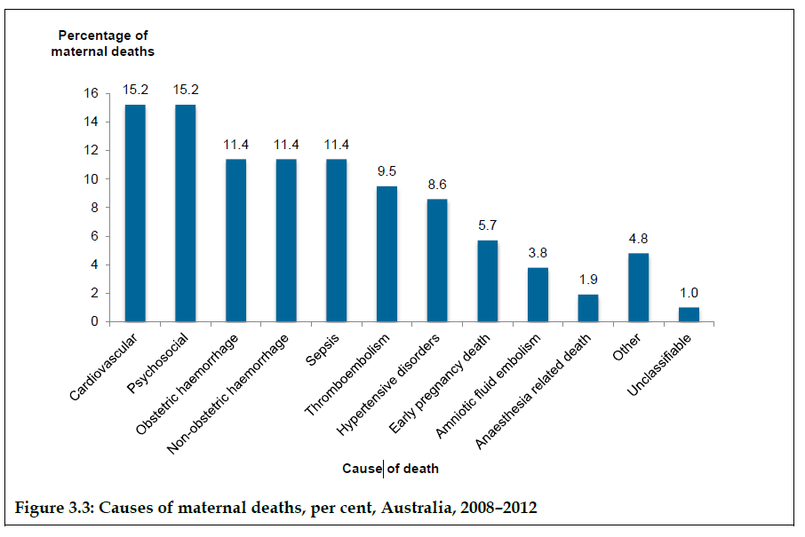
Source: Humphrey MD, Bonello MR, Chughtai A, Macaldowie A, Harris K & Chambers GM 2015. Maternal deaths in Australia 2008–2012. Maternal deaths series no. 5. Cat. no. PER 70. Canberra: AIHW.
Notes:
We can see what the stats tell us, but lets see how it can impact individual patients……

Slide 11
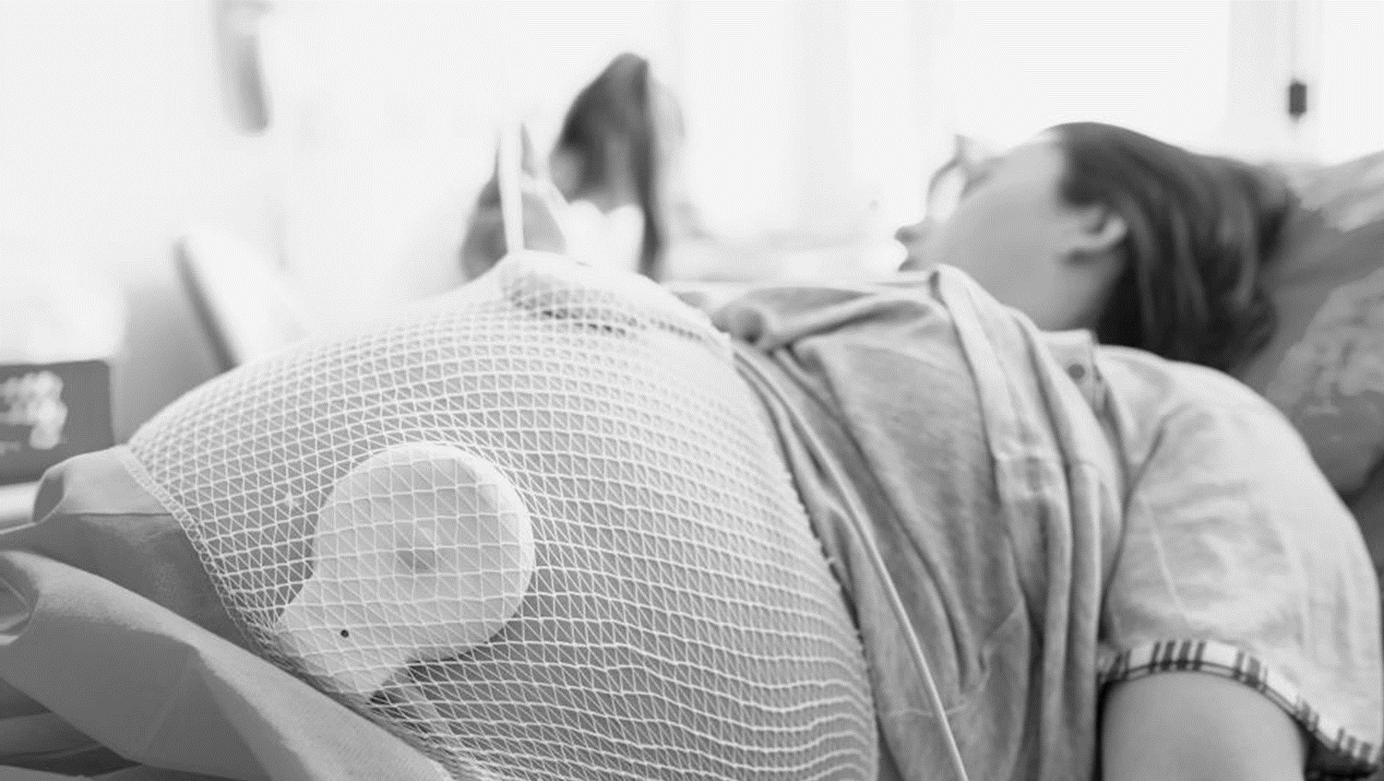
What’s the Harm?
Case ONE
28 year old presented at 34 weeks
Underwent emergency LSCS for placental abruption
Hx indicates previous DVT post-op requiring 3 month warfarin therapy
Prescribed Clexane 40mg post-LCSC
Ceased Day 4

Slide 12
What’s the Harm?
Case ONE
Represented 28 days post-partum with significant pain and swelling of calf
U/S confirmed DVT
Commenced on treatment dose of anticoagulant for 6 months
Notes:
Important to highlight that the duration of therapy is equally as important as initiation. Being high risk, this women may have required at least 6 weeks of prophylaxis with clexane

Slide 13
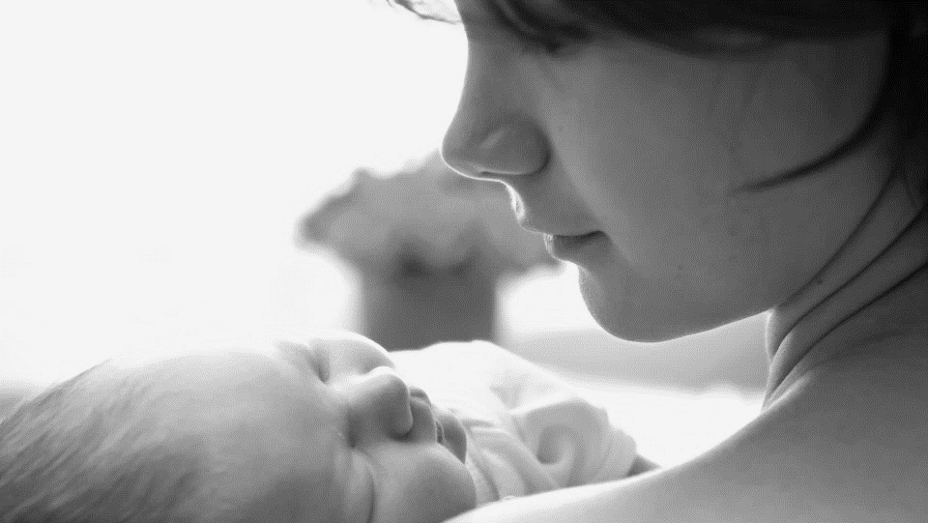
What’s the Harm?
Case TWO
32 year old presented at 40+1 weeks
Fully dilated
Rapid NVB, nil complications
Hx notes BMI = 42, family history of PE
Nil VTE Risk Assessment completed
Discharged 3/7 post-partum

Slide 14
What’s the Harm?
Case TWO
10 days post-partum found collapsed at home
Paramedics called and transported patient to hospital
Dead on arrival
Post-mortem findings: Extensive pulmonary embolism

Slide 15
Completing a VTE risk assessment and prescribing appropriate prophylaxis can save a mother’s life
Notes:
Appropriate in terms of drug, dose and also duration of therapy

Slide 16
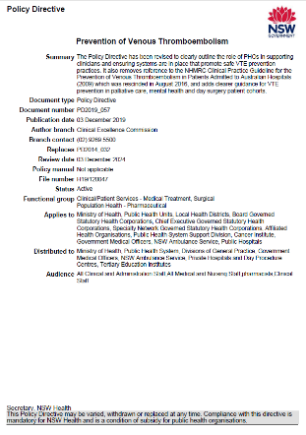
VTE Risk Assessment
Prevention of Venous Thromboembolism Policy Directive (PD2019_057) states:
All pregnant and postpartum women must undergo VTE risk assessment:
During the first comprehensive antenatal assessment
Within 24 hours of admission into a non-obstetric setting for a non-pregnancy related complaint
Within 24 hours of admission into an obstetric setting for a pregnancy or non-pregnancy related complaint
During postpartum care, within 2 hours of birth (vaginal or caesarean section)

Slide 17
Who Should Complete the Tool?
Either a Midwife or Medical Officer (JMO, Resident, Register or Consultant) can complete the tool
At <your facilities name> we encourage <midwives and/or medical officers> to complete the tool
Remember, following assessment, only an authorised prescriber (usually a Medical Officer) can prescribe appropriate prophylaxis
Notes:
Insert your facilities name and who you have decided locally should complete the tool – either midwife and MO, midwife alone or MO alone

Slide 18
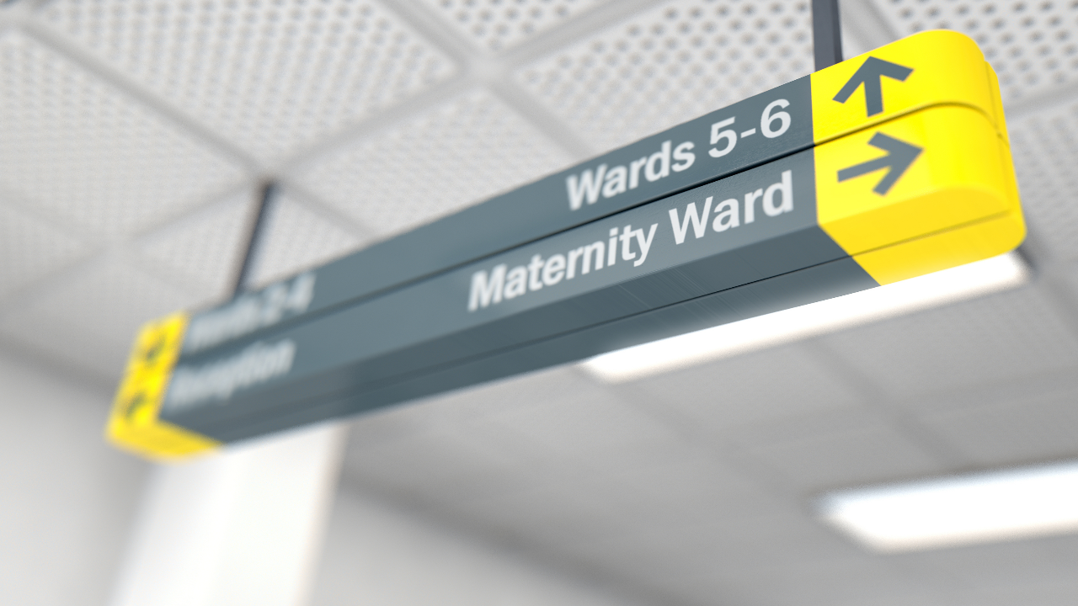
Who to assess and reassessment
Special conditions to be aware of
Risk Factors
Step-by-step use of the tool
Using the Maternal VTE Risk Assessment Tool

Slide 19
When Should I Assess?
The tool is for antenatal or postpartum women during:
Booking-in
Any antenatal admission
When clinical condition alters
Postpartum care, within 2hrs of birth (vaginal or caesarean section)
Clinicians should also consider women who have recently
experienced miscarriage, ectopic pregnancy or termination
Notes:
Since women who have recently been pregnant ie experienced a miscarriage, ectopic pregnancy or termination, as not theoretically considered ‘postpartum’ we need to be aware of them and that they may indeed still be at risk of VTE as their bodies have undergone the physiological changes associated with a higher risk of VTE.

Slide 20
Reassessment
Reassessment is just as important as the initial assessment
Reassessment should take place at different points eg admission, postpartum
BUT ALSO
For admitted women, reassessment needs to occur
every 7 days (or as clinical condition changes)
The tool can be used on 3 occasions
If more than 3 assessments are required, use a new form

Slide 21
Care with Special Conditions
Some women may have particular conditions that need a unique approach
Take care in the following situations:
Women on therapeutic anticoagulation
Women who have undergone IVF
Women with Ovarian Hyperstimulation Syndrome
The way these women are managed may differ slightly…….

Slide 22
Women on Therapeutic Anticoagulation
If you assess a woman (antenatal or postpartum) who was on long-term therapeutic anticoagulation either:
Before she became pregnant, or
During her pregnancy
refer to Haematology so they can determine how to best manage VTE risk
These women often need to remain on therapeutic doses of anticoagulation with the same medication, or a safer alternative.

Slide 23
IVF and VTE Risk
Following IVF, women are at a 7-fold increase in risk of VTE in the 1st trimester SAX Institute 2015 Rapid Report
Other factors play a role, which include:
hyperoestrogenaemia
oocyte retrieval
ovarian hyperstimulation syndrome
reduced mobility seem to play a role
Ensure women admitted during the first trimester following IVF are risk assessed
Risk may reduce over the course of the pregnancy, depending on the women's individual risk

Slide 24
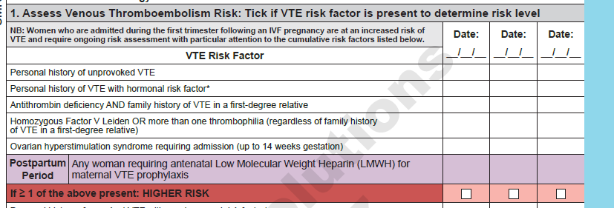
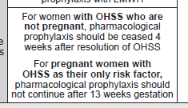
Ovarian Hyperstimulation Syndrome
Women with OHSS who require admission are considered to be at a HIGHER RISK of developing VTE
This is only valid for up to 14 weeks gestation
Management for these women differs – consultation is required if you are uncertain
Notes:
This is only valid for up to 14 weeks gestation. After 14 weeks, this risk ceases for the woman

Slide 25
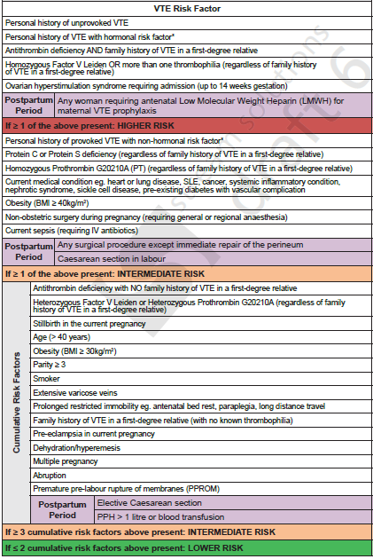
Risk Factors
The tool contains a range of factors that place women at risk of developing a VTE
Some risk factors may be a little confusing……

Slide 26
Thrombophilia
Some risk factors refer to thrombophilia
There are several types of thrombophilia’s, which can be overwhelming!
Here are the ones to keep an eye out for:
Homozygous Factor V Leiden
Heterozygous Factor V Leiden
Antithrombin deficiency
Protein C deficiency
Protein S deficiency
Homozygous Prothrombin G20210A
Heterozygous Prothrombin G20210A
If you are unsure, speak to a consultant Obstetrician or Haematologist

Slide 27
Use of antenatal LMWH for maternal VTE prophylaxis
Women who have been on antenatal LMWH for VTE prophylaxis are considered to be at a higher risk of VTE postpartum
Note that this does NOT include the use of LMWH for other indications such as recurrent miscarriage without evidence of antiphospholipid syndrome (APS)
Only include women who have used LMWH for prevention of VTE ie for the indication of maternal VTE prophylaxis only

Slide 28
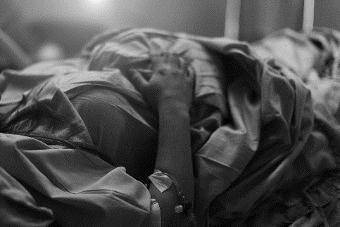
Prolonged Restricted Mobility
A woman that has experienced prolonged restricted mobility can be at a higher risk of VTE
This may be due to antenatal bed rest, paraplegia or long distance travel
Also take into account women who have experienced prolonged labour
( >24 hours)

Slide 29
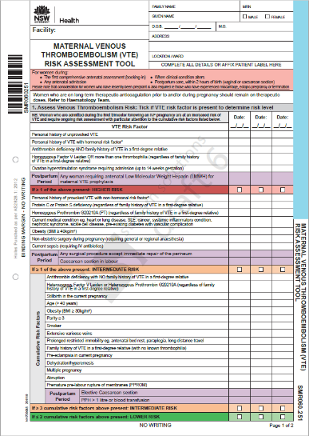
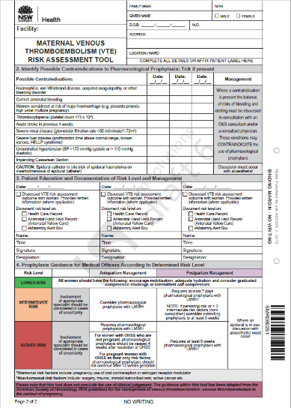
Using the Tool

Slide 30
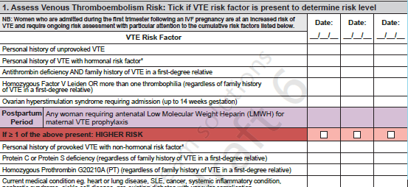
Using the Tool – Step 1: Assessing VTE Risk
Document the date of assessment
Place a  where a VTE risk factor is present under the appropriate date column
Start in the ‘Higher Risk’ section and move your way down until one of the following categories are met:
HIGHER RISK
INTERMEDIATE RISK
INTERMEDIATE RISK (due to ≥ 3 cumulative risk factors)
LOWER RISK

Slide 31
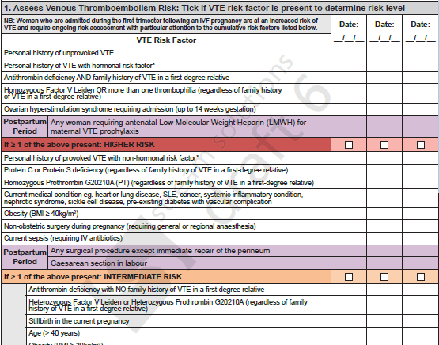
Using the Tool – Step 1: Assessing VTE Risk
Some risk factors are related to the postpartum period only
These are shaded in purple to help differentiate

Slide 32
Using the Tool – Step 1: Assessing VTE Risk
At the end of Step 1, risk factors should be assessed and the woman allocated into a risk category
If the women is considered LOWER RISK → assessment COMPLETED
Guidance on Page 2, Step 4:
If the women is considered INTERMEDIATE RISK or HIGHER RISK → CONTINUE to Step 2

Slide 33
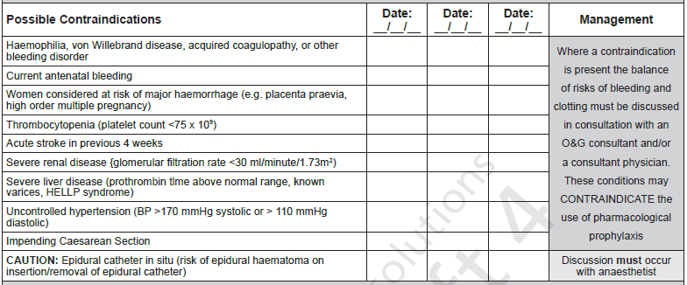
Using the Tool – Step 2: Identifying Contraindications
Prompts identification to contraindications to pharmacological prophylaxis
Document the date of assessment
Place a  where a contraindication is present under the appropriate date column
Notes:
The second section prompts the midwife or medical officers to identify contraindications to pharmacological prophylaxis. If unsure, consult a senior clinician.

Slide 34
Using the Tool – Step 2: Identifying Contraindications
If contraindication identified → speak to O&G Consultant or Consultant Physician such as a Haematologist
Therapy may not be appropriate for this woman
If no contraindication identified → CONTINUE to Step 3
NB: If epidural catheter in use
Notes:
If a C/I has been identified then consultation with a consultant must be undertaken.
Be very careful if an epidural catheter is in use. While this doesn’t mean the women cannot have prophylaxis, discussion with an anaesthetist will hep guide the timing of the dose and/or insertion/removal of the catheter to avoid epidural haematoma.

Slide 35
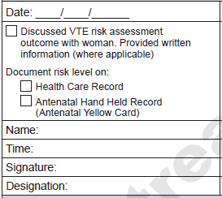
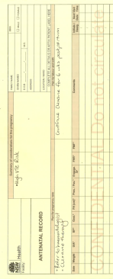
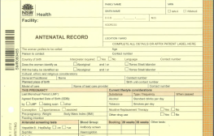
Using the Tool – Step 3: Educate and Document
On each occasion of screening, ensure you what completed the following:
Sign off to help others identify who completed the assessment

Slide 36
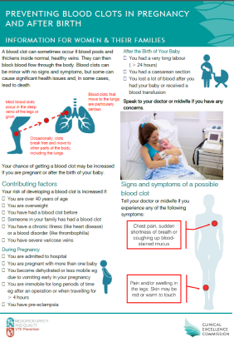
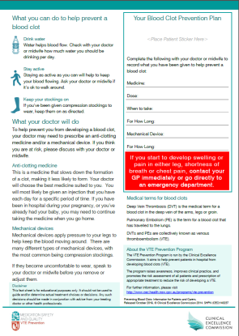
Education
It is vital that women are empowered on:
Examples of VTE risk factors
What their level of risk is
What is being done to manage their risk
What they can do to manage their risk
Signs and symptoms of a VTE, and what they should do if they notice any of these
There is a dedicated leaflet available that can assist when providing women this information
This leaflet has also been translated into various languages
Notes:
Also available in Arabic, Chinese (simplified), Chinese (traditional), Greek, Hindi, Korean, Vietnamese

Slide 37
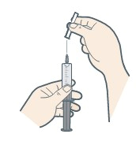
Education
If the woman is an outpatient OR to be discharged on prophylaxis, further education will be required to:
Show the women/her carer how to self-inject
(or discuss what community healthcare providers can assist her eg GP, Community Nursing etc)
Resources are available for both Clexane and Fragmin
Notes:
Determine if the woman or her carer is able to manage injections. If not, consider alternative arrangements to ensure continuity in management (e.g. GP, HITH, ambulatory care units, community nursing etc.)

Slide 38
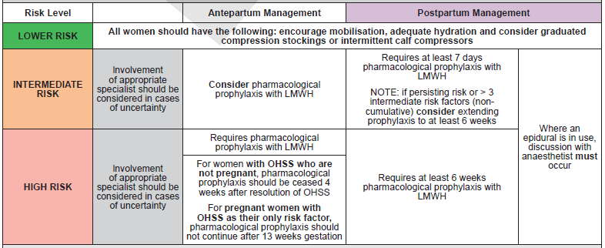
Using the Tool – Step 4: Guidance
Provides guidance for MOs to prescribe appropriately according to risk level
<may want to discuss the role of midwives in your facility in guiding MOs (in particular JMOs) with prescribing>

Slide 39
Prophylaxis and Prescribing

Slide 40
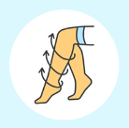
Types of Prophylaxis
There are two types of prophylaxis:
Pharmacological prophylaxis:
Examples include enoxaparin (Clexane™), dalteparin (Fragmin™) or unfractionated heparin. These are usually administered subcutaneously
NB: Some women may require therapeutic doses of prophylaxis during their pregnancies
Mechanical prophylaxis:
Examples include anti-embolic stockings, intermittent pneumatic compression or foot impulse devices
Notes:
Some women may need therapeutic doses of anticoagulation rather than prophylactic doses, particularly if they were on long-term anticoagulation prior to and/or during pregnancy as discussed earlier

Slide 41
Prescribing
If eMeds (or similar electronic prescribing systems) are in place, prescribe prophylaxis appropriately
If paper charting is in use, then the VTE section of the NIMC should be completed:
1) Complete and sign the VTE risk assessment box
2) Prescribe any pharmacological prophylaxis within this section
3) Prescribe any mechanical prophylaxis within this section
Image taken from: Australian Commission on Safety and Quality in Health Care. 2015. NIMC VTE Prophylaxis Section, http://www.safetyandquality.gov.au/our-work/medication-safety/medication-chart/nimc/vteprophylaxis/
Notes:
The regular NIMC contains a dedicated VTE section. Where this chart is used, the Medical Officer must prescribe pharmacological and / or mechanical prophylaxis within the dedicated section. Prescribing outside of this section may lead to duplication of orders and risk of patient harm. Where other versions of the NIMC without this section are in use, such as the longstay chart, prescribing should be completed within the normal sections. Checks associated with mechanical prophylaxis must also be documented at least twice daily by nursing staff / midwives. Checks should be documented on the NIMC, where mechanical prophylaxis has been prescribed.

Slide 42
Prescribing
If the women is an outpatient OR to be discharged on prophylaxis, ensure an appropriate outpatient prescription is provided

Slide 43
Mechanical Prophylaxis
Midwife Responsibilities
Regular monitoring of mechanical prophylaxis to ensure correct application
Check morning and evening shift
skin integrity (colour, warmth, pulse, pressure area)
stockings are being worn
responsible clinician signs their initials in the space provided when the check has been satisfactorily completed
NB: Graduated compression stockings may increase the risk of falls in mobilising women. Approved non-slip oversocks or appropriate footwear should be worn to avoid falls.
Notes:
Mechanical prophylaxis requires regular surveillance.

Slide 44
Practise VTE Risk Assessments

Slide 45
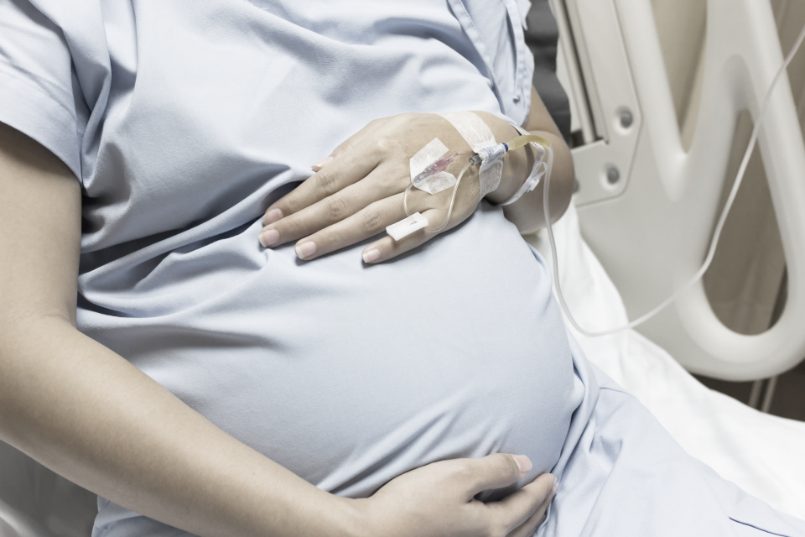
Using the Tool
Example ONE
Presentation:
Presented at 36+5 with PPROM
Multiple pregnancy
PPH (1.2L) requiring blood transfusion
Patient Background:
29 years old
Smoker
Medication History:
Mild migraines
Medications:
Nil regular
Assess risk at Day 0 postnatal

Slide 46
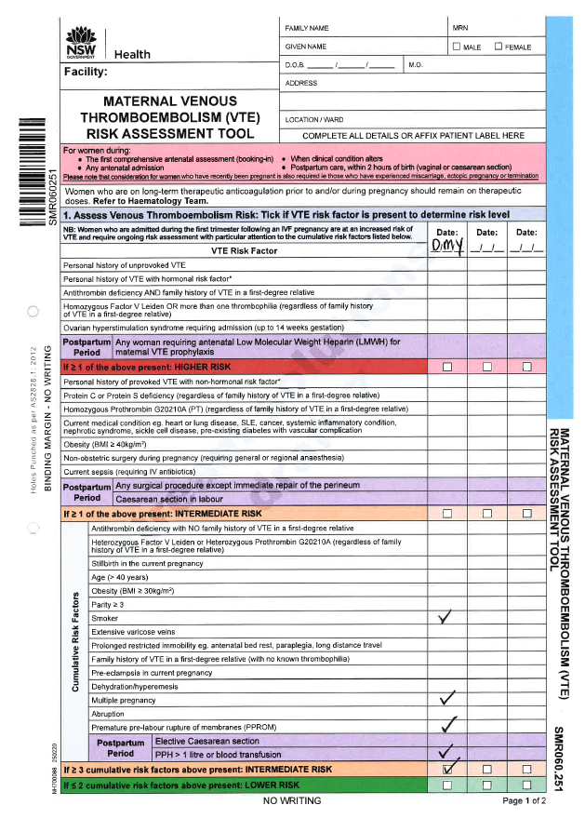
Using the Tool
Example ONE
Take some time to complete Step 1.

Slide 47
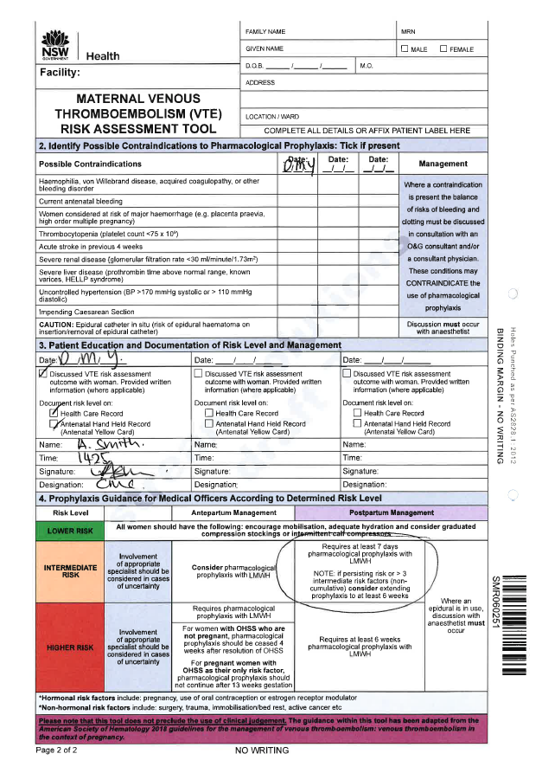
Using the Tool
Example ONE
Take some time to complete Steps 2 to 4.

Slide 48
Using the Tool
Example TWO
Presentation:
Presented at 6+1 with OHSS
Requires admission
Patient Background:
41 years old
Medication History:
Previous VTE following ankle surgery 3 years ago
Medications:
Nil regular
Assess risk on hospital admission

Slide 49
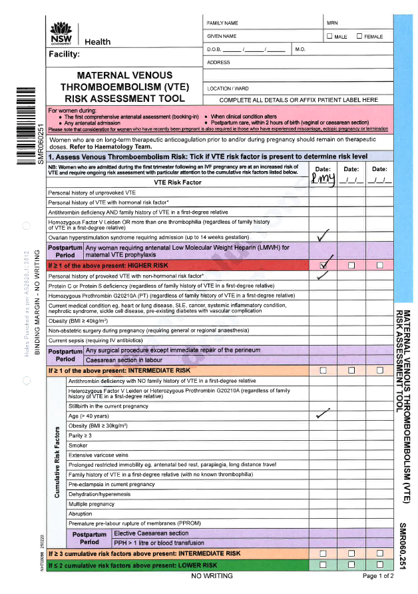
Using the Tool
Example TWO
Take some time to complete Step 1.

Slide 50
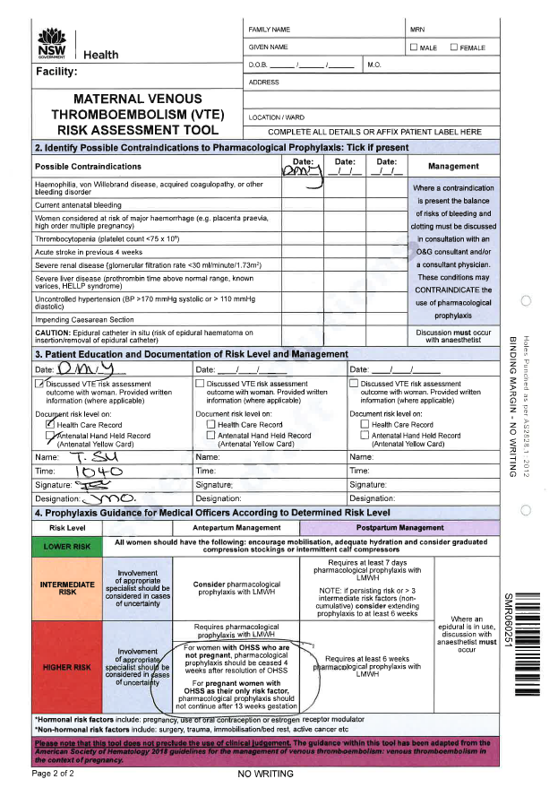
Using the Tool
Example TWO
Take some time to complete Steps 2 to 4.

Slide 51
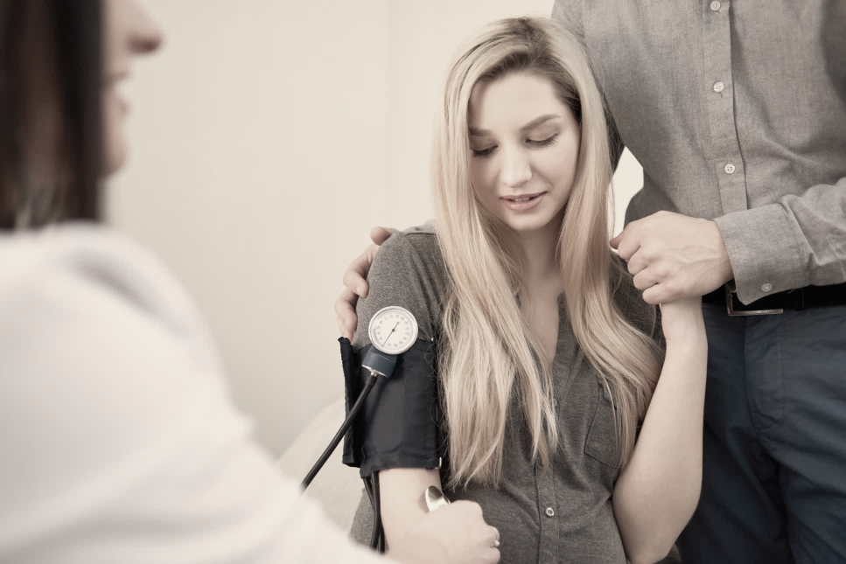
Using the Tool
Example THREE
Presentation:
Antenatal booking
8+3 gestation
Patient Background:
31 years old
Obesity (BMI 34kg/m²)
Medication History:
Nil significant
Medications:
Antenatal vitamins
Assess risk at booking-in

Slide 52
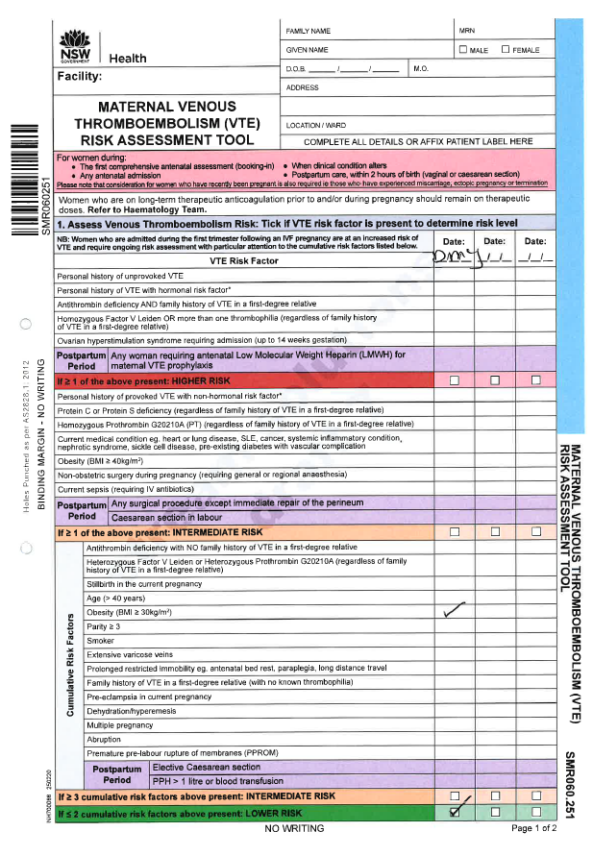
Using the Tool
Example THREE
Take some time to complete Step 1.

Slide 53
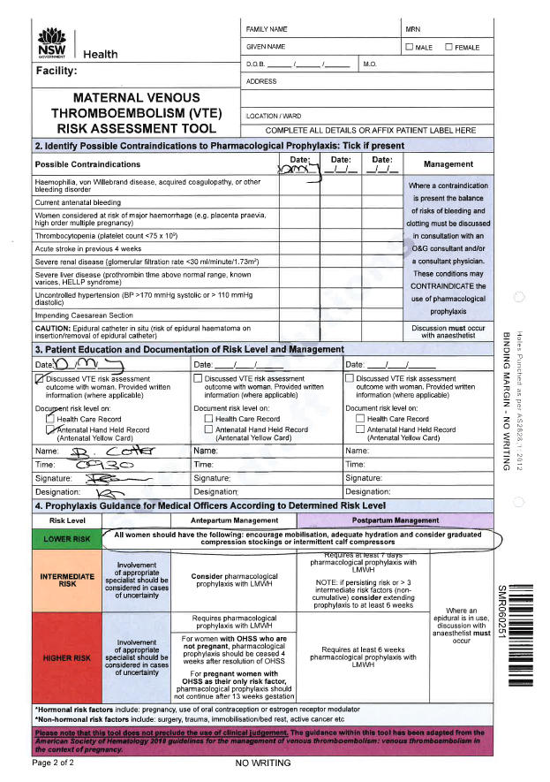
Using the Tool
Example THREE
Take some time to complete Steps 2 to 4.

Slide 54
Questions/Concerns

Slide 55
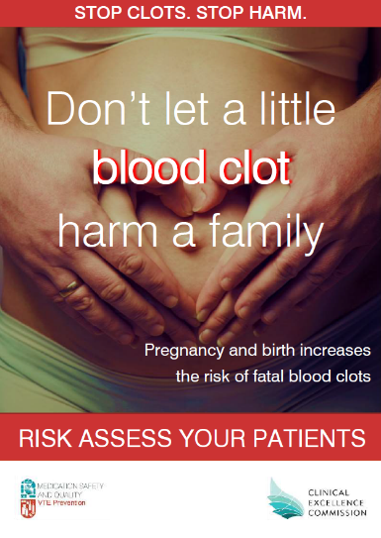
Summary
VTE affects women during their pregnancy
VTE is highly preventable
The Maternity VTE Risk Assessment Tool aids in assessing and managing VTE risk in women throughout their journey
It is intended to provide guidance. The tool does not preclude the use of clinical judgment and discretion
VTE prevention is a team effort and is everybody’s business
Notes:
Poster available on CEC webpage: http://www.cec.health.nsw.gov.au/patient-safety-programs/adult-patient-safety/vte-prevention/maternity

Slide 56
www.cec.health.nsw.gov.au

