Slide 1
Preliminary risk assessment
Immediacy, accountability, kindness
<These slides can incorporated into / adapted for use in local education sessions or training programs. There is also a brief version available for those wanting more detail>
Notes:
This brief provides you with information about Preliminary Risk Assessment – The Preliminary Risk Assessment forms an important part of NSW Health’s early response to our most serious incidents.

Slide 2
When things go wrong
Our guiding principles
Immediacy
We act immediately when people are harmed or at risk of harm.
Accountability
We are open when things go wrong.
We review to learn.
We make changes to improve.
We share what we find and learn.
Kindness
We are caring.
We are fair and just.
We support all who are affected.
Notes:
Australia is one of the safest healthcare systems in the world. Our clinicians and teams are committed to providing the very best and safest care.
On occasion things do go wrong and errors are made that lead to poor outcomes for patients, carers and their families.
In response to incidents, our guiding principles for action are
1) Immediacy - We act immediately when people are harmed or at risk of harm. We put measures in place to address care needs, reduce risk and support everyone effected.
Accountability - We are open with patients and their families when things go wrong. We seek to learn by reviewing what happened and making changes to improve our system. We share what we find with others to reduce the likelihood of another incident occurring.
Kindness – We are caring and support everyone who is impacted on by the incident. We put measures in place to meet the needs of our patient, families and staff. We have an open and just culture that holds people accountable but doesn’t place blame. Our focus in on learning.

Slide 3
What is a preliminary risk assessment (PRA)?
An initial assessment following a serious incident to guide the next steps.
Allows for earlier identification of risks and earlier communication with family.
Notes:
Let’s begin by looking at what a preliminary risk assessment is?
A preliminary risk assessment or PRA is an initial assessment following a serious incident to guide the next steps.
It allows for earlier identification of risks and earlier communication with family.

Slide 4
Who undertakes a PRA?
Chief Executive appoints a team of assessors
Appointment is via email, memo or standing appointment, meaning a standing team of assessors who are part of every PRA.
Notes:
Who undertake the PRA?
The PRA is completed by a team of assessors who are appointed by the Chief Executive.
The appointment process if formalised via email or memo. Some LHDs may have a standing appointment for PRA assessors meaning that there is a standing team who are part of every PRA.

Slide 5
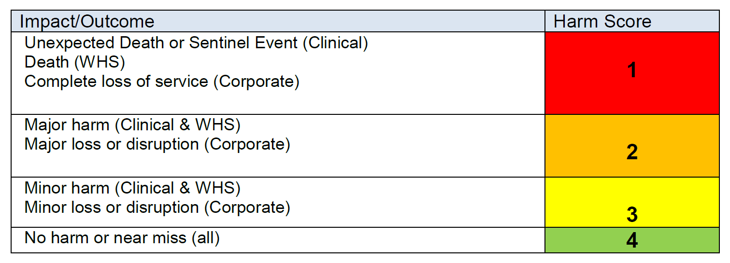
When is a preliminary risk assessment (PRA) required?
Notes:
When is a PRA completed?
Here are our Harm Scores.
A PRA is completed for only the most serious incidents (PRESS ENTER TO BRING UP ANIMATION)
A PRA, is a requirement for all clinical Harm Score 1 incidents.
The Chief Executive may also appoint PRA assessors for any clinical incident they believe may be due to serious systemic issues.

Slide 6
What do PRA assessors do?
The PRA team work through a PRA template.
They visit the workplace and speak to staff and the family, read notes and may take photos.
Notes:
WHAT DOES THE PRA TEAM DO?
The PRA team work through a template either on ims+ or on paper.
To do this they visit the workplace and speak to staff, they read notes and may take photos of where the incident occurred.
They also meet with the family to gain if they are agreeable.

Slide 7
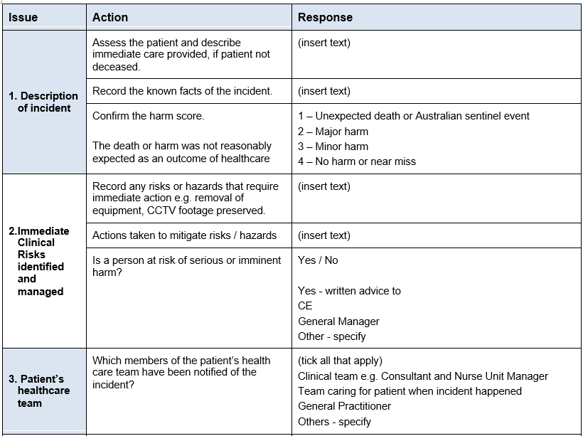
PRA template
Mandatory state-wide template
Completed on paper or in ims⁺
Optional action log available to assist assessors in tracking any actions arising from the assessment process.
Notes:
This is what the PRA template looks like. It includes action prompts to ensure that all of the required tasks are completed. There are drop down boxes and prompts built into ims+ that will assist the team
Although not mandatory, there is an action log available to assist teams in tracking the actions arising from the assessment process.

Slide 8
When does a PRA need to be completed?
Within 72 hours or sooner if directed by the Chief Executive or Ministry of Health
Notes:
A PRA needs to be completed within 48-72 hours or sooner if directed by the Chief Executive or Ministry of Health

Slide 9
Dedicated family contact
During this time a dedicated family contact is assigned
This staff member is the primary point of contact for the family
They provide continuity from the time of the PRA until the completion of the review (and sometimes beyond).
Notes:
During this time a dedicated family contact is assigned
This is a staff member who because the primary point of contact for the family
They provide continuity from the time of the PRA until the completion of the review (and sometimes beyond).

Slide 10
Next Steps
What happens after the PRA?
The team work through the actions ensuring that any immediate risks are addressed and notifications made
The report is sent to the Chief Executive outlining the team’s understanding of the event and highlighting any outstanding issues that require action.
Assessors also provide a copy of the assessment to the serious adverse event review team.
Dedicated family contact initiates contact with the family
Notes:
WHAT HAPPENS NEXT?
The PRA team submit their report to the CE. The job is completed
The CE will take action and appoint a review team. The review team receive a copy of the PRA report
The dedicated family contact will touch based with the family, introduce themselves and invite the family to meet with the Open Disclosure team

Slide 11
PRA in context
Incident notification
RIB Part A
CE appoints PRA assessors
PRA completed
Dedicated family contact assigned
RIB Part B submitted
Family feedback
Review
Notes:
Let’s have a look at how the PRA fits into the bigger picture.
You can see that when a serious incident is notified, a reportable incident brief is submitted to the Ministry of Health.
The Chief Executive appoints PRA assessors who complete an initial assessment to guide next steps.
The dedicated family contact is assigned.
A more detailed Reportable Incident is submitted to the Ministry of Health
The family are invited to meet with the Open Disclosure Team to hear about the findings of the PRA
When all of those actions have been completed, the serious incident review process begins

Slide 12
Privilege for clinical incidents
What is covered?
During the PRA, the team generate documents including notes, records of interviews with staff, minutes of meetings and records of discussions with people. These documents and the final report are
privileged by law meaning they cannot be used as evidence in court.
Assessors must not share any of the documents or discussions with other people.
Notes:
A note on privilege for clinical incidents
The PRA attracts privilege. This means that assessors cannot be compelled to provide evidence in any proceedings.
During the PRA, the team will generate documents including notes, records of interviews with staff, minutes of meetings and records of discussions with people. These documents attract privilege
Assessors must not share any of the documents or discussions with other people.
It is important that Health Services develop processes to ensure that these documents are maintained in separate files and stored securely.

Slide 13
Preliminary risk assessment: Supporting our principles of immediacy, accountability and kindness For more information refer to the CEC Website www.cec.health.nsw.gov.au
Notes:
For templates and additional information relating to Preliminary Risk Assessment, please refer to the CEC website

