Slide 1
Adult Venous Thromboembolism (VTE) Risk Assessment Tool
Name of presenter
Insert presenter’s position
Insert the presenter’s facility
Adult Venous Thromboembolism (VTE) Risk Assessment Tool,
Released 2015, updated 2021 © Clinical Excellence Commission 2015. SHPN (CEC) 210393

Slide 2
Acknowledgement of Country and Elders
Before we begin,
I would like to acknowledge the traditional owners of the land where we meet today.
I pay my respects to their Elders past and present.
It is upon their lands that we meet.
Notes:
This artwork has been commissioned by the CEC. It is called ‘Health Custodian’ and was created by Jasmine Sarin. Jasmine is a proud Kamilaroi (kuh-mi-luh-roy) and Jerrinja (jer-in-ja) woman from New South Wales.

Slide 3
Objectives
Provide an introduction to venous thromboembolism
Provide an overview of VTE Risk Assessment with regards to:
Using the VTE Risk Assessment Tool
Factors to consider when performing VTE risk assessments
Practise performing VTE Risk Assessments
Notes:
The purpose of this presentation is to provide an introduction to venous thromboembolism and how to assess and manage VTE risk using the adult inpatient VTE risk assessment tool. We will practise performing VTE risk assessments using three cases at the end of the presentation.

Slide 4
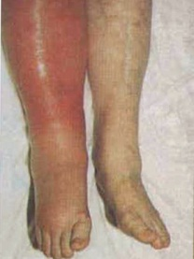
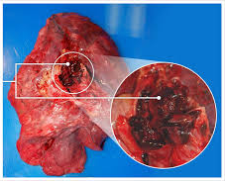
Venous Thromboembolism (VTE)
VTE
Deep Vein Thrombosis (DVT) | Pulmonary Embolism (PE)
Occurs in deep veins (most commonly in legs and groin) | Occurs after DVT dislodges and travels to the lungs
Can cause long-term issues – ‘post-thrombotic syndrome’ (PTS). PTS affects 23-60% of DVT patients within 2 years | Serious complication which can lead to death
Lower-extremity DVT has 3% PE-related mortality rate | Patients with PE have 30-60% chance of dying from it
Notes:
VTE is the term used to define cases of Deep Vein Thrombosis (DVT) and Pulmonary Embolism (PE).
DVTs as you know develop in the deep veins (most commonly in the lower leg). They can lead to ‘post-thrombotic syndrome’ (PTS), which can cause chronic symptoms including leg pain, swelling, redness, and ulceration. PTS affects 23-60% of DVT patients within 2 years.
The most serious complication of a DVT is that the clot could dislodge and travel to the lungs, becoming a Pulmonary Embolism (PE). In fact, lower-extremity DVT has a 3% PE-related mortality rate.
PE is a serious complication which can lead to death. Patients with PE have a 30-60% chance of dying from it.
We must remember that DVT and PE are not just single events, often patients suffer long-term complications.

Slide 5
What causes VTE?
Virchow’s Triad = categories of factors contributing to blood clot formation
Stasis
Alteration in normal blood flow
VIRCHOW’S TRIAD
Endothelial Injury
Injury or trauma to the inside of the blood vessel
Hypercoagulability
Alteration in the constitution of blood causing blood to clot more easily
Notes:
Virchow was the first to explain the categories of factors that contribute to the formation of thrombosis
Stasis e.g. due to varicose veins, prolonged travel, immobility
Hypercoagulability or the activation of coagulation e.g. due to inherited bleeding disorders, cancer, or during pregnancy
Endothelial Injury i.e. injury or trauma to the inside of the blood vessel

Slide 6
The Impact of VTE
More than 14,000 Australians develop a VTE per year
More than 5,000 of them will die as a direct result
VTE causes 7% of all hospital deaths
Incidence 100 times greater in hospitalised patients than community residents
Largely preventable
Notes:
The impact of VTE is significant. An article by Access Economics estimated that in 2008 there were approximately 14 000 cases of VTE in Australia. Using epidemiological evidence, it was estimated that VTE was responsible for more than 5000 deaths.
It is estimated that VTE causes 7% of all hospital deaths and the incidence is 100 times greater in hospitalised patients than in community residents.
Often these are just numbers to us, we might not experience what VTE actually does to patients, or we don’t see the impact often enough to warrant concern.
What does the harm VTE imposes actually mean for our patients on a case by case level?
What is the real harm?
Reference: Access Economics. The burden of venous thromboembolism in Australia. Report by Access Economics Pty Limited for the Australian and New Zealand Working Party on the management and prevention of venous thromboembolism, 2008.

Slide 7
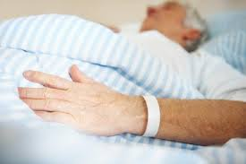
What’s the Harm?
71-year-old male
C/O: L hip pain
Hx: recent L THR
Recent fall, injury to knee
Underwent closed reduction
L knee Zimmer splint to prevent dislocation
Difficultly mobilising
Notes:
A 71 year old man presented to hospital with left hip pain on the background of a left total hip replacement. He had a recent fall resulting in a knee injury and underwent surgery (closed reduction) and had a left knee Zimmer splint applied post-operatively to prevent dislocation. He had difficulty mobilising.

Slide 8
What’s the Harm?
10 days post-op: noticed nil VTE prophylaxis
Prophylaxis prescribed
Physio
Collapse and LOC → MET
Cardiac arrest → deceased
Coroner’s report: PE at time of death
Notes:
Ten days post-operatively, it was noticed that he had no prescribed VTE prophylaxis despite his immobility. Prophylaxis was prescribed, however later that day, while with the physiotherapist, he collapsed and lost consciousness, resulting in a MET call. The patient later passed away from cardiac arrest. The Coroner’s preliminary report suggests pulmonary embolism at time of death.

Slide 9
Risk of VTE – No Prophylaxis
No prophylaxis + routine objective screening for DVT
Patient Group | DVT Incidence
Medical patients | 10-26
Major gynaecological, urological or general surgery | 15-40
Neurosurgery | 15-40
Stroke | 11-75
Hip or knee surgery | 40-60
Major trauma | 40-80
Spinal cord injury | 60-80
Critical care patients | 15-80
Notes:
This table shows the incidence of DVT in specific patient groups who do not receive VTE prophylaxis. In medical patients, the incidence is 10-26%. In higher risk patients such as those who have had hip or knee surgery, experienced major trauma or spinal cord injury, the incidence can be as high as 80%.
Reference: Agency for Healthcare Research and Quality. Preventing Hospital-Acquired Venous Thromboembolism. A Guide for Effective Quality Improvement. August 2008.

Slide 10
What’s the Harm?
VTE
Mortality
Readmission
Increased LOS
Post-thrombotic syndrome
Morbidity
Fatal PE
Notes:
VTE causes a significant mortality and morbidity burden.
Of course deaths from PEs concern us, but the impact of DVT also warrants action. We can see more readmissions, increased LOS and the possibility that many patients with DVT may then develop post thrombotic syndrome (PTS).
PTS affects 23-60% of DVT patients within 2 years.
Chronic symptoms including leg pain, swelling, redness, and ulceration.

Slide 11
The VTE Prevention Program
Guidelines
VTE Prevention Framework
Revised Policy Directive
Tools
Electronic support through eMR
Audit / performance monitoring tool
Education and Raising Awareness
eLearning module for clinicians
VTE Risk Assessment Tool
Non-fatal VTE Incident Management Tool
Revised NIMC with dedicated VTE section
Educational resources for clinician training
Patient education material
Posters focused on patients, and clinicians
Notes:
The CEC has developed a program to reduce the incidence of hospital-associated VTE state-wide. Studies suggest that there is variability in how VTE risk is assessed and managed. This is part of the complexity associated with implementing VTE prevention processes. International evidence suggests that standardised approaches to VTE prevention are effective in reducing the incidence of hospital-acquired VTE. A VTE Risk Assessment Tool has been developed to aid facilities with standardising their approach to VTE risk assessment.
The tool’s development: A study was conducted to test and evaluate the reliability and user acceptability of five risk assessment tool models. Based on the results of this study and extensive consultation through the CEC’s VTE Expert Advisory Group which includes medical, surgical, pharmacy and nursing representation, the VTE Risk Assessment and Prophylaxis Orders, San Diego Medical Center tool was adapted leading to the development of the NSW adult inpatient VTE Risk Assessment Tool. Guidance was largely based on NHMRC guidelines as you will see in the tool.

Slide 12
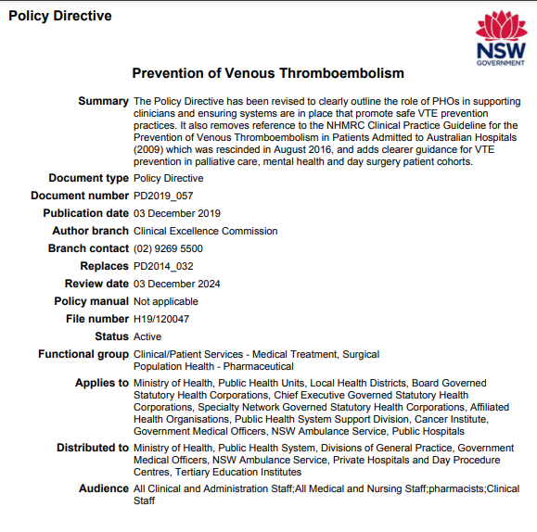
VTE Risk Assessment
The NSW Health Prevention of Venous Thromboembolism policy states that the MO must :
Assess VTE risk within 24 hours of admission
Review bleeding risk and prescribe appropriate prophylaxis
Discuss treatment with the patient
Document VTE risk assessment and prophylaxis treatment
Reassess VTE risk regularly (at least every 7 days), if clinical condition changes, and at transfer of care
Notes:
The Policy Directive: Prevention of Venous Thromboembolism (PD2014_032) states the Medical Officer must assess and manage VTE risk
-Within 24 hours of admission
-at least every 7 days, if clinical condition changes and at transfer of care

Slide 13
About the VTE Risk Assessment Tool
The CEC’s Adult Venous Thromboembolism Risk Assessment Tool was developed to:
aid MOs with assessing and managing VTE risk
provide a standardised approach to VTE Risk Assessment
provide a form of documentation showing the MO’s risk assessment process and decision
Please note:
The tool should be used for ADULT INPATIENTS only and be filed with the patient’s PROGRESS NOTES
Taking a comprehensive admission history streamlines the VTE risk assessment process and minimises the time it takes to complete an assessment.
Notes:
The CEC has developed a double sided VTE Risk Assessment Tool to guide VTE risk assessment and the prescribing of appropriate prophylaxis. There are several advantages to using the tool. These include: 1) it assists medical officers with appropriately assessing and managing VTE risk, that is, it provides clinical decision support 2) it provides a standardised and evidence-based approach to VTE risk assessment and management. We know from international experience that standardised approaches reduce variability and are effective in reducing the incidence of hospital-acquired VTE 3) the tool provides a form of documentation showing the medical officer’s risk assessment process and decision (i.e. which risk factors and bleeding risks the medical officer took into account when making the decision). While this is important from a medico-legal point of view, this clear documentation serves as a communication tool between members of the multidisciplinary team. Other members of the multidisciplinary team are able to see how the medical officer made the decision and which risk factors/bleeding risks were considered. For example, a pharmacist or nurse may be wondering why a patient did not receive pharmacological and/or mechanical prophylaxis. In such cases, s/he can refer to the tool and see that this was because the patient had documented contraindications.
The tool is intended for use in ADULT INPATIENTS and should be filed with patient’s progress notes.
Taking a comprehensive admission history streamlines the VTE risk assessment process. It should only take 1-2 minutes to complete a VTE risk assessment if a comprehensive admission history is taken.

Slide 14
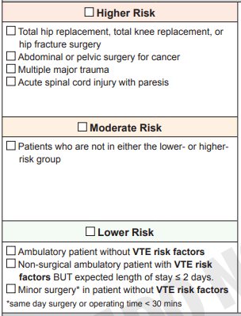
Using the VTE Risk Assessment Tool
Step 1:
The first section prompts MOs to:
Assess baseline risk according to 3 risk categories
Higher Risk
Some types of surgeries and injuries put patients at a higher risk of developing VTE
Moderate Risk
Lower Risk
Then
Assess additional risks posed by hospitalisation or illness.
Notes:
The first section of the tool prompts medical officers to assess baseline risk then consider additional risk factors posed by hospitalisation or illness. Some types of surgery such as total hip or knee replacement surgery and abdominal or pelvic surgery for cancer put patients at a high risk of developing VTE. Patients with multiple major trauma or acute spinal cord injury with paresis are also at a high risk of developing VTE.
Lower risk patients are those who are ambulatory without VTE risk factors or those who are ambulatory with VTE risk factors but their expected length of stay is less than or equal to 2 days. Patients undergoing minor surgery (that is, same day surgery or operating time less than 30 minutes) without VTE risk factors are also considered lower risk patients. Patients who are not in the higher or lower risk categories are at moderate risk of developing VTE.

Slide 15
VTE Risk Factors
Intrinsic Risk Factors
Age > 60 years
Obesity (BMI > 30kg/m²)
Prior history of VTE
Pregnancy or post-partum
Known thrombophilia (including inherited disorders)
Varicose veins
Extrinsic Risk Factors
Significantly reduced mobility (relative to normal state) due to injury or illness
Active malignancy or treatment with chemotherapy
Use of HRT or oral contraception
Surgical intervention, particularly major orthopaedic surgery or abdominal/pelvic surgery for cancer
Active infection
Inflammatory bowel disease
Notes:
Risk factors can be intrinsic i.e. individual patient risk factors such as age or extrinsic i.e. those associated with external circumstances. While intrinsic and extrinsic risk factors are listed on the slide, this is not an exhaustive list.
Most patients admitted to hospital will have at least one VTE risk factor and most will have reduced mobility compared to normal state.

Slide 16
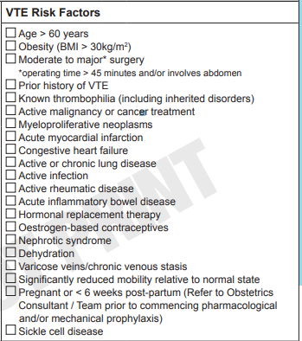
VTE Risk Factors
Before ticking relevant boxes, consider transient VTE Risk factors which could be removed. For e.g.
Dehydration
Consider hydration unless contraindicated due to clinical condition e.g. fluid restriction due to congestive cardiac failure.
Medications containing oestrogen (HRT and oestrogen-based contraceptives)
Review current evidence: risks of unplanned pregnancy vs. benefit of VTE prevention
If appropriate, consider discontinuing HRT or oestrogen- containing oral contraceptives. Consult senior clinician when making this decision.
Communicate risks of stopping contraceptives to the patient and arrange alternative contraception until restarted
Notes:
Some risk factors may be transient, that is, they are temporary. If possible, the elimination of such risk factors may alter a patient’s risk level and management. For example, dehydration may be treated. Consider hydration unless contraindicated due to the patient’s clinical condition, for example, the patient may be fluid restricted due to congestive cardiac failure.
Medications containing oestrogen such as hormone replacement therapy (HRT) and oestrogen-based contraceptives can increase the risk of VTE. If appropriate, consider discontinuing these medications in consultation with a senior clinician. In the case of oral contraceptives, VTE risk is dependent on the dose of oestrogen, the progestogen and the presence of other risk factors. Before ceasing oestrogen-containing contraceptives, review current evidence when weighing the risk of unplanned pregnancy and the benefits of VTE prevention. Studies suggest that the likelihood of VTE in pregnancy is higher than the likelihood of VTE when using combined oral contraceptives. If discontinuing contraceptives, communicate the risks of cessation to the patient and refer her to the GP for management post-discharge. Following discharge, the patient may need to use additional contraceptive methods until they have taken active pills for 7 days.

Slide 17
VTE Risk and Other Medications
Other medications may increase the risk of developing VTE, particularly during periods of immobilisation or following surgery.
For example,
Tamoxifen
Epoetin alfa
Strontium ranelate
Raloxifene
Consider the temporary cessation of such agents or use VTE prophylaxis where appropriate. Consult senior clinician when making this decision.
Notes:
Other medications may increase the risk of developing VTE, particularly when the patient is immobilised or following surgery.
Consider the temporary cessation of such agents or use VTE prophylaxis where appropriate. Consider the risk of ceasing these medications vs. the benefits of VTE prevention. Consult a senior clinician when making this decision.

Slide 18
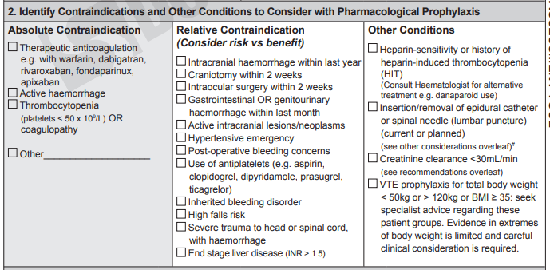
Using the VTE Risk Assessment Tool
Step 2:
The second section prompts MOs to identify:
contraindications to pharmacological prophylaxis
Absolute: Pharmacological prophylaxis should NOT be prescribed
Relative: Pharmacological prophylaxis MAY be prescribed, consider risks vs. benefits of prescribing
other conditions to consider with pharmacological prophylaxis
Notes:
The second section prompts medical officers to identify contraindications to pharmacological prophylaxis. Some contraindications are absolute, so pharmacological prophylaxis must not be prescribed. Other contraindications are relative. This means that the risks and benefits of prescribing should be considered. If unsure, consult a senior clinician.

Slide 19
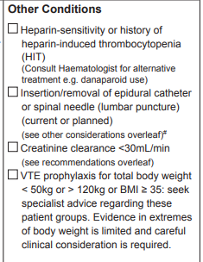
Other conditions to Consider with Pharmacological Prophylaxis
These conditions may require special courses of action. For e.g.
- Heparin-sensitivity or history of heparin-induced thrombocytopenia (HIT)
Consult haematologist for alternative treatment to LMWH/heparin e.g. danaparoid
Calculate a 4Ts score (available via MDCALC) to help assess the likelihood of the patient having HIT http://www.mdcalc.com/4ts-score-heparin-induced-thrombocytopenia/
- the insertion or removal of an epidural catheter or spinal needle (lumbar puncture) should be carried out:
≥ 4 hours before a prophylactic dose of LMWH AND
≥ 10 hours after a previously administered dose
Note the hash #
Notes:
There are other conditions to consider when determining if pharmacological prophylaxis. These may involve consulting relevant medical personnel. For example, in the case of heparin-sensitivity or heparin-induced thrombocytopenia, it is important to consult a haematologist for alternative treatment to unfractionated heparin and Low Molecular Weight Heparins (LMWH) such as enoxaparin and dalteparin. An alternative agent may be danaparoid, however a haematologist must be consulted. If there is suspicion of HIT, the haematologist may ask you to calculate a 4Ts score to help assess the likelihood of the patient having HIT.
Other considerations include the insertion/removal of an epidural catheter or spinal needle (lumbar puncture). Note the hash in section 5 which states, ‘insertion or removal of epidural catheter or spinal needle (lumbar puncture) should be carried out ≥ 4 hours before a prophylactic dose of LMWH AND ≥ 10 hours after a previously administered dose. For all surgery and imaging guided invasive procedures (particularly if central neural blockade is used), the timing of pharmacological prophylaxis should be carefully planned with the anaesthetist to minimise the risk of developing an epidural haematoma.
Other considerations include:
Renal impairment: calculate Creatinine Clearance (CrCl) using the Cockcroft-Gault equation. CrCl is important for determining the correct choice and dose of agents. Anticoagulants such as LMWH, oral anticoagulants and fondaparinux are renally-cleared. CrCl Calculators are available in references such as the Australian Medicines Handbook or online through MDCalc.
Acute stroke: seek advice from stroke service
Neurosurgery: seek advice from Neurosurgery Consultant
Weight less than 50kg or greater than 100kg, consider dose adjustment as per local guidelines

Slide 20
Anaesthesia and VTE
The type of anaesthesia a patient receives impacts on VTE risk.
Patients receiving regional anaesthesia (also referred to as central neural blockade) have significantly lower rates of DVT compared with those receiving general anaesthesia.
Other timing considerations:
No pharmacological prophylaxis with LMWH should be administered prior to establishment of neural blockade, or the block should be performed ≥ 12 hours after the last dose of LMWH if preoperative prophylaxis has been administered with this drug. Dosing after surgery should start ≥ 6 hours post-operatively.
Fondaparinux and dabigatran etexilate have longer half-lives: special arrangements should be made between the surgical and anaesthetic teams if these drugs are being used.
Notes:
For all surgery and imaging guided invasive procedures (particularly if central neural blockade is used), the timing of pharmacological prophylaxis should be carefully planned with the anaesthetist to minimise the risk of developing an epidural haematoma.
The type of anaesthesia a patient receives impacts on VTE risk.
Patients receiving regional anaesthesia (also referred to as central neural blockade) have significantly lower rates of DVT compared with those receiving general anaesthesia.
Other timing considerations (according to NHMRC recommendations):
No pharmacological prophylaxis with LMWH should be administered prior to establishment of neural blockade, or the block should be performed ≥ 12 hours after the last dose of LMWH if preoperative prophylaxis has been administered with this drug. Dosing after surgery should start ≥ 6 hours post-operatively.
Fondaparinux and dabigatran etexilate have longer half-lives: special arrangements should be made between the surgical and anaesthetic teams if these drugs are to be used.

Slide 21
Using the VTE Risk Assessment Tool
Step 3:
The third section prompts MOs to consider contraindications to mechanical prophylaxis:
Mechanical prophylaxis may be appropriate despite the presence of some ‘contraindications’: use your clinical judgement
Consider severity, extent and location of the contraindication e.g. skin ulceration
Some types of mechanical prophylaxis may be suitable in certain conditions (see brackets for suggestions).
Notes:
Step 3 of the tool is about identifying contraindications to mechanical prophylaxis.
Mechanical prophylaxis may be appropriate despite the presence of some contraindications which may be ‘relative’ contraindications’. Consider the severity, extent and location of the condition and use your clinical judgement when assessing contraindications to mechanical prophylaxis. For example:
Skin ulceration – Compression can be used if ulceration caused by venous insufficiency, this would of course depend on the degree of ulceration
Severe dermatitis – Compression could be considered in certain circumstances. For example, if caused by venous stasis
Lower leg trauma – depends on the degree and location of trauma and the non-affected leg could still be compressed
Some types of mechanical prophylaxis may be suitable in certain conditions (see brackets for suggestions).

Slide 22
More on Mechanical Prophylaxis
Note the following:
Intermittent Pneumatic Compression (IPC) or Foot Impulse Devices (FID) can exacerbate lower limb ischemic disease and are contraindicated in patients with peripheral arterial disease or arterial ulcers
IPC is contraindicated in acute lower limb DVT
Notes:
It should also be noted that:
Intermittent Pneumatic Compression (IPC) or Foot Impulse Devices (FID) can exacerbate lower limb ischemic disease and are contraindicated in patients with peripheral arterial disease or arterial ulcers
IPC is contraindicated in acute lower limb DVT.
The NHMRC notes that a recent study provides no evidence to support the routine use of graduated compression stockings in immobile, hospitalised patients following acute stroke.

Slide 23
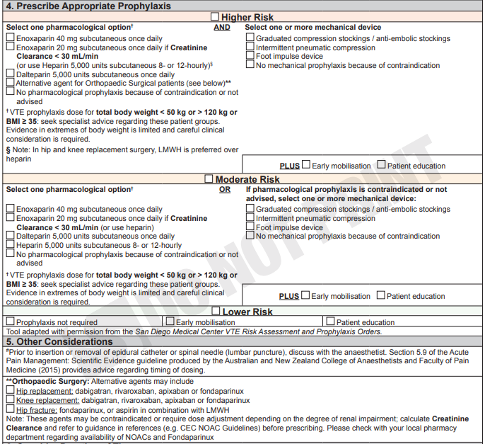
Using the VTE Risk Assessment Tool
Steps 4 and 5:
Provides prescribing guidance based on risk categories.
Points to consider:
encourage early mobilisation and provide patient education for ALL patients regardless of risk level
keep patients adequately hydrated (unless contraindicated due to their clinical condition e.g. fluid restriction due to CCF)
dosing adjustment in renal impairment
preference for Low Molecular Weight Heparin (LMWH) such as enoxaparin or dalteparin in hip and knee replacement surgery §
alternative oral agents may be used for Orthopaedic Surgical patients *
where pharmacological prophylaxis is contraindicated, mechanical prophylaxis could be considered, as indicated, till the patient is mobile.
*
§
*
Notes:
The second side of the tool provides guidance on prescribing based on VTE risk categories. This section is intended to provide guidance only and does not preclude the use of clinical judgement.
In the higher risk category, pharmacological and mechanical prophylaxis can be used unless contraindications are present. In orthopaedic surgical patients, alternative oral agents may be considered.
In moderate risk patients, pharmacological prophylaxis can be used or mechanical prophylaxis if pharmacological prophylaxis is not being prescribed. While some types of mechanical prophylaxis may not be appropriate depending on the patient’s conditions, others might be suitable. Cross-reference to Step 3 (identify contraindications to mechanical prophylaxis) when prescribing mechanical prophylaxis.
Lower risk patients do not require pharmacological or mechanical prophylaxis.
Consider the need to adjust dosages in renal impairment. Renal function is estimated using the Cockcroft-Gault Equation which requires you to know the patient’s bodyweight and serum creatinine levels. When calculating renal function, use ideal or actual bodyweight, whichever is lower. Creatinine Clearance calculators are available in references such as the Australian Medicines Handbook (AMH) or online (MDCalc).
Consult your pharmacist for advice on dosing.
ALL patients should receive education and be encouraged to mobilise early regardless of their risk category. A plan for early mobilisation should be developed by a multidisciplinary team with the patient and their family/carer.
Other additional prevention strategies such as hydration should also be considered (unless hydration is contraindicated due to a clinical condition such as congestive cardiac failure).

Slide 24
Pharmacological Prophylaxis
Main anticoagulants include:
Drug Class | Agents
Unfractionated heparin | Unfractionated heparin | Preferred in patients with renal impairment
LMWH | Enoxaparin Dalteparin | Most commonly used agents Require dosage adjustment in renal impairment
Factor Xa inhibitors | Apixaban Rivaroxaban | Alternative for prophylaxis in post- hip or knee replacement
 | Fondaparinux | Alternative for prophylaxis in post- hip or knee replacement and hip fracture surgery
Direct thrombin inhibitors | Dabigatran | Alternative for prophylaxis in prophylaxis post- hip or knee replacement
Heparinoid | Danaparoid | Used in heparin-sensitivity or HIT
Notes:
The main anticoagulants used in VTE prevention include unfractionated heparin, Low Molecular Weight Heparins (LMWH) such as enoxaparin and dalteparin, Factor Xa inhibitors, direct thrombin inhibitors and heparinoids such as danaparoid.
Some agents may be preferred over others in particular clinical settings.

Slide 25
Using the VTE Risk Assessment Tool
Step 6:
Consider duration of therapy:
VTE prophylaxis use is recommended till the patient regains normal mobility
In some cases, it may be needed post-discharge. For e.g. in hip and knee surgery
Consider the patient’s ongoing management if prophylaxis is required post-discharge:
Patient education
Discharge medication supply
Inform GP/relevant HCP via discharge summary
Notes:
VTE prophylaxis is recommended to be continued until the patient regains his/her normal mobility.
Pharmacological prophylaxis may need to be continued beyond the hospital stay, particularly in the case of joint replacement surgery (hip and knee).
If this is the case, consider the patient’s ongoing management:
Organise discharge supply of the medication
Inform the GP of the patient’s post-discharge VTE risk management plan via the discharge summary
Determine if the patient or the patient’s carer is able to manage injections (alternatively use oral agents if appropriate). If not, consider alternative arrangements to ensure continuity in the patient’s management (e.g. GP, HITH, ambulatory care units, community nursing etc.)
Provide the patient with education and encourage mobilisation post-discharge.

Slide 26
NIMC VTE Section
Please ensure that the VTE section of the NIMC is also completed by:
1) Completing and signing the VTE risk assessment box
2) Prescribing pharmacological and/or mechanical prophylaxis in the appropriate sections (if VTE prophylaxis is required)
Image taken from: Australian Commission on Safety and Quality in Health Care. 2015. NIMC VTE Prophylaxis Section, http://www.safetyandquality.gov.au/our-work/medication-safety/medication-chart/nimc/vteprophylaxis/
Notes:
It is also important to ensure that the VTE risk assessment box of the National Inpatient Medication Chart (NIMC) is completed by ticking the relevant box/es and signing the section.
Prophylactic doses of anticoagulants should be prescribed in the VTE prophylaxis section of the NIMC. Therapeutic doses of anticoagulants should be prescribed in the regular section of the NIMC.
Mechanical prophylaxis should be prescribed in the dedicated section.
For more information on the VTE section of the NIMC, refer to the Australian Commission on Safety and Quality in Health Care’s website: http://www.safetyandquality.gov.au/our-work/medication-safety/medication-chart/nimc/vteprophylaxis/

Slide 27
Using the Tool: Example 1
Please use the VTE Risk Assessment Tool to assess and manage the patient’s VTE Risk.
Presenting Problem: BIBA for pain management
Admitting Team: Orthopaedics
Patient Background:
Male
86-year-old
Creatinine clearance 29mL/min
WCC: 9.0
RCC: 4.7
Hb: 131
Platelets: 155
Neutrophils: 2.5
Lymphocytes: 2.0
BP: 121/65
Medical History:
Hip replacement - 2 weeks ago
Lung Ca (refused chemo) – diagnosed 1 month ago
Gastric ulcer bleed – 2 weeks ago
Previous VTE
Medications:
Panadol Osteo 665mg tds
Pantoprazole 20mg daily
Creatinine clearance for all patients has been calculated using the Cockcroft-Gault Equation. Calculator can be accessed at: http://www.mdcalc.com/creatinine-clearance-cockcroft-gault-equation
Blood Count Reference Ranges
WCC: 4.0 – 10.0 10^9/L
RCC: 4.5 – 5.5 10^12/L (male)
3.8 – 4.8 10^12/L (female)
Hb: 130 – 170 g/L (male)
120 – 150 g/L (female)
Platelets: 150 – 400 10^9/L
Neutrophils: 2.0 – 7.0 10^9/L
Lymphocytes: 1.0 – 3.0 10^9/L
Any significantly abnormal results are marked with (H) High or (L) Low
Notes:
This is a case of an 86 year old male, brought in by ambulance for pain management. He was admitted under the Orthopaedics team.
Medical History:
Hip replacement - 2 weeks ago
Lung Ca (refused chemo) – diagnosed 1 month ago
Gastric ulcer bleed – 2 weeks ago
Previous VTE
Please use the VTE Risk Assessment Tool to assess and manage the patient’s VTE risk.

Slide 28
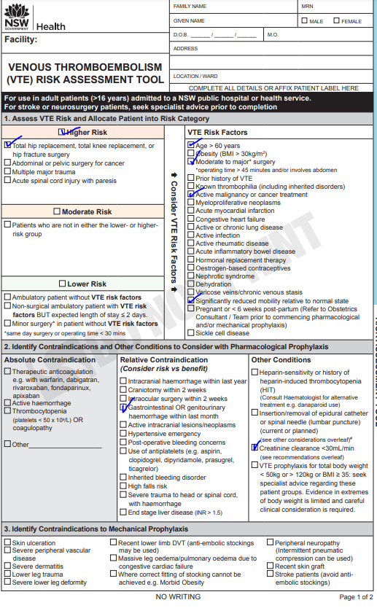
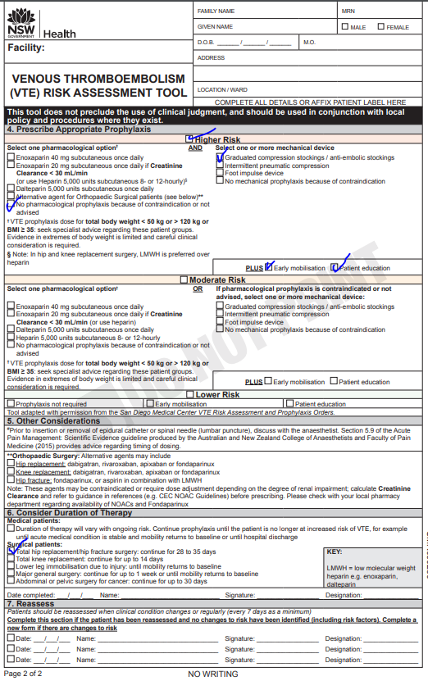
Example 1
PATIENT DETAILS
PATIENT DETAILS
Notes:
This patient has a high risk of VTE, with a high bleeding risk. Use mechanical prophylaxis only.

Slide 29
Using the Tool: Example 2
Presenting Problem: One week history of fatigue, SOB at rest, 7kg weight gain
Diagnosed with acute decompensated heart failure
Admitting Team: Cardiology
Patient Background:
Male
45-year-old
Obese
Creatinine clearance 35mL/min
WCC: 5.6
RCC: 4.8
Hb: 150
Platelets: 298
Neutrophils: 5.5
Lymphocytes: 2.7
BP: 142/87
Please use the VTE Risk Assessment Tool to assess and manage the patient’s VTE Risk.
Creatinine clearance for all patients has been calculated using the Cockcroft-Gault Equation. Calculator can be accessed at: http://www.mdcalc.com/creatinine-clearance-cockcroft-gault-equation
Blood Count Reference Ranges
WCC: 4.0 – 10.0 10^9/L
RCC: 4.5 – 5.5 10^12/L (male)
3.8 – 4.8 10^12/L (female)
Hb: 130 – 170 g/L (male)
120 – 150 g/L (female)
Platelets: 150 – 400 10^9/L
Neutrophils: 2.0 – 7.0 10^9/L
Lymphocytes: 1.0 – 3.0 10^9/L
Any significantly abnormal results are marked with (H) High or (L) Low
Medical History:
Coronary artery disease
CABG 8 years ago
Hyperlipidemia
Hypertension
CCF
Medications:
Ramipril 5mg daily
Aspirin 100mg daily
Atorvastatin 80mg nocte
Metoprolol 50mg bd
Frusemide 20mg mane (stopped) – now on IV frusemide 20mg bd
Notes:
This is a case of a 45 year old male patient presenting with a one week history of fatigue, shortness of breath at rest and 7kg of weight gain. He has been diagnosed with acute decompensated heart failure and was admitted under the Cardiology team.
Medical History:
Coronary artery disease
CABG 8 years ago
Hyperlipidemia
Hypertension
CCF
Please use the VTE Risk Assessment Tool to assess and manage the patient’s VTE risk.

Slide 30
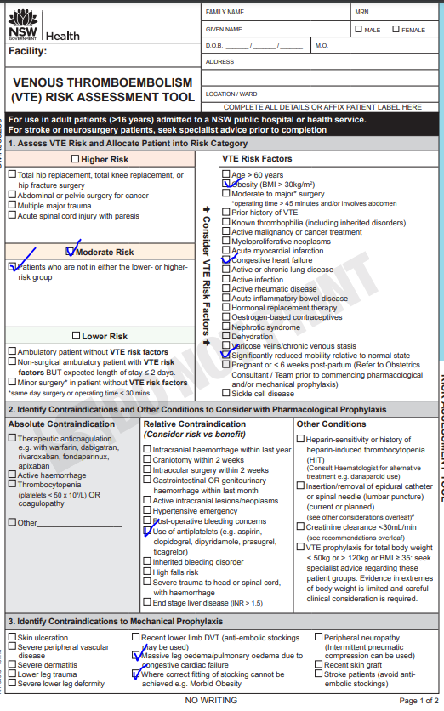
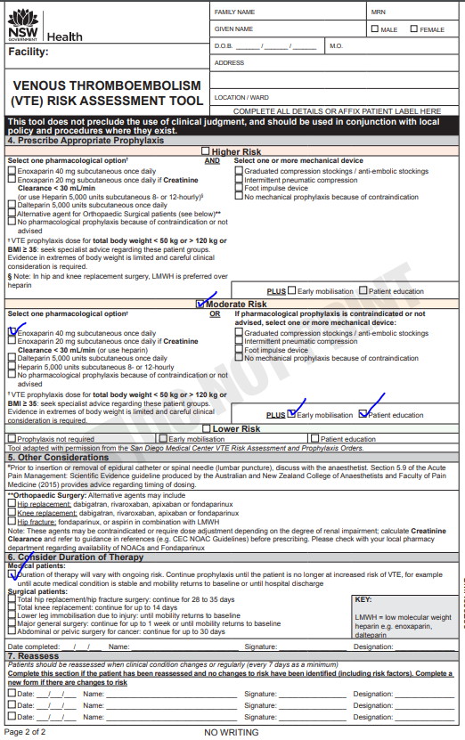
Example 2
PATIENT DETAILS
PATIENT DETAILS
Notes:
This is a patient with a moderate VTE risk. Although the patient has a relative contraindication to pharmacological prophylaxis (low bleeding risk), after assessing the risks vs benefits, it is appropriate to prescribe pharmacological prophylaxis. The patient’s renal function does not warrant dosage adjustment of enoxaparin, however since the patient’s CrCl is close to 30mL/min, it should be monitored. A dose adjustment (enoxaparin 20mg) may be required if the patient’s renal function deteriorates. Alternatively, heparin may be considered as it can be used in the context of renal impairment.

Slide 31
Using the Tool: Example 3
Presenting Problem: Pulmonary oedema, pneumonia. For BIPAP.
Admitting Team: Respiratory
Patient Background:
Female
66-year-old
+++ obese
Creatinine clearance 50mL/min
Using mobile but now only able to walk 20m
Chronic ETOH abuse
WCC: 5.0
RCC: 34.1
Hb: 123
Platelets: 40 (L)
Neutrophils: 2.1
Lymphocytes: 1.2
BP: 150/89
Please use the VTE Risk Assessment Tool to assess and manage the patient’s VTE Risk.
Medical History:
NIDDM
HTN
Chronic liver disease – INR 2.1
Medications:
Candesartan 16mg nocte
Felodipine SR 10mg mane
Metformin 1g bd
Gliclazide SR 30mg nocte
Glucosamine 1 tablet bd
Creatinine clearance for all patients has been calculated using the Cockcroft-Gault Equation. Calculator can be accessed at: http://www.mdcalc.com/creatinine-clearance-cockcroft-gault-equation
Blood Count Reference Ranges
WCC: 4.0 – 10.0 10^9/L
RCC: 4.5 – 5.5 10^12/L (male)
3.8 – 4.8 10^12/L (female)
Hb: 130 – 170 g/L (male)
120 – 150 g/L (female)
Platelets: 150 – 400 10^9/L
Neutrophils: 2.0 – 7.0 10^9/L
Lymphocytes: 1.0 – 3.0 10^9/L
Any significantly abnormal results are marked with (H) High or (L) Low
Notes:
This is a 66 year old female patient presenting with pulmonary oedema and pneumonia.
Medical History:
NIDDM
HTN
Chronic liver disease – INR 2.1
Please use the VTE Risk Assessment Tool to assess and manage the patient’s VTE risk.

Slide 32
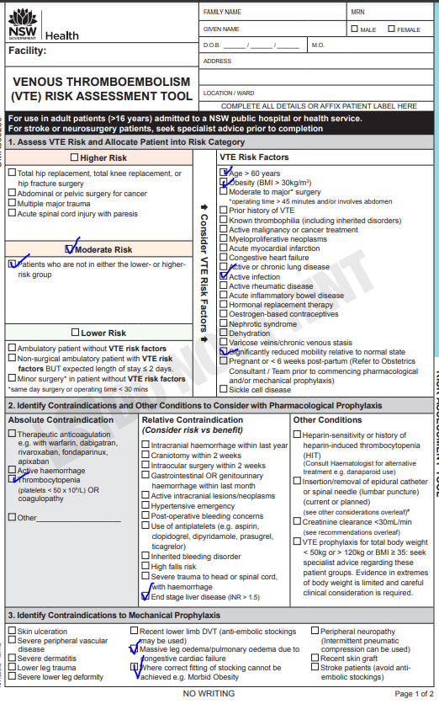
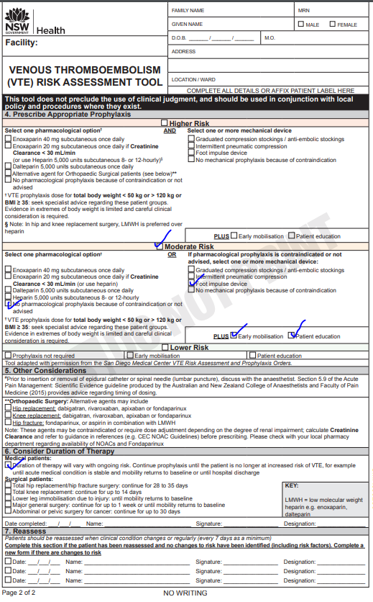
Example 3
PATIENT DETAILS
PATIENT DETAILS
Notes:
This is a patient with a moderate risk of developing VTE. The patient has thrombocytopenia which is an absolute contraindication to pharmacological prophylaxis. Consider mechanical prophylaxis only. It may not be possible to correctly fit stockings on this patient. Using a foot impulse device might be a better option for mechanical prophylaxis.

Slide 33
Summary
The VTE Risk Assessment Tool aids Medical Officers with assessing and managing VTE risk.
It is intended to provide guidance. The tool does not preclude the use of clinical judgment and discretion.
If unsure, consult/refer to a senior clinician.
Notes:
In summary, the VTE Risk Assessment Tool aids Medical Officers with assessing and managing VTE risk. It is intended to provide guidance. The tool does not preclude the use of clinical judgment and discretion. If unsure, consult/refer to a senior clinician.

Slide 34
Questions
For further information:
CEC-stopclots@health.nsw.gov.au
https://www.cec.health.nsw.gov.au/keep-patients-safe/medication-safety/vte-prevention

Slide 35
John Smith
Medical Director | Clinical Excellence Commission
T +61 555 555 555
E John.smith@health.nsw.gov.au
W cec.health.nsw.gov.au
1 Reserve Road, St Leonards NSW 2065

