Slide 1
Team Stripes and Safety Fundamentals for Teams

Slide 2
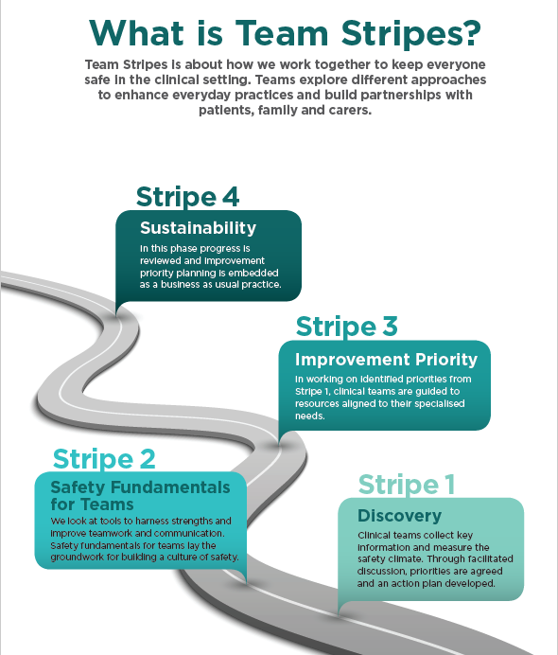
What is Team Stripes?
A framework which takes a step back to gain an understanding of the current state of a unit
It is context driven recognizing the unique identities of every clinical team
Helps teams identify priority areas for improvement
Teams explore different approaches to enhance everyday practices and build partnerships with patients, family and carers

Slide 3
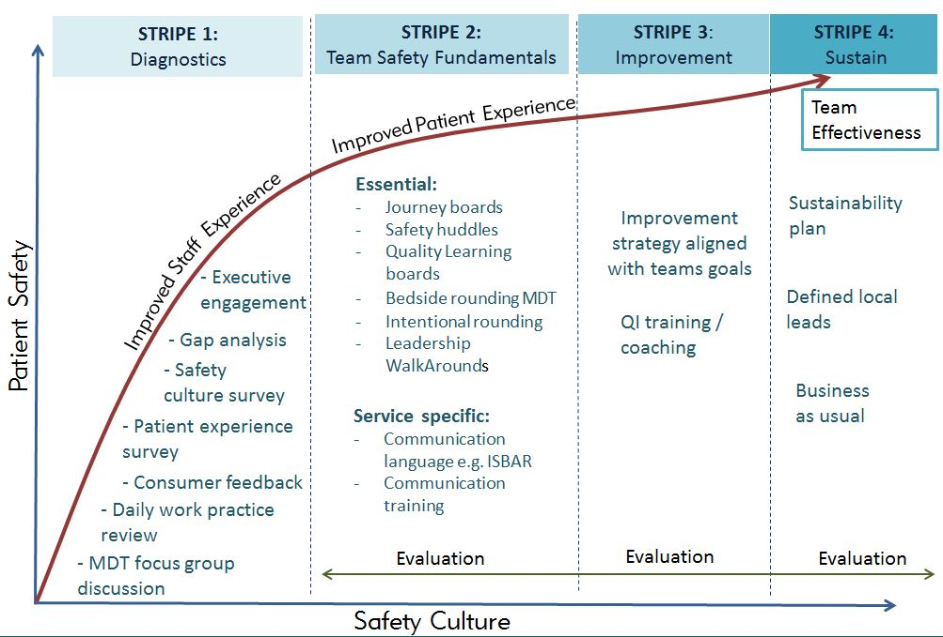

Slide 4
Why focus on teams?
Effective teamwork
Shared goals
Mutual trust
Closed loop communication
Leadership
The benefits of effective teamwork are well described
Harm minimisation
Increase in patient safety
Better staff experience
Reduction in staff stress
Improved job satisfaction
Teams who engage in teamwork processes are 2.8 times more likely to achieve high performance than teams who do not (Schmutz et al. 2019)

Slide 5
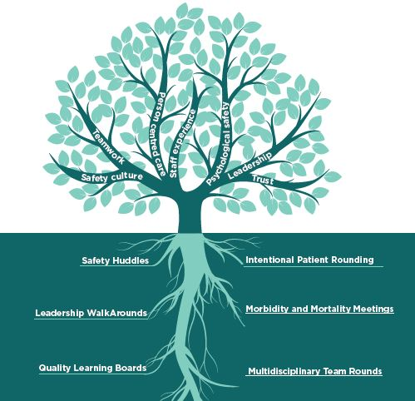
What is a Safety Fundamental?
An activity that changes behaviours that affect quality and safety of care and staff and patient experience i.e. supports development of high reliability
Practical tools and processes some of which require a short implementation time and have the potential to bring quick measurable gains
Not aspirational e.g. health literacy is aspiration – teach back is something that can be done
https://www.cec.health.nsw.gov.au/improve-quality/teamwork-culture-pcc/safety-fundamentals/for-teams

Slide 6
Features of Safety Fundamentals
Behaviour focused: can change behaviour of staff and how they interact within the team and with patients/families/carers
Important: staff recognise the activity will improve their experience of work and will have a meaningful impact
Evidence-based: either through research or quality improvement measurement
Measurable: specific enough to determine whether or not the process or behaviours occur reliably.
Sustainable: achievable and sustainable without substantial renovations or the purchase of new equipment or technology

Slide 7
Safety Fundamentals and high reliability
Characteristics of high reliability
Leadership
Teamwork and communication
Transparency
Deference to expertise
Preoccupation with failure
Continuous learning and improvement
Measurement and data
Psychological safety
Safety Huddles
Leadership WalkArounds
Quality Learning Boards
Multidisciplinary Team Rounds
Intentional Patient Rounding
Morbidity and Mortality Meetings

Slide 8
Guidance
Guidance documents on the Safety Fundamentals for Teams can be found http://www.cec.health.nsw.gov.au

