Slide 1
Risk and resilience: maternity services

Slide 2
In NSW…..
250 women birth each day of which:
25% are overweight, 15% are obese, 9% smoke
25% are over the age of 35
4% are Aboriginal and/or Torres Strait Islander, and of these 43% smoke
15% are affected by diabetes
5% are affected by hypertension
4 women suffer a 3rd or 4th degree perineal tear everyday
Of the 262 babies born each day:
Over 1/3 are delivered by caesarean section
20 are born prematurely, 18 are low birth weight
2 babies die everyday
12 families are affected by stillbirth every week
100 women per month are transferred for urgent higher level care
Safety has to be the priority

Slide 3
Maternity care in NSW …. a call to action
Aims
Improve the safety of mothers and their babies
Improve the experience of care (including quality and satisfaction)
Achieve high value maternity care
Realised through
Improved safety
Enhanced quality
Better value
With a focus on
Women and their families
Improved governance and accountability
Real time data and analytics
Redesign of maternity care
System integration
A life course approach to maternity care
Disinvestment in low value care

Slide 4
Safety
Managing risk
A safety management system is a systematic approach to managing safety risks, including the necessary organisational structures, accountabilities ,policies and procedures

Slide 5
Safety Culture
About attitudes and behaviours
Unless it is a national, jurisdictional, organisational, and professional priority it will not permeate groups and individuals
Leadership is crucial:
Attitudes / actions that constantly emphasize the importance of safety must be demonstrated, developed and encouraged
Behaviours that support this approach should be rewarded
Behaviours that undermine this approach should not be tolerated
A sound safety culture is wary, just, flexible, learning and informed

Slide 6
Evolution of a sound safety culture
Pathological – who cares as long as we don’t get caught
Reactive – safety is important, we do a lot when we have an incident
Planned – we have a system in place to manage all risks
Proactive – we work on the problems that we still find
Resilient – safety is how we do business around here

Slide 7
Resilience
Concept utilised to evaluate the capability of complex systems to maintain safety, flexibility and recover from a range of potential adverse events
Offers the capability to better review how systems may continually adjust to changing information, relationships, goals, threats and other factors that may yield negative outcomes

Slide 8
Resilience
Preparation for reducing the negative consequences of adverse events includes:
Enhancing resilience of systems in desirable states, &
Considering risk assessment as well as necessary resilience actions before, during, and after an adverse event occurs
Resilience efforts inherently consider the passage of time and shifting capabilities and risks that may accrue due to changes in system performance and its capability to absorb adverse events.
Resilience strategies have the potential to change how a service prepares for adverse events

Slide 9
Comparison of Risk and Resilience Management Systems
Risk assessment examines individual components of a system
With a view to harden a vulnerable component of the system based upon a snapshot at a point in time
Identification of threats and protecting against them based on the events likelihood and consequences
Resilience thinking considers future threats to the system with a view to minimising the impact of future adverse events
The ability to plan and prepare for, absorb, recover from, and adapt to adverse events
Both allow for the use of quantitative and qualitative data

Slide 10
Benefits of Resilience Thinking over Traditional Risk Analysis
Whilst they differ they are complimentary approaches to dealing with risk
Risk assessment is a bottom up approach that starts with data collection and progresses through modelling
Resilience is a top down approach that starts with assessing values of stakeholders and critical functions and through decision models progresses to generation of metrics and data that can ultimately inform risk assessments
Risk assessment is a preliminary phase to resilience analysis
Provides the first elements needed to trigger, or not, the need for resilience assessment.
Resilience analysis centres on the integration of risk perception,
risk mitigation,
risk communication, and
risk management

Slide 11
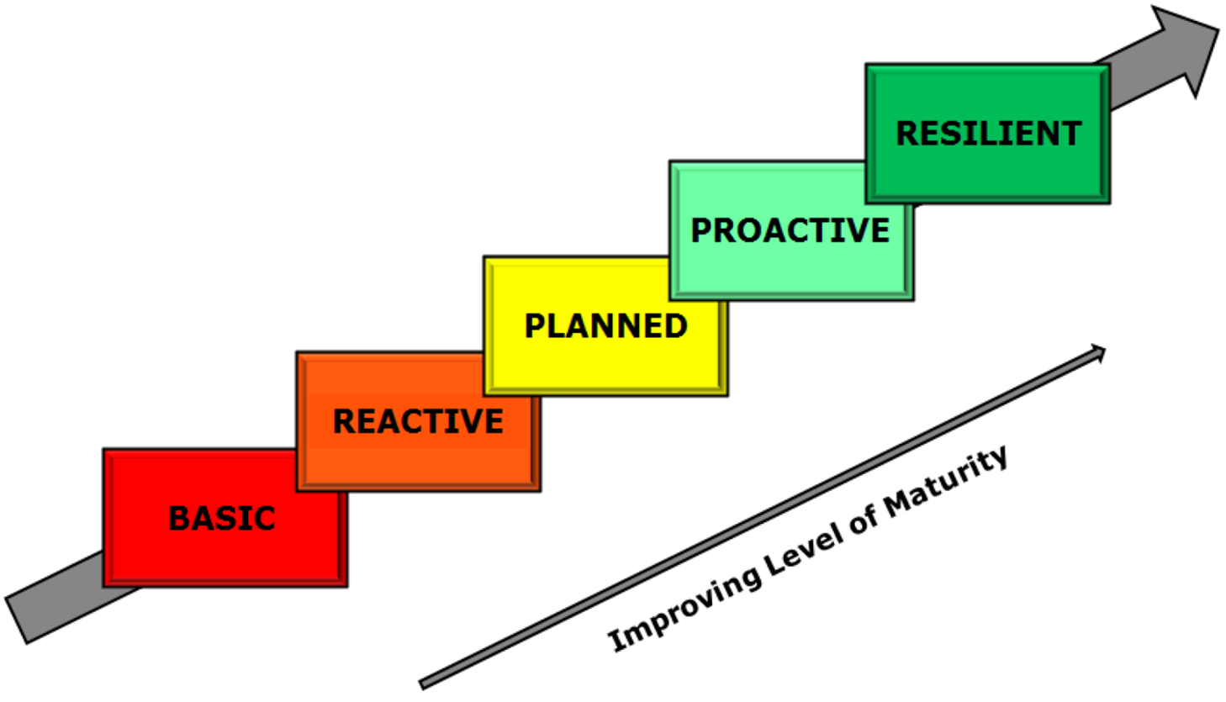
Increasingly informed

Slide 12
Methodology
Risk management helps the system prepare and plan for adverse events, whereas resilience management goes further by integrating the temporal capacity of a system to absorb and recover from adverse events, and then adapt.
The Resilience Matrix is a framework for the performance assessment of integrated complex systems. The framework consists of a 4 x 4 matrix where one axis contains the major subcomponents of any system and the other axis lists the stages of a disruptive event. The rows describe the four general management domains of any complex system (physical, information, cognitive, social). The four domains can be described as follows:
Physical: Physical resources and the capabilities and the design of those resources
Information: Information and information development about the physical domain
Cognitive: Use of the information and physical domains to make decisions
Social: Organisation structure and communication for making cognitive decisions
The columns describe the four stages of incident management (plan/prepare, absorb/withstand, recover, adapt).

Slide 13
Resilience matrix
 | PREPARE | ABSORB | RECOVER | ADAPT
PHYSICAL
INFORMATION
COGNITIVE
SOCIAL

Slide 14
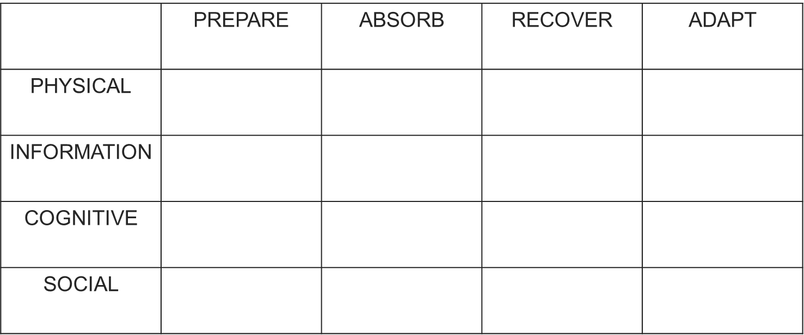
Methodology
Collectively, these sixteen cells provide a general description of the functionality of the system through an adverse event. Resilience is assessed by assigning a score to each cell that reports the capacity of the system to perform in that domain and time .For example:
The Information - Recover cell is assigned a rating according to the ability of the system to collect (monitor) and share (analyse and disseminate) data that will aid in ‘recovery’.
The Social - Adapt cell is assigned a rating according to the capacity of the system users to modify behaviour and sustain changes beyond the immediate incident response.

Slide 15
Methodology
The matrix of scores can be aggregated to represent a snapshot of overall system resilience, which can be monitored over time, used for comparison with similar systems, or examined more closely to illuminate gaps in system capacity.
To perform the resilience assessment using the matrix approach a team of reviewers have:
defined the system boundary and the threat scenario under consideration;
identified the critical function(s) of the system to be maintained;
for each critical function, selected indicators and generated scores for system performance in each cell; and
aggregated the matrices to create an overall resilience rating.
The scoring of the metrics in this review is based on evidence provided to the reviewers.

Slide 16
Resilience Matrix
 | PREPARE | ABSORB | RECOVER | ADAPT
PHYSICAL | Quantified resources Local Resources | Resource planning Mobilising resources | Networked resources Networked resources | Flexibility of resources Flexibility of resources
INFORMATION | Collected / Reported What data do we collect and report? | Reported / Reviewed What data reported is reviewed? | Reviewed / Analysed What data reviewed is analysed? | Analysed / Refined What data analysed is refined to inform improvement?
COGNITIVE | Capability / Escalation What can we do? | Escalation / Performance What happens when we need help? | Performance / Review How are we really doing? | Review / Improvement How can we improve?
SOCIAL | Educated / Connected How do we learn? | Connecting / Listening How do we feedback? | Listening / Responding How do we respond? | Responding / Collaborating How do we work better together?

Slide 17
Methodology
 | PREPARE | ABSORB | RECOVER | ADAPT
PHYSICAL | Quantified resources - physical facility operational - core services operational - permanent workforce - equipment available | Resource planning - demand management | Networked resources - operational plan | Flexibility of resources - facility disaster plan - maternity business continuity plan
INFORMATION | Collected / Reported - multiple (3) data sources | Reported / Reviewed - data incorporated into meetings | Reviewed / Analysed - data monitoring with interpretation | Analysed / Refined - data analysis and refinement
COGNITIVE | Capability / Escalation - service capability - individual capability | Escalation / Performance - escalation procedures both operational and clinical | Performance / Review - internal service performance review - individual performance development review | Review / Improvement - service redesign - improvement capability
SOCIAL | Educated / Connected - clinician education - patient education | Connecting / Listening - staff feedback - patient feedback | Listening / Responding - feedback to staff - feedback to patients | Responding / Collaborating - collaboration - co-design

Slide 18
Scoring –example ‘prepare phase’
Matrix Position | Metric Selected | Value | Source | Upper score | Lower score | Score
Prepare - Physical | - physical facility is operational - core services operational - permanent workforce - equipment available | Confirmed Mostly confirmed Part confirmed Not confirmed | Interview, observation | Confirmed | Not confirmed
Prepare - Information | - multiple (3) data sources | Confirmed Mostly confirmed Part confirmed Not confirmed | Interview, observation | Confirmed | Not confirmed
Prepare - Cognitive | - service capability - scope of practice | Confirmed Mostly confirmed Part confirmed Not confirmed | Interview, observation | Confirmed | Not confirmed
Prepare - Social | - clinician education - patient education | Confirmed Mostly confirmed Part confirmed Not confirmed | Interview, observation | Confirmed | Not confirmed
Confirmed (all elements demonstrated) / Mostly confirmed (minor deficits) /
Partially confirmed (major deficits) / Not confirmed (absence of elements)

Slide 19
 | PREPARE | ABSORB | RECOVER | ADAPT
PHYSICAL | BASIC REACTIVE | PLANNED | PROACTIVE | RESILIENT
INFORMATION | BASIC REACTIVE | PLANNED | PROACTIVE | RESILIENT
COGNITIVE | BASIC REACTIVE | PLANNED | PROACTIVE | RESILIENT
SOCIAL | BASIC REACTIVE | PLANNED | PROACTIVE | RESILIENT

Slide 20
Increasingly informed

Slide 21
Analysis
Assessment by domain
Assessment across prepare – absorb – recover – adapt
Overall assessment
Themes and thematic analysis
Recommendations – from the top down (Ministry, pillars, LHD’s, facilities, etc)

Slide 22
The role of resilience assessments
Challenges our existing mental and process models
Prioritises work to be done
Achieves high level engagement
Complimentary to risk assessment
Complimentary to standards / accreditation
Drives:
Flexibility of resources
Data analytics
Practice improvement
Development of collaboration and a shared mental model of safety

Slide 23
Questions

