Slide 1
CEC PowerPoint for use by LHDs/SHNs
Terms and conditions of use
This PowerPoint presentation has been prepared by the Adult Patient Safety Program of the Clinical Excellence Commission.
The presentation has been designed so that you can add your logo to each page.
By using this presentation, our expectation is that you will make no further amendments which might impact on factual content or the meaning and intention of the presentation.
For further information or clarification please contact CEC-Reach@health.nsw.gov.au

Slide 2
REACH: Patient, carer and family escalation
In partnership with the Clinical Excellence Commission
Put LHD/SHN LOGO here, EXAMPLE below

Slide 3
Outline of presentation
Background and rationale for REACH
What is REACH?
The consumer voice – patient story
Plan for xxx hospital/facility
Tip: describe your facility / unit’s ‘burning platform’ for implementing REACH
Put LHD/LOGO here
Clinical Excellence Commission
Notes:
Add name of hospital/facility

Slide 4
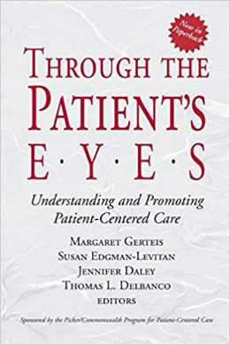
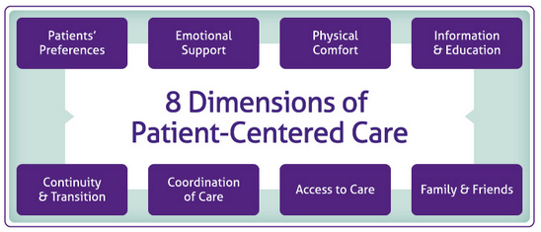
Person Centred Care
92% of patients said that they wanted to be involved in decisions about their hospital care and treatment (n= 20,489, BHI 2018)
‘consumer activation’
‘nothing about me without me’
‘partnering with patients, carers and families’
‘shared decision making’
‘consumer engagement’
Genteis, M., Edgman-Levitan, S., Dalay, J., & Delbanco, T. L. (2003). Through the patient's eyes: understanding and promoting patient-centered care. The Journal for Healthcare Quality (JHQ), 25(3), 47.
Put LHD/LOGO here
Clinical Excellence Commission
Notes:
Research conducted more than 25 years ago demonstrated why some hospitals are more patient-centered than others and showcased the models of care that can make hospitalization more humane
This is not new information, we have known this for a while now, but yet we still notice gaps in the care we provide and partnering with our patients.
Not just because it’s the right thing to do … but it is a key element of patient safety and supports the patient experience – person centred care has been recognised in its own right as one of 6 domains of quality healthcare
We know that patients want to be involved in their care - OPPORTUNITY for IMPROVEMENT (61% definitely involved in care and treatment as much as they wanted to be. Serious Adverse Event Reviews for NSW Health identified approximately 11% patient/carer concerns not considered) 2013.
Genteis, M., Edgman-Levitan, S., Dalay, J., & Delbanco, T. L. (2003). Through the patient's eyes: understanding and promoting patient-centered care. The Journal for Healthcare Quality (JHQ), 25(3), 47.

Slide 5
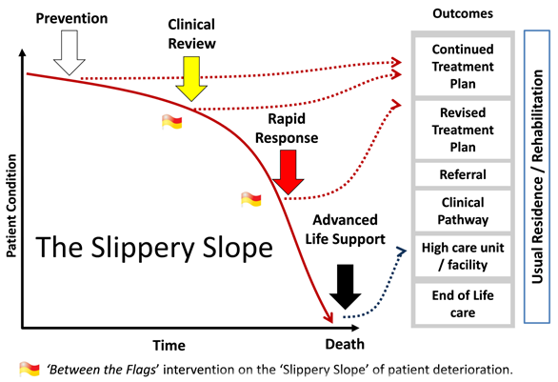
Deteriorating patients
Put LHD/LOGO here
Clinical Excellence Commission
Notes:
When deteriorating patients are not recognised the outcome can be tragic.
This graph highlights the importance of recognising patient deterioration early and the impact that it has on the patient’s outcomes.
The CEC’s Between the Flags (BTF) program has made great improvements in how we recognise and respond to deteriorating patients. I’m sure you’re all familiar with the Between the Flags program and DETECT training. Through the work of the CEC and the hospitals that have implemented the BTF program, there has been a 46% reduction in cardiac arrest rates across NSW healthcare facilities since 2010.
Despite improvement in this area, failure to recognise, escalate and respond to deterioration have consistently been identified as leading contributory factors in review of serious adverse events - so we know that there is still OPPORTUNITY for IMPROVEMENT in this area

Slide 6
Our goal
To improve early recognition, escalation and response to clinical deterioration (physical and mental state) by partnering with patients, carers and families.
Reduce potentially preventable deaths and serious adverse events.
Put LHD/LOGO here
Clinical Excellence Commission
Notes:
Add name of hospital/facility

Slide 7
REACH
Patient, carer and family activated escalation system
Aims to ↑ consumer engagement and ↓ adverse outcomes
Promotes inclusion of patients, carers, and their families as partners in the healthcare team
Principle of ‘speaking up for safety’ / patients/carers/families know themselves best and are ‘expert’
REACH is one part of the safety net for deteriorating patients
2013
11 healthcare facilities
2022
200⁺ healthcare facilities
Put LHD/LOGO here
Clinical Excellence Commission
Notes:
REACH is a system that helps patients, carers, and their families to raise their concerns with staff about worrying changes in a patient’s condition.
Aims to increase consumer engagement and decrease adverse outcomes
Very much promotes inclusion of patients, and their families and carers as partners in the healthcare team – and the principle of ‘speaking up for safety’ / patients/carers/families know themselves best/ ‘expert’
Important to note that REACH is only one part of a much broader safety and quality system for recognising, escalating and responding to deteriorating patients. The main part of this bigger system is theBTF program, that many of you would be familiar with. The Between The Flags program was developed by the CEC, and helps staff to recognise signs of deteriorating and to escalate and respond appropriately to deteriorating patients. It was based on the surf life saving analogy, of being safe when you are swimming BTF, in this case referring to being safe when your vital signs, such as heart rate and blood pressure, are ‘BTF’ or in other words within normal range.

Slide 8
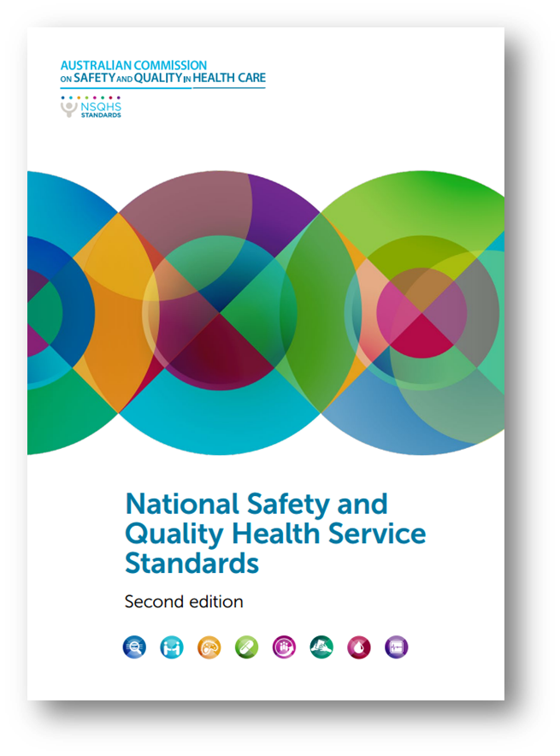
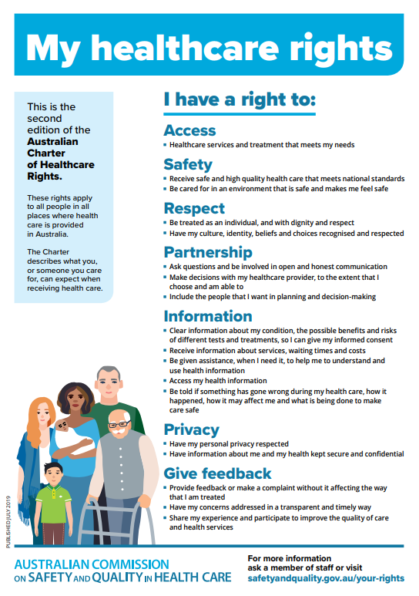
Action 8.7: The health service organisation has processes for patients, carers or families to directly escalate care.
Put LHD/LOGO here
Clinical Excellence Commission
Notes:
Aligns with National Standards and Australian Charter of Healthcare Rights

Slide 9
Put LHD/LOGO here
Clinical Excellence Commission
Notes:
REACH stands for Recognise, Engage, Act, Call and Help is on its way.
Staff can also make a REACH call on behalf of a patient/carer/or family member.
Like making a triple 0 call from within hospital
The key to the program is about engaging with the patient, carer or family member. Its not just about making a REACH call, ideally concerns resolved before calling emergency team through the engagement with the clinical staff.

Slide 10
REACH calls in NSW public hospitals in 2018
The evidence about impact
Range: average of X calls/year to X calls/month
‘Family concern’ continues to be reason for activation of rapid response in 5-6% of total calls.
Reasons for calls mirror those identified by staff (e.g. shortness of breath).
Over 50% of family activated cases require transfer to ICU
Put LHD/LOGO here
Source: REACH survey 2018
Tip: Add some local data
Clinical Excellence Commission
Notes:
>>Suggest add in some data on the number and type of calls you get
International literature and the CEC’s experience with the REACH program suggest that when starting REACH in a facility all staff (managers, executive and frontline clinicians) are apprehensive about a number of things, but once the program is in place it becomes part of normal business.
Internationally the CEC had expected to see 2 calls per month to 2 calls per year – depending on the size of the hospital and number of in-patient beds. At this stage REACH is an in-patient only program (the CEC are working with other sites to expand REACH into other areas on a case by case basis).
Most calls tend to be for appropriate reasons and are often when the patient, carer or family do not feel that they are being heard by the local team.
>>Add in some local data numbers or feedback from surveys.

Slide 11
Consumer feedback
‘I felt isolated with no other family members to help in questioning the doctor. REACH gave me confidence to do this.’
‘REACH is a great system...it gave me reassurance and confidence to say “Hey, I don’t think this is right”.
Tip: add own patient quote
Put LHD/LOGO here
Clinical Excellence Commission

Slide 12
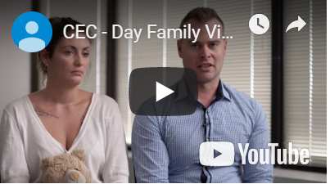
Day family video
Put LHD/LOGO here
Tip: add own patient story
Clinical Excellence Commission
Notes:
https://youtu.be/3gxsCgOpThQ
This video has been made following the death of an infant receiving treatment in the Illawarra Shoalhaven Local Health District (ISHLHD), and the family now reside within the Northern New South Wales Local Health District (NNSWLHD). ​
​
As the video tells a real story, the content may be upsetting particularly for staff from ISLHD. Acknowledge that some people may recognise the parent/case and please remind staff that if this video raises personal stress to contact EAP services, speak to any of the course instructors or unit educators/managers. ​
​
Remind the audience to be respectful when providing comments, which should be limited to the benefits to patient care that the REACH program provides as it recognises patients/parents and carers are part of the health care team and are able to raise their hand for help.​
​
Whilst this is a paediatric case, the themes and elements are transferable to adult populations. ​
​

Slide 13
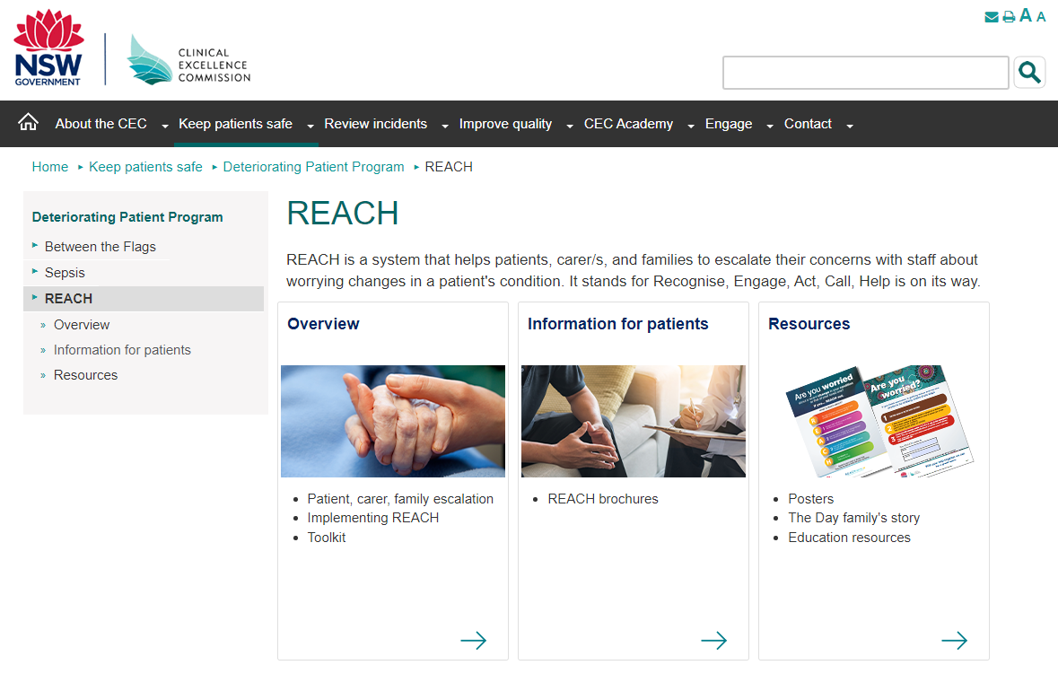
Information and resources
http://www.cec.health.nsw.gov.au/
Put LHD/LOGO here
Clinical Excellence Commission
Notes:
https://www.cec.health.nsw.gov.au/keep-patients-safe/deteriorating-patient-program/reach
More information is available on our website.
The REACH Toolkit provides information, resources and quality improvement (QI) tools for managers and clinicians to improve patient, carer and family recognition and escalation of clinical deterioration in NSW health services.
The resources can be adapted to suit local needs including initial program implementation, to review and improve current practices, or to support current practice.

Slide 14
Take home message
Patient, carer and family activated program
Reduces adverse events
Values the patient voice
Engagement with the local team first
Not about complaints
Put LHD/LOGO here
Clinical Excellence Commission
Notes:
REACH recognises that patients, their carers and families know themselves best
REACH is a patient, carer and family activated escalation system
Aims to reduce adverse events by partnering with patients, carers and families in recognising and escalating deterioration
It’s about valuing (listening, acknowledging and acting on) the patient voice
Its about engaging with the local team first before escalating to a REACH call
It’s not about complaints – there are existing pathways to make complaints and these do not change

Slide 15
Further Information
Mary Fullick
Senior Improvement Lead | Clinical Excellence Commission
E CEC-Reach@health.nsw.gov.au
W cec.health.nsw.gov.au
1 Reserve Road, St Leonards NSW 2065
Name
Role | LHD/SHN
T +61 555 555 555
E John.smith@health.nsw.gov.au
W cec.health.nsw.gov.au
1 Reserve Road, St Leonards NSW 2065

