Slide 1


Antibiotics
Why we must use them wisely!
<Insert Presenter Details>
Antibiotic Awareness Week
Educational Inservice
<Date of Presentation>

Slide 2
Learning outcomes
At the end of this session, participants will be able to:
Define the term ‘antibiotic’
List the names of commonly used antibiotics
Identify key risks associated with antibiotic use
Describe the role of different members of the healthcare team in improving antimicrobial use
Notes:
Educator notes:
Outline the learning objectives for this session, namely to:
Define what an antibiotic is
List the names of commonly used antibiotics
Identify key risks associated with antibiotic use including adverse effects and antibiotic resistance
Describe the role of different members of the healthcare team in improving antimicrobial use
Ask the audience if they have any learning outcomes they would like to add, and try to cover any additional topics of interest at the end of the presentation.

Slide 3
What are antibiotics?
Antibiotics are medicines used to kill or stop the growth of microbial life in the body
  In general conversation however, the term ‘antibiotic’ usually refers to medication for a bacterial infection
The term antimicrobials is accepted as a broader definition, and includes medicines used for:
bacterial
viral
fungal
parasitic
infections
Notes:
**Contains animation**
Educator notes:
Ask the audience what they think the term “antibiotics” means, then click to reveal the definition. These days, the term is most commonly associated with treatment of bacterial infections.
Click to reveal the common definition for antimicrobial: medicines used to treat bacterial, viral, fungal and parasitic infections
The most commonly used antimicrobials in hospital patients are antibacterials, which will be the focus of this presentation

Slide 4
Examples of antimicrobials
Antimicrobial Group | Class | Examples
Antibacterials (antibiotics) | Penicillins | Flucloxacillin (Flopen, Flucil) Amoxycillin + clavulanate (Augmentin, Clamoxyl) Piperacillin + tazobactam (Tazocin)
 | Cephalosporins | Cephalexin (Keflex, Ibilex) Cephazolin (Kefzol) Ceftriaxone (Rocephin)
 | Macrolides | Azithromycin (Zithromax) Roxithromycin (Rulide)
Antifungals | Azoles | Fluconazole (Diflucan) Voriconazole (Vfend)
Antivirals | Guanine analogues | Aciclovir (Zovirax) Valaciclovir (Valtrex)
Notes:
Educator notes:
**Amend slides depending on the types of antimicrobials your audience are likely to be familiar with**
There are many types of antimicrobials used in NSW public hospitals
Some of the more common antibiotics are penicillins, cephalosporins and macrolides. These are used for a range of infections, such as chest infections and skin and soft tissue infections.
Some examples of antibiotics are listed under their respective class, and common brand names are also included.
There are different types of antifungals but one of the most common classes used in hospital patients are the azoles e.g. fluconazole
Antiviral agents used in hospital patients include guanine analogues, such as aciclovir.
Invite your audience to contribute other examples that they might know
References for this slide:
Australian Medicines Handbook 2014 (online). Adelaide: Australian Medicines Handbook Pty Ltd; 2014 July. Available from: http://www.amh.net.au

Slide 5
Frequency of antibiotic use
How many hospital patients are on antibiotics at any one time?
35 to 50%
(i.e. These are very common medications!)
Notes:
**You may wish to add your own data if available (e.g. from NAPS or a similar point prevalence study)
Educator notes:
This percentage varies between different facilities, but Australian studies suggest 35-50%

Slide 6
Why is it important to use antibiotics with care?
1. Antibiotics are life-saving medicines
2. Only effective if the antibiotic works against the organism causing infection
3. Risk of side effects and harm
4. Use of antibiotics can contribute to the problem of antimicrobial resistance
Notes:
Educator notes:
There are many reasons to use antibiotics with care, and we will address a them one by one.
The first is to highlight their important role in treating serious and life-threatening infections, as well as common infections which would otherwise get a lot worse without treatment

Slide 7
Indications for antibiotics
Antibiotics can be used to treat (or prevent) a wide range of bacterial infections
  Sepsis is an example of a serious infection with high mortality → must be treated promptly
  A sore throat is an example of a less serious infection where antibiotics are only needed in high-risk cases → refer to guidelines
The Therapeutic Guidelines: Antibiotic are Australian and are available on CIAP
Notes:
Educator notes:
Prior to the availability of antibiotics, many infections were fatal. (E.g. blood stream infections due to Staph. aureus had a mortality rate of 80%!) The discovery of antibiotics led to a huge reduction in deaths and disability due to many infectious diseases.
Today, antibiotics are used to treat a range of infections, from minor to more serious infections.
Sepsis is a dangerous syndrome caused by the body’s intense, systemic response to an infection. Septic patients often deteriorate very quickly and this condition can result in multi-organ failure and death. Prompt administration of antibiotics is vital for effective management of sepsis. The goal is to commence antibiotic therapy within the first hour of recognition and diagnosis of sepsis. Delays in administering appropriate antibiotics are associated with increased mortality in patients with septic shock.
On the other end of the spectrum, sore throats may be caused by bacteria but don’t routinely require antibiotics, except in high risk patients or selected groups. Guidelines such as Therapeutic Guidelines: Antibiotic (available online as eTG complete) can help us assess the appropriateness of antibiotics in common infections.
**You may wish to give a demo on how to access the eTGs, and show your audience how to look up a common condition, e.g. cellulitis and interpret the recommendations**
References for this slide:
Clinical Excellence Commission (2014). Sepsis Kills clinical presentation adult inpatient. Sydney: Clinical Excellence Commission. Available at: http://www.cec.health.nsw.gov.au/programs/sepsis/education#education1.
Collignon, P (2002). Antibiotic resistance. Med J Aust, 177: 325-329.
eTG complete [Internet] (2014). Melbourne: Therapeutic Guidelines Limited. Available at: www.ciap.health.nsw.gov.au (accessed 28 Aug 2014).
Kumar A, Roberts D, Wood KE, Light B, Parrillo JE, Sharma S, Suppes R, Feinstein D, Zanotti S, Taiberg L, Gurka D, Kumar A, Cheang M. (2006). Duration of hypotension before initiation of effective antimicrobial therapy is the critical determinant of survival in human septic shock. Crit Care Med. Jun;34(6):1589-96.

Slide 8
Why is it important to use antibiotics with care?
1. Antibiotics are life-saving medicines
2. Only effective if the antibiotic works against the organism causing infection
3. Risk of side effects and harm
4. Use of antibiotics can contribute to the problem of antimicrobial resistance
Notes:
Educator notes:
The second reason to use antibiotics with care is that all antibiotics are different!
Care must be taken to “match the drug to the bug”

Slide 9
Antibiotic selection
Choosing the most appropriate antibiotic for a patient is very important
  Antibiotics are often selected according to their class and ‘spectrum’ of activity (e.g. broad vs. narrow)
  Growing cultures in the micro lab can help to identify the bacteria and decide which antibiotic may be best to use
What if we don’t know the causative organism?
  Guidelines recommend the most appropriate antibiotic to be used until results are available (‘empirical therapy’)
Notes:
Educator notes:
Using the most appropriate antibiotic for a patient is particularly important, especially in critical illnesses.
Many antibiotics only work on a specific range of bacteria, and are selected based on the likely pathogens causing the disease.
Taking specimens for culture in the micro lab is an important way of finding out what bacteria is causing the infection and what antibiotic is most suitable. This may include blood specimens, urine specimens, sputum and wound swabs.
Broad spectrum antibiotics are those that are effective against a wide range of bacteria. It is important to reserve these antibiotics for serious infections where the likely organism is not known, as it will keep them effective for longer and minimise the risk of affecting non-harmful bacteria in the patient’s body.
Guidelines provide assistance in selecting the most suitable antibiotic until microbiology results are known.

Slide 10
QUICK QUIZ: Broad vs. narrow spectrum
Which of the following antibiotics are considered broad spectrum?
Hint:
Think about WHY these antibiotics are prescribed
piperacillin+tazobactam
metronidazole
cephazolin
moxifloxacin
benzylpenicillin
meropenem
ceftriaxone
trimethoprim
Notes:
Educator notes:
Activity: let’s talk about some antibiotics you may have seen used in hospital patients.
Are they broad spectrum or narrow spectrum?
Think about what patients in hospital receive when we don’t know what’s causing their infection or when they have a very serious infection of unknown origin.
References for this slide:
eTG complete [Internet] (2014). Melbourne: Therapeutic Guidelines Limited. Available at: www.ciap.health.nsw.gov.au (accessed 28 Aug 2014).

Slide 11
QUICK QUIZ: Broad vs. narrow spectrum
Which of the following antibiotics are considered broad spectrum?
Hint:
Think about WHY these antibiotics are prescribed
piperacillin+tazobactam
BROAD
metronidazole
NARROW
cephazolin
NARROW
moxifloxacin
BROAD
benzylpenicillin
NARROW
meropenem
BROAD
ceftriaxone
BROAD
trimethoprim
NARROW
Notes:
Educator notes:
Broad-spectrum: piperacillin-tazobactam, ceftriaxone, moxifloxacin, meropenem
Narrow spectrum: cefalotin, benzylpenicillin, metronidazole, trimethoprim
References for this slide:
eTG complete [Internet] (2014). Melbourne: Therapeutic Guidelines Limited. Available at: www.ciap.health.nsw.gov.au (accessed 28 Aug 2014).

Slide 12
De-escalation of therapy
Once micro results are available, therapy can be targeted at the causative organism based on its antibiotic susceptibilities
  May mean switching to a more narrow-spectrum antibiotic, which reduces negative effects on the body’s natural flora
  Care needed when interpreting microbiology reports → seek advice if needed
Notes:
Educator notes:
Once microbiology results are available, therapy can be tailored to the organism causing infection and its antibiotic susceptibilities.
This affords the opportunity to switch the patient from a broad-spectrum antibiotic to a narrow-spectrum antibiotic.
This ensures therapy is targeted to the bacteria causing harm rather than the body’s natural flora.
Care needed when interpreting microbiology reports to distinguish between harmful infection, non-harmful colonisation and contaminants.

Slide 13
Why is it important to use antibiotics with care?
1. Antibiotics are life-saving medicines
2. Only effective if the antibiotic works against the organism causing infection
3. Risk of side effects and harm
4. Use of antibiotics can contribute to the problem of antimicrobial resistance
Notes:
Educator notes:
Antibiotics CAN cause harm to patients, and must be used responsibly
Some antibiotics can have significant side effects
References for this slide:

Slide 14
Adverse effects of antibiotics
Common side effects: rash, nausea or diarrhoea
More serious reactions include immediate hypersensitivity (severe allergy) or angioedema
The risk of Clostridium difficile infection is significantly raised in patients on broad-spectrum or multiple antibiotics, particularly when used for prolonged periods
    This condition can be a very serious complication for patients who are already unwell or frail, and can be very difficult to treat
    Some antibiotics are higher risk (e.g. cephalosporins, co-amoxiclav, clindamycin and ciprofloxacin – known as “the 4 C’s”)
Notes:
Educator notes:
All medicines may cause side effects, and antibiotics are no different.
Common side effects of more frequently used antibiotics include skin rash, nausea, vomiting, diarrhoea, metallic taste
More serious side effects include hepatitis, angioedema, severe hypersensitivity
C.diff can have a huge impact on morbidity and mortality, particularly in patients with multiple concurrent problems
References for this slide:
Australian Medicines Handbook 2014 (online). Adelaide: Australian Medicines Handbook Pty Ltd; 2014 July. Available from: http://www.amh.net.au

Slide 15
Penicillin allergy
Up to 10% of patients self-report an allergy to penicillin antibiotics
Must determine the nature of their previous reaction and treat according to Therapeutic Guidelines or expert advice
  Allergic or non-allergic?
  Immediate or non-immediate?
  Was the previous reaction severe e.g. Stevens–Johnson syndrome?
Notes:
Educator notes:
A brief note about penicillin allergy, as this is one of the more common antibiotics your patients may report they are allergic to.
There is a significant risk that patients with an immediate penicillin hypersensitivity (severe and fast allergic reaction) will also have a similar reaction to cephalosporins.
Carbapenems are less closely related to penicillins, but still contain a beta-lactam ring so there may be a risk of cross-sensitivity. In some circumstances and under controlled conditions, meropenem has been used in patients with an immediate penicillin hypersensitivity, but in everyday practice they are almost always avoided in this patient group.
References for this slide:
eTG complete [Internet] (2014). Melbourne: Therapeutic Guidelines Limited. Available at: www.ciap.health.nsw.gov.au (accessed 28 Aug 2014).

Slide 16
QUICK QUIZ: Penicillins
Which of the following options contains only antibiotics from the penicillin class?
(a) Tazocin, amoxycillin, Keflex, doxycycline
(b) Tazocin, flucloxacillin, Augmentin, Timentin
(c) Augmentin, Lincocin, cephalexin, flucloxacillin
(d) Timentin, ampicillin, amoxycillin, clindamycin
Notes:
Educator notes:
You may wish to encourage your audience to name the generic drugs for each of the brand names (italics).
References for this slide:
Australian Medicines Handbook 2014 (online). Adelaide: Australian Medicines Handbook Pty Ltd; 2014 July. Available from: http://www.amh.net.au

Slide 17
QUICK QUIZ: Penicillins
Which of the following options contains only antibiotics from the penicillin class?
(a) Tazocin, amoxycillin, Keflex, doxycycline
(b) Tazocin, flucloxacillin, Augmentin, Timentin
(c) Augmentin, Lincocin, cephalexin, flucloxacillin
(d) Timentin, ampicillin, amoxycillin, clindamycin
Notes:
Educator notes:
Tazocin is a brand name for piperacillin + tazobactam = a penicillin + a beta-lactamase inhibitor
Amoxycillin = a penicillin
Keflex is a brand name for cephalexin = a cephalosporin
Doxycycline = a tetracycline
Flucloxacillin = a penicillin
Augmentin is a brand name for amoxycillin + clavulanic acid = a penicillin + a beta-lactamase inhibitor
Lincocin is brand name for lincomycin = a lincosamide
Ampicillin = a penicillin
Clindamycin = a lincosamide
References for this slide:
Australian Medicines Handbook 2014 (online). Adelaide: Australian Medicines Handbook Pty Ltd; 2014 July. Available from: http://www.amh.net.au

Slide 18
Why is it important to use antibiotics with care?
1. Antibiotics are life-saving medicines
2. Only effective if the antibiotic works against the organism causing infection
3. Risk of side effects and harm
4. Use of antibiotics can contribute to the problem of antimicrobial resistance
Notes:
Educator notes:
Antibiotic resistance is a major concern for modern medicine, and is vastly accelerated by unnecessary and inappropriate use of antibiotics
References for this slide:

Slide 19
Impact on current and future patients
Antibiotic use contributes to the development of antibiotic resistance
  For most medicines, side effects are limited to the individual patient
  Resistance developed from exposure to an antibiotic may affect the patient, but also affects future patients and the wider community
  This reduces the number of effective antibiotics available to treat infections
Notes:
Educator notes:
References for this slide:

Slide 20
Antibiotic resistance
When bacteria develop new ways to defend against antibiotics, this is called ‘antibiotic resistance’
Resistance to an antibiotic means the drug is no longer effective against the infecting bacteria
Examples:
  Methicillin-resistant Staphylococcus aureus (MRSA) cannot be treated with flucloxacillin
  Vancomycin-resistant enterococci (VRE) cannot be treated with vancomycin
  Carbapenem-resistant Enterobacteriaceae (CRE) cannot be treated with meropenem or other carbapenems
Notes:
Educator notes:
References for this slide:
CDC Threat Report – Antibiotic resistance threats in the United States, 2013 http://www.cdc.gov/drugresistance/threat-report-2013/

Slide 21
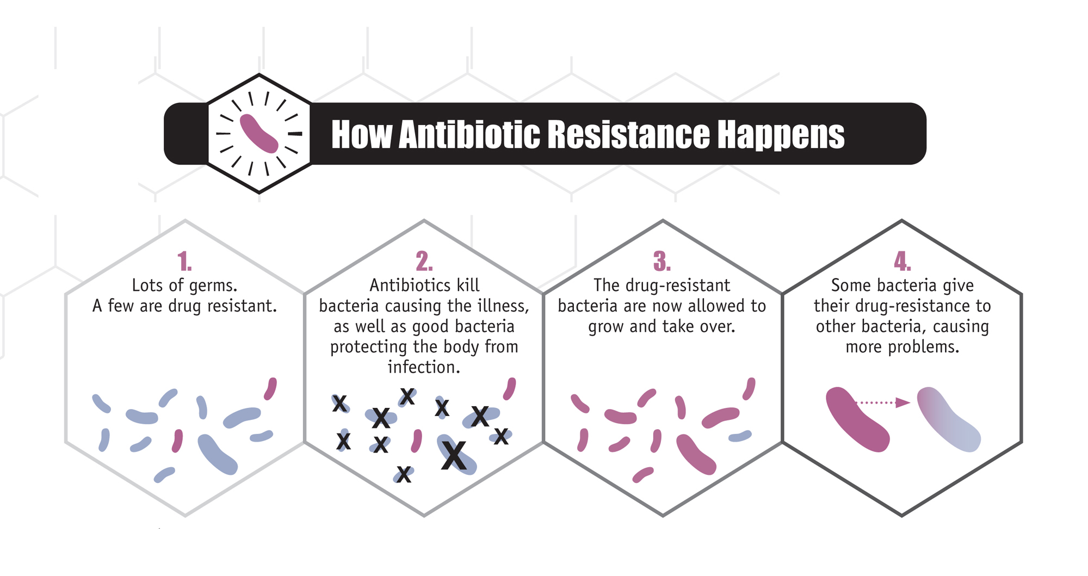
Development of Antibiotic Resistance
Image courtesy of CDC / Melissa Brower
Centers for Disease Control and Prevention Public Health Image Library
http://phil.cdc.gov/phil/home.asp
Notes:
Educator notes:
References for this slide:
From CDC website re: image (might want to rephrase)
Lots of germs, with some being drug resistant.
Antibiotic kill bacteria causing the illness, as well as good bacteria protecting the body from infection.
The drug-resistant bacteria remain to grow and take over.
Some of the drug-resistant bacteria pass on their drug-resistance to other, non-resistant bacteria, increasing the numbers that are resistant, and causing more problems.

Slide 22
Development of Antibiotic Resistance
Selective advantage
  Bacteria that contain resistance mechanisms can survive and multiply when exposed to antibiotics
Gene transfer
  Allows bacteria to share genes that cause antibiotic resistance
Cross-resistance
  Changes in bacteria which create resistance to one antibiotic may cause resistance to other antibiotics as well
Notes:
Educator notes:
Selective advantage
Bacteria that contain DNA encoding resistance can more easily survive and multiply when exposed to antibiotic
Genes encoding resistance can be widespread even before antibiotic use e.g. Ampicillin-resistant E. coli in kangaroos and wombats
Exposure to the antibiotic means that individual strains can spread efficiently – hospital acquired strains now in community
Resistant bacteria then spread (via people, animals, the environment)
Gene transfer
Bacteria have mechanisms to allow them to share genetic material e.g. conjugation
Genetic material that encodes antibiotic resistance is often clonal especially when carried within a plasmid
Cross-resistance
Exposure to one antibiotic can help induce resistance to other antibiotics → multi-resistance
References for this slide:
Collignon, P J (2002). Med J Aust 2002; 177 (6): 325-329.
https://www.mja.com.au/journal/2002/177/6/11-antibiotic-resistance

Slide 23
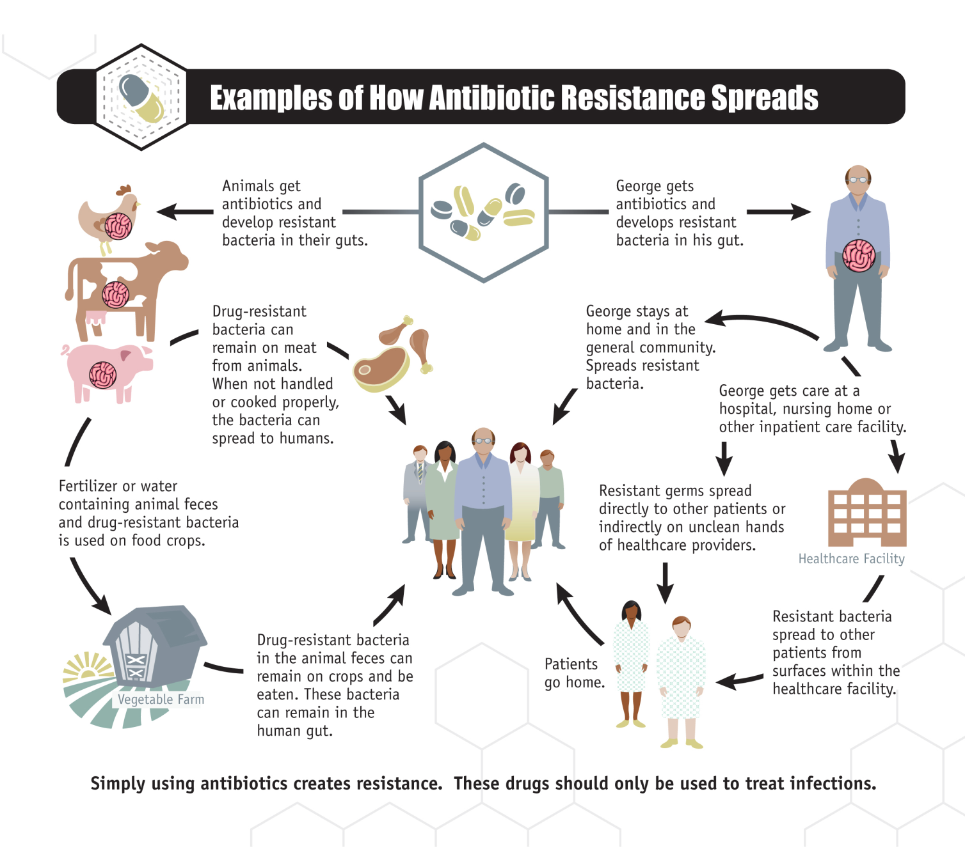
Notes:
Educator notes:
References for this slide:

Slide 24
QUICK QUIZ: Combating antibiotic resistance
Which of the following strategies reduce the development and/or spread of antibiotic resistance?
(a) Targeted interventions to reduce unnecessary use of antibiotics
(b) Performing hand hygiene before and after touching a patient or surrounds
(c) Ensuring environmental cleaning procedures are complete and consistent
(d) Using the most narrow spectrum antibiotic(s) that will treat a patient’s infection
(e) All of the above

Slide 25
QUICK QUIZ: Combating antibiotic resistance
Which of the following strategies reduce the development and/or spread of antibiotic resistance?
(a) Targeted interventions to reduce unnecessary use of antibiotics (reduces development)
(b) Performing hand hygiene before and after touching a patient or surrounds (reduces spread)
(c) Ensuring environmental cleaning procedures are complete and consistent (reduces spread)
(d) Using the most narrow spectrum antibiotic(s) that will treat a patient’s infection (reduces development)
(e) All of the above
Notes:
Educator notes:
Some of these answers reduce the development of antibiotic resistance while others reduce the spread of resistant microbes from patient to patient, therefore the answer is “All of the above”.

Slide 26
The role of different health professionals
Patients
Nurses
Pharmacists
Doctors
Notes:
Educator notes:
All health professionals can play a role in ensuring antibiotics are used appropriately, with particular emphasis on doctors, pharmacists and nurses
References for this slide:

Slide 27
Nurses can…
Encourage antibiotic prescribers to:
  Communicate with the multidisciplinary team
  Obtain approval for prescribing restricted antibiotics
  Obtain cultures before starting therapy
  Use local guidelines or Therapeutic Guidelines: Antibiotic
Prompt a review of antibiotics after 48 hours
  Can the patient be switched to a more suitable antibiotic or dose form? (e.g. IV to oral switch)
Discuss your patient’s antibiotic therapy with the pharmacist
Monitor patients for adverse effects
Notes:
Educator notes:
**Give local examples of how nurses can be or have been involved, and invite your audience to suggest other ideas**

Slide 28
Pharmacists can…
Provide in-depth information and education to patients and healthcare professionals
Review prescribed antimicrobials in each patient:
  Review clinical progress notes and results
  Compare current therapy to guidelines or micro results
  Consider patient preferences (e.g. dose forms and treatment needs post-discharge)
  Review allergies, medical conditions and risk of drug interactions
  Discuss concerns with the healthcare team

Slide 29
Doctors can…
Obtain cultures before starting therapy
Document the reason for prescribing an antibiotic and the intended duration in the patient’s clinical notes and medication chart
Use local guidelines or Therapeutic Guidelines: Antibiotic for empiric therapy
Review empiric antibiotics after 48 hours (or sooner if results are available)
  Switch patients to a safer or more narrow spectrum antibiotic if appropriate
Discuss antibiotic therapy with their patients

Slide 30
Antimicrobial stewardship
An ongoing effort that aims to optimise antimicrobial use, in order to:
  Improve patient outcomes
  Ensure cost-effective therapy
  Minimise the risk of adverse consequences (including side effects and antibiotic resistance)
Notes:
Educator notes:
Because of the need for better antimicrobial stewardship in Australia’s hospitals, it is now a standalone criterion within the National Safety & Quality Health Service Standards (i.e. the standards hospitals are measured against during accreditation). This means all hospitals in Australia need an antimicrobial stewardship program, and must be able to demonstrate that they are making efforts to monitor and improve their antibiotic use.
References for this slide:

Slide 31
Antimicrobial stewardship
Examples of antimicrobial stewardship activities in our hospital include:
  Point 1
  Point 2
  Point 3
Notes:
Educator notes:
**OPTIONAL SLIDE – this is a good opportunity to discuss some of the ways your own facility is improving antimicrobial use**

Slide 32
Talking to patients about antibiotics
Discussions with patients should outline:
  The reason for receiving antibiotic therapy
  The name of antibiotic
  How it should be taken and how long it needs to be taken for
  Possible side effects of antibiotic and what to do if these occur
  Address concerns about antibiotic resistance or interactions with the patient’s other medications
Arrange an interpreter if needed
Notes:
Educator notes:
Don’t overestimate how much your patient understands about their treatment – take the time to make sure they have received the right information

Slide 33
How to find supporting information for patients and carers
CIAP → MIMS Online → CMI (Consumer Medicines Information)
      Enter name of antibiotic (and preferably the same brand)
      Select an appropriate font size (large or small print)
      Print and discuss with patient
NSW Health (http://www.health.nsw.gov.au)
      Infectious Diseases Factsheets
NPS MedicineWise (http://www.nps.org.au/)
Better Health Channel (http://www.betterhealth.vic.gov.au/)

Slide 34

Teamwork is essential!
It is everyone’s job to:
Communicate the patient’s condition and reason for antibiotic therapy among the team
Review the patient’s response
Talk to the patient about their antibiotic therapy

Slide 35
Key messages
Antibiotics are essential medicines in healthcare and are used to treat bacterial infections
There are many types of antibiotics used in hospital patients
Using the most suitable antibiotic in a patient minimises the risk of harm to the patient
Antibiotic resistance is a global problem, and responsible antibiotic use is needed
Discussing antibiotic therapy with patients during their hospital stay can help to ensure antibiotics are used properly

Slide 36
Thank you
Questions
For further information:
<insert your contact details>

